Slide 1
WACC Review
Explain capital structure
List the different types of capital a company can use to finance their assets
Which is the cheapest type of capital and why is it the cheapest?
Which is the most expensive type of capital?

Slide 2
I look at my annual budgets for everything and anything, and I look to see where I can save the most money on those items. Saving 30% to 50% buying in bulk - replenishable items from toothpaste to soup, or whatever I use a lot of - is the best guaranteed return on investment you can get anywhere.
~Mark Cuban

Slide 3
Capital Budgeting
Chapter 11

Slide 4
What is capital budgeting?

Slide 5
Capital Budgeting Projects
Investment opportunities
Enhance a firm’s competitive advantage
Ideas often generated by employees
Typically long-term projects
Large investment
Should be evaluated by time value of money techniques
Increase shareholder wealth
Very important to a firm’s future!

Slide 6
Classification of Investment Projects
1. Independent projects
Accepting or rejecting one project has no effect on other projects
Cash flows are unrelated
Ex: Expand warehouse and/or buy a new service vehicle
2. Mutually exclusive projects
Accepting one project is a simultaneous decision to reject another project
These projects perform the same function
Ex: Expand a warehouse OR sell it and buy a bigger warehouse

Slide 7
Capital Budgeting Process
Proposal Generation
Find opportunities; replacement and/or expansion
Reviewed by Finance personnel
Review and Analysis
Estimate cash flows (in and out)
Determine WACC
Use capital budgeting techniques for evaluation
Decision making
Which projects will be accepted/rejected?
Implementation – make it happen!
Ongoing Review and Post Audit
Track, review, analyze or audit decisions/projects

Slide 8
Net Present Value
Best method to evaluate capital projects
Considers time value of money
Includes all project cash flows
Value measures dollar impact on shareholder wealth
NPV inputs
cash in/outflows
cost of capital (the firm’s required rate of return)
Decision Rule: Accept projects with NPV > $0

Slide 9
Cash Flow Data
YEAR Replacement Expansion
0 (today) -20,000 -25,000
1 5,800 4,000
2 5,800 4,000
3 5,800 8,000
4 5,800 10,000
5 5,800 10,000

Slide 10
NPV of Replacement Project
Cost of capital (WACC)= 10%
CASH PRESENT
YR FLOW N VALUE
0 –$20,000 0 –$20,000
1-5 5,800 5
Net Present Value =$

Slide 11
NPV of Expansion Project
Cost of capital (WACC) = 10%
CASH PRESENT
YR FLOW N VALUE
0 -$25,000 0 -$25,000
1 4,000 1
2 4,000 2
3 8,000 3
4 10,000 4
5 10,000 5
Net Present Value = $

Slide 12
Net Present Value

Slide 13
Internal Rate of Return
The discount rate or “cost of capital” at which NPV = zero
IRR = WACC; NPV = 0
IRR > WACC; NPV positive (> 0)
IRR < WACC; NPV negative (< 0)
Compute the IRR by:
Trial and error
Financial calculator
Spreadsheet software
Easier to compute for annuity cash flows
Decision Rule: Accept if IRR > WACC (required return on the project or cost of capital)

Slide 14
Cash Flow Data
YEAR Replacement Expansion
0 (today) -20,000 -25,000
1 5,800 4,000
2 5,800 4,000
3 5,800 8,000
4 5,800 10,000
5 5,800 10,000
IRR =
Which project should we accept?

Slide 15
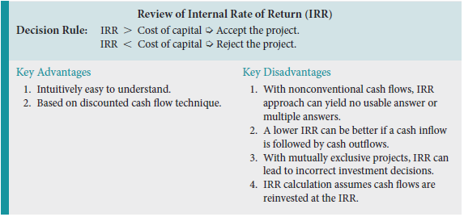
IRR: A Final Comment

Slide 16
NPV vs. IRR
Always agree on whether to accept or reject a project
If projects are independent: either method is acceptable
Problem: they may rank projects differently
What if projects are mutually exclusive and the rankings conflict?
Answer: use NPV as it measures the change in shareholder wealth

Slide 17
NPV Profile for the Expansion Project

Slide 18
Reinvestment Rate Assumptions
NPV assumes CFs are reinvested at WACC.
Realistic assumption!
IRR assumes CFs are reinvested at IRR.
NPV method should be used to choose between mutually exclusive projects.
Is there a hybrid of the IRR that assumes WACC reinvestment?

Slide 19
MIRR
Find the FV (Terminal Value) all future cash inflows at project’s end
Find the PV of all cash outflows.
Use TVM to determine I/Y (the return; MIRR)
MIRR is the return earned when the PV of CIF = PV of COF
MIRR < IRR when NPV positive
MIRR > IRR when NPV negative
MIRR always closer to WACC
Decision Rule: Accept if MIRR > WACC

Slide 20
Project: Expansion MIRR Example Investment: $25,000
Cash
YR Flow
1 4,000
2 4,000
3 8,000
4 10,000
5 10,000

Slide 21
Payback Period
Number of years until the cash flows from a project equal the project’s cost
Time to recoup an investment’s cost
Decision Rule: Accept if payback period is less than a maximum desired time period
Management determines the required time period (subjective)

Slide 22
Project: Replacement Payback Example Investment: $20,000
Cash Cumulative Dollars Needed
YR Flow Cash flow To recoup costs
1 5,800
2 5,800
3 5,800
4 5,800
5 5,800
Fraction of year: ________/5,800 =
Payback = _______ years

Slide 23
Strengths and Weaknesses of Payback
Strengths
Provides an indication of a project’s risk and liquidity.
Easy to calculate and understand.
Weaknesses
Ignores the time value of money (TVM).
Ignores CFs occurring after the payback period.
No relationship between a given payback and investor wealth maximization.
Discounted payback considers TVM, but other 2 flaws remain.

Slide 24
Discounted Payback Period
Same idea as Payback period
Find PV of cash inflows
Determine payback of initial investment using PV of inflows
Considerations
TVM
Liquidity of project
Vermeer Equipment uses this method with NPV
Decision Rule: Accept if DPB Period < Project’s Useful Life

Slide 25
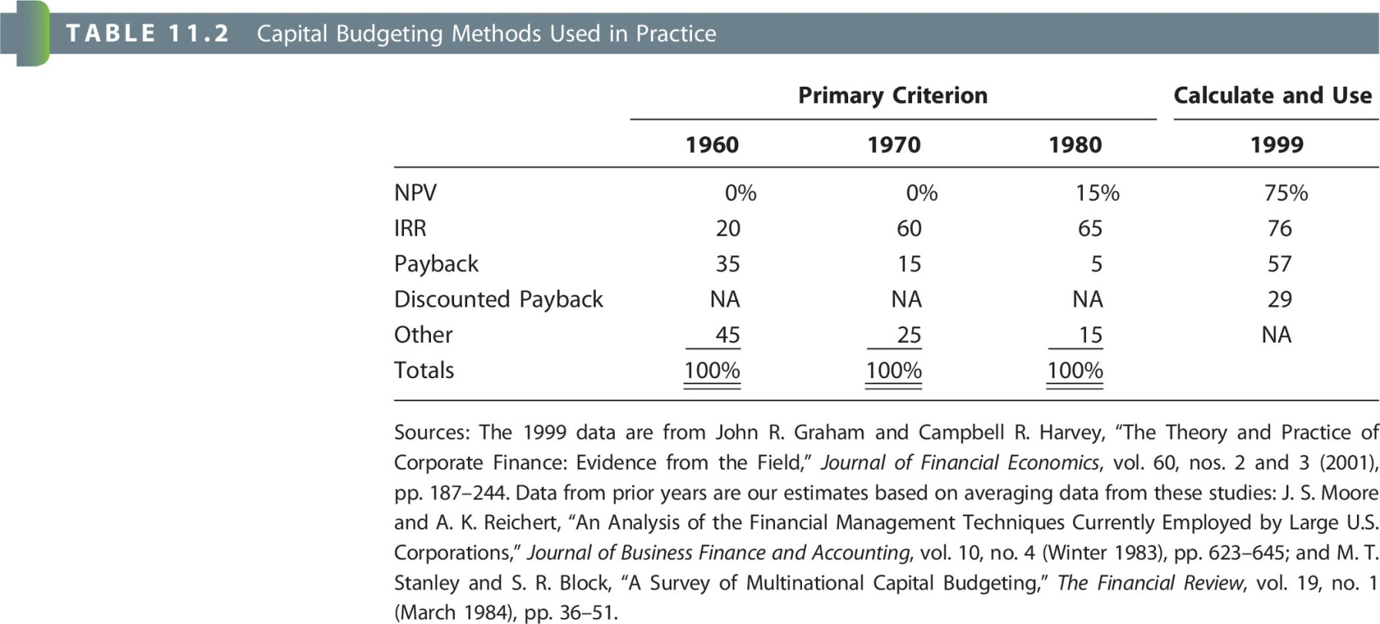
Capital-Budgeting Techniques Used by Business Firms

Slide 26
Assignment
Chapter 11 MindTap due Monday, November 12th on BbLearn by 11:59 pm
Read Chapter 12 for Tuesday

