Slide 1
Chapter 10
Economic Analysis of Financial Regulation

Slide 2
Preview
This chapter develops an economic analysis of financial regulation.

Slide 3
Learning Objectives
Identify the reasons for and forms of a government safety net in financial markets.
List and summarize the types of financial regulation and how each reduces asymmetric information problems.

Slide 4
Asymmetric Information as a Rationale for Financial Regulation
Bank panics and the need for deposit insurance:
FDIC: short circuits bank failures and contagion effect
Payoff method
Purchase and assumption method (typically more costly for the FDIC)
Other form of government safety net:
Lending from the central bank to troubled institutions (lender of last resort)

Slide 5
Government Safety Net
Moral Hazard
Depositors do not impose discipline of marketplace
Financial institutions have an incentive to take on greater risk
Adverse Selection
Risk-lovers find banking attractive
Depositors have little reason to monitor financial institutions

Slide 6
“Too Big to Fail”
Government provides guarantees of repayment to large uninsured creditors of the largest financial institutions even when they are not entitled to this guarantee.
Uses the purchase and assumption method
Increases moral hazard incentives for big banks

Slide 7
Financial Consolidation and the Government Safety Net
Larger and more complex financial organizations challenge regulation:
Increased “too big to fail” problem
Extends safety net to new activities, increasing incentives for risk taking in these areas (as has occurred during the global financial crisis

Slide 8
Restrictions on Asset Holdings
Attempts to restrict financial institutions from too much risk taking:
Bank regulations
Promote diversification
Prohibit holdings of common stock
Capital requirements
Minimum leverage ratio (for banks)
Basel Accord: risk-based capital requirements
Regulatory arbitrage

Slide 9
Capital Requirements
Government-imposed capital requirements are another way of minimizing moral hazard at financial institutions
There are two forms:
Based on the leverage ratio, the amount of capital divided by the bank’s total assets: to be classified as well capitalized, a bank’s leverage ratio must exceed 5%; a lower leverage ratio, especially one below 3%, triggers increased regulatory restrictions on the bank.
Risk-based capital requirements

Slide 10
Financial Supervision: Chartering and Examination
Chartering (screening of proposals to open new financial institutions) to prevent adverse selection
Examinations (scheduled and unscheduled) to monitor capital requirements and restrictions on asset holding to prevent moral hazard
Capital adequacy
Asset quality
Management
Earnings
Liquidity
Sensitivity to market risk
Filing periodic ‘call reports’

Slide 11
Assessment of Risk Management
Greater emphasis on evaluating soundness of management processes for controlling risk
Trading Activities Manual of 1994 for risk management rating based on:
Quality of oversight provided
Adequacy of policies and limits for all risky activities
Quality of the risk measurement and monitoring systems
Adequacy of internal controls
Interest-rate risk limits:
Internal policies and procedures
Internal management and monitoring
Implementation of stress testing and Value-at risk (VAR)

Slide 12
Disclosure Requirements
Requirements to adhere to standard accounting principles and to disclose wide range of information
The Basel 2 accord and the SEC put a particular emphasis on disclosure requirements
The Sarbanes-Oxley Act of 2002 established the Public Company Accounting Oversight Board
Mark-to-market (fair-value) accounting

Slide 13
Consumer Protection
Consumer Protection Act of 1969 (Truth-in-lending Act)
Fair Credit Billing Act of 1974
Equal Credit Opportunity Act of 1974, extended in 1976
Community Reinvestment Act
The subprime mortgage crisis illustrated the need for greater consumer protection.

Slide 14
Restrictions on Competition
Justified as increased competition can also increase moral hazard incentives to take on more risk.
Branching restrictions (eliminated in 1994)
Glass-Steagall Act (repeated in 1999)
Disadvantages:
Higher consumer charges
Decreased efficiency

Slide 15
Macroprudential Vs. Microprudential Supervision
Before the global financial crisis, the regulatory authorities engaged in microprudential supervision, which is focused on the safety and soundness of individual financial institutions.
The global financial crisis has made it clear that there is a need for macroprudential supervision, which focuses on the safety and soundness of the financial system in the aggregate.

Slide 16
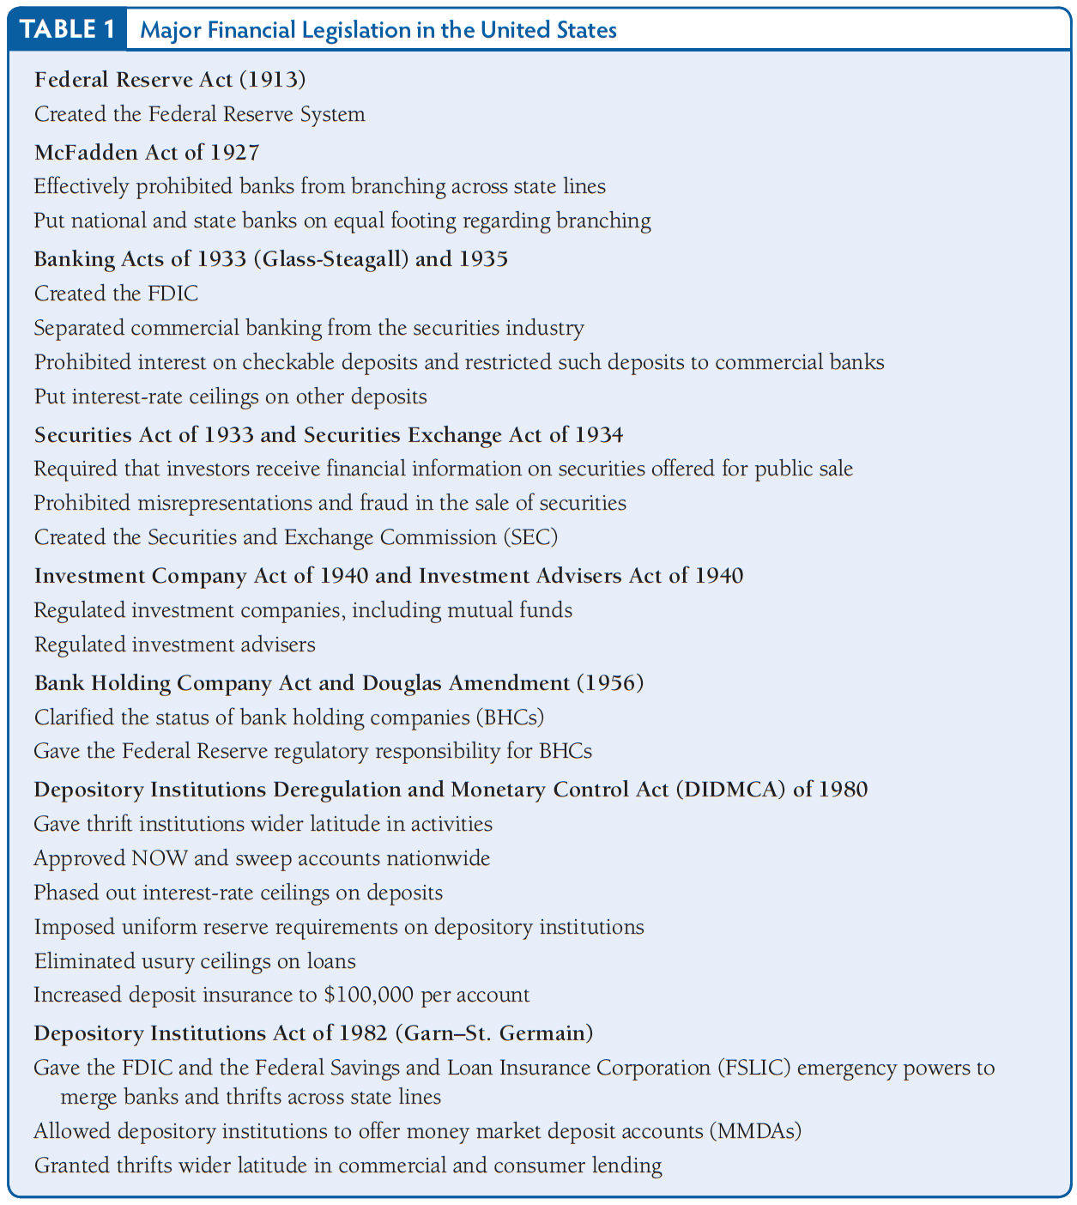
Table 1 Major Financial Legislation in the United States

Slide 17
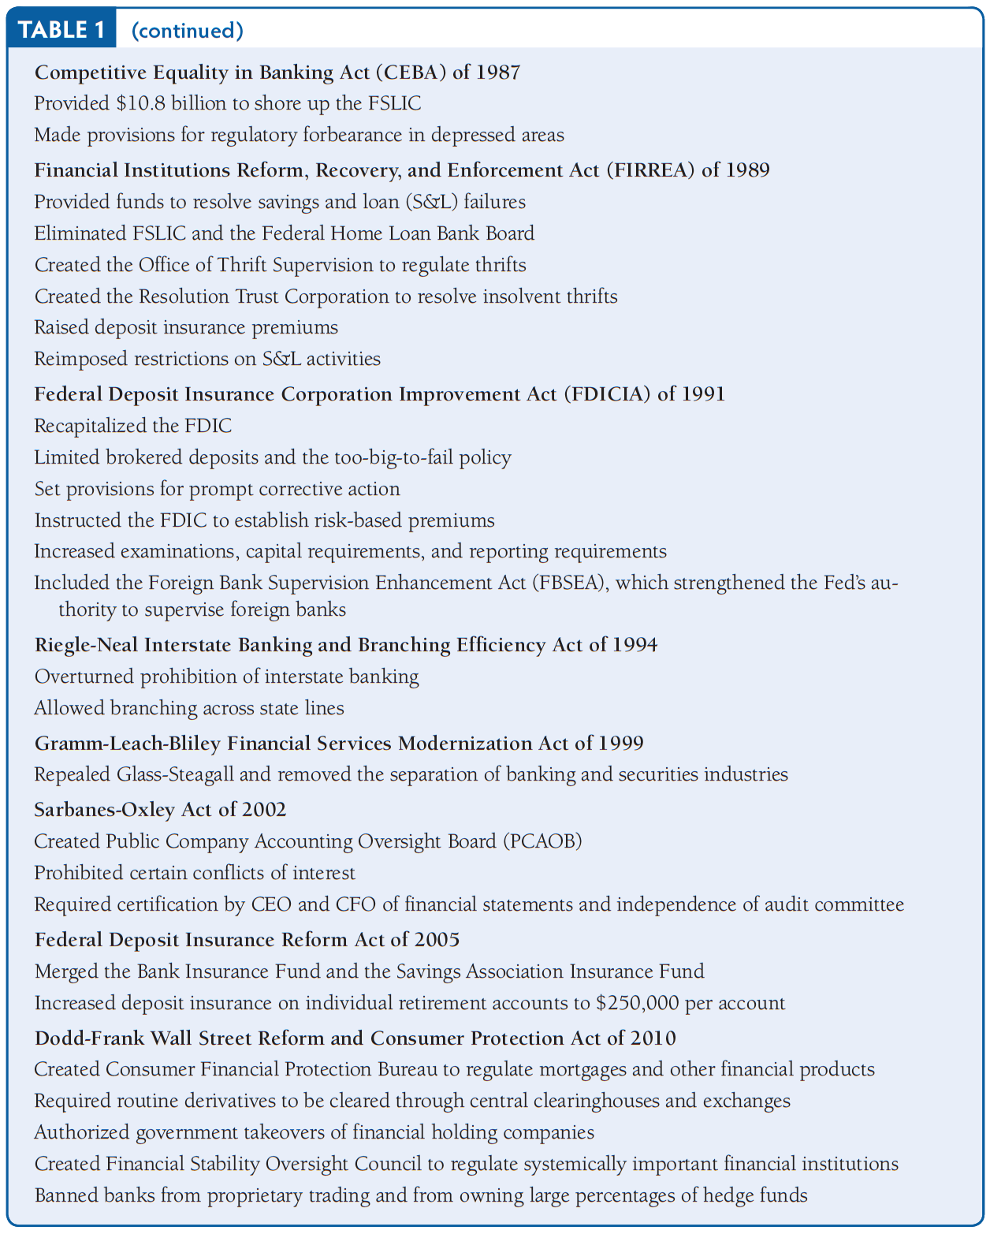
Table 1 Major Financial Legislation in the United States (cont’d)

Slide 18
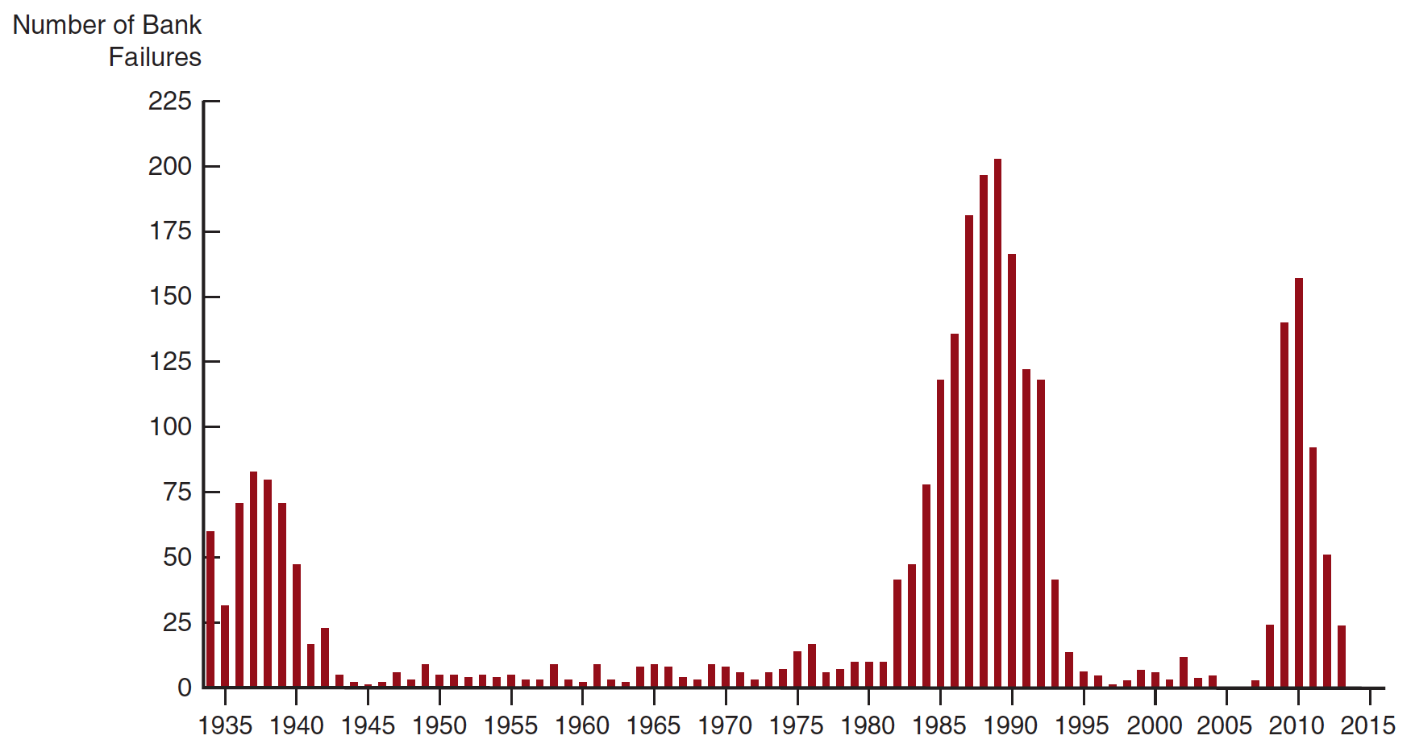
Figure 1 Bank Failures in the United States, 1934–2013
Source: www.fdic.gov/bank/historical/bank/index.html.

Slide 19
The 1980s Savings and Loan and Banking Crisis
Financial innovation and new financial instruments increased risk taking
Increased deposit insurance led to increased moral hazard
Deregulation
Depository Institutions Deregulation and Monetary Control Act of 1980
Depository Institutions Act of 1982

Slide 20
Savings and Loan Bailout: The Financial Institutions Reform, Recovery, and Enforcement Act of 1989
Financial Institutions Reform, Regulatory and Enforcement Act of 1989
Federal Deposit Insurance Corporation and Improvement Act of 1991
Cost of the bailout approximately $150 billion, or 3% of GDP

Slide 21
Banking Crises Throughout the World
“Déjà vu all over again”:
Deposit insurance is not to blame for some of these banking crises.
The common feature of these crises is the existence of a government safety net, where the government stands ready to bail out troubled financial institutions.

Slide 22
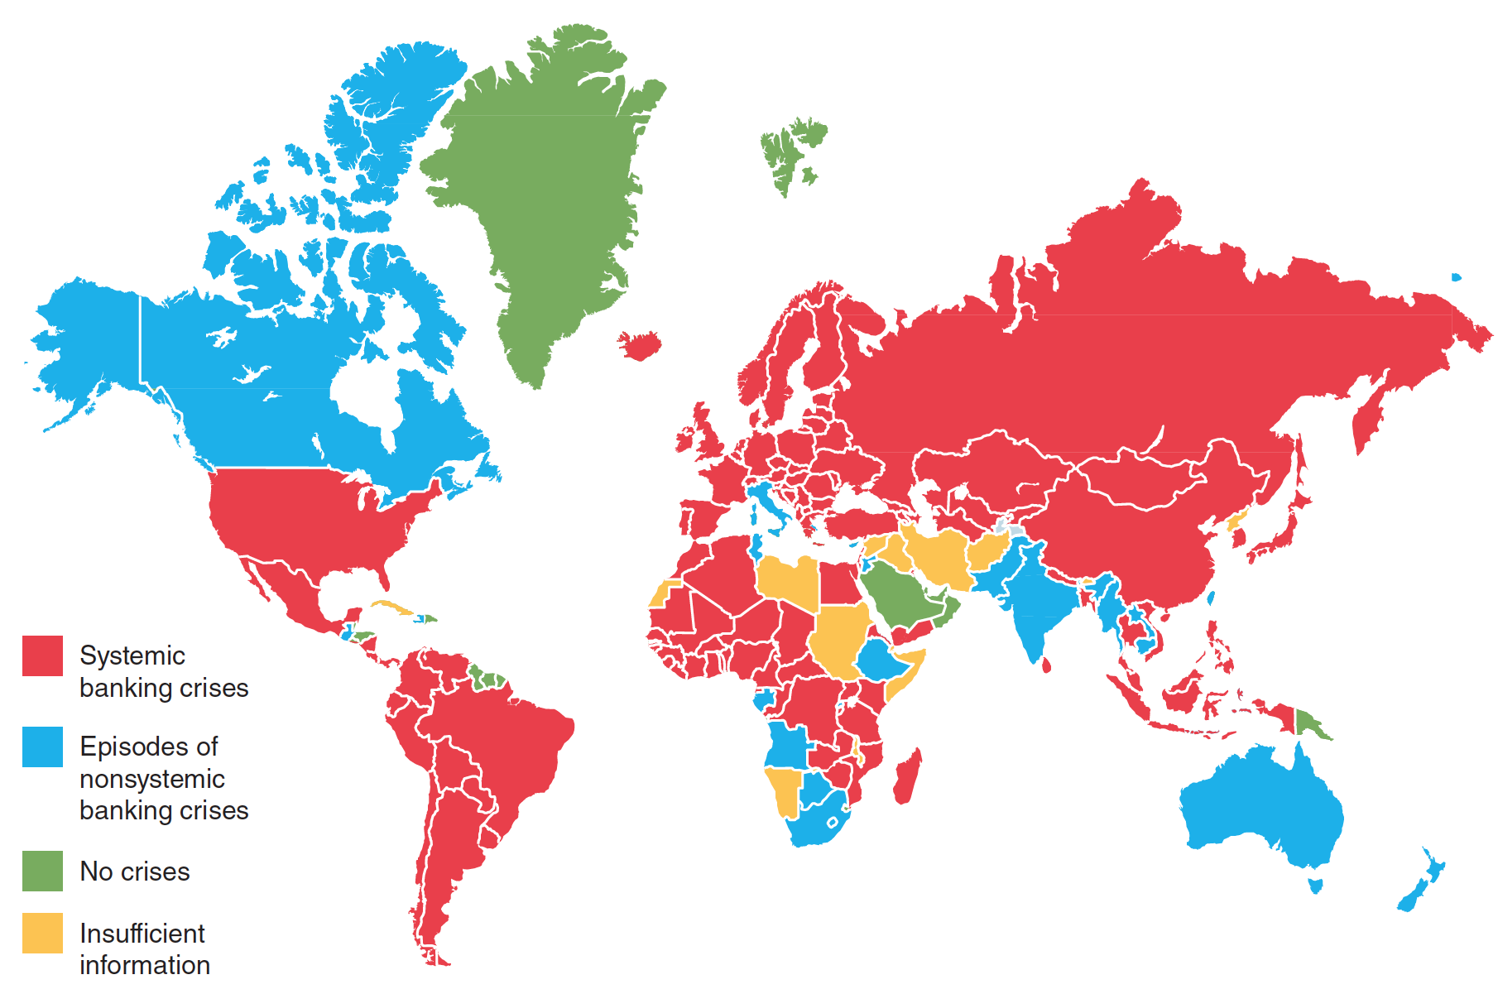
Figure 2 Banking Crises Throughout the World Since 1970
Sources: Luc Laeven and Fabian Valencia, “Resolution of Banking Crises: The Good, the Bad and the Ugly,” IMF Working Paper No. WP/10/46 ( June 2010), and Luc Laeven, Banking Crisis Database at http://www.luclaeven.com/Data.htm.

Slide 23
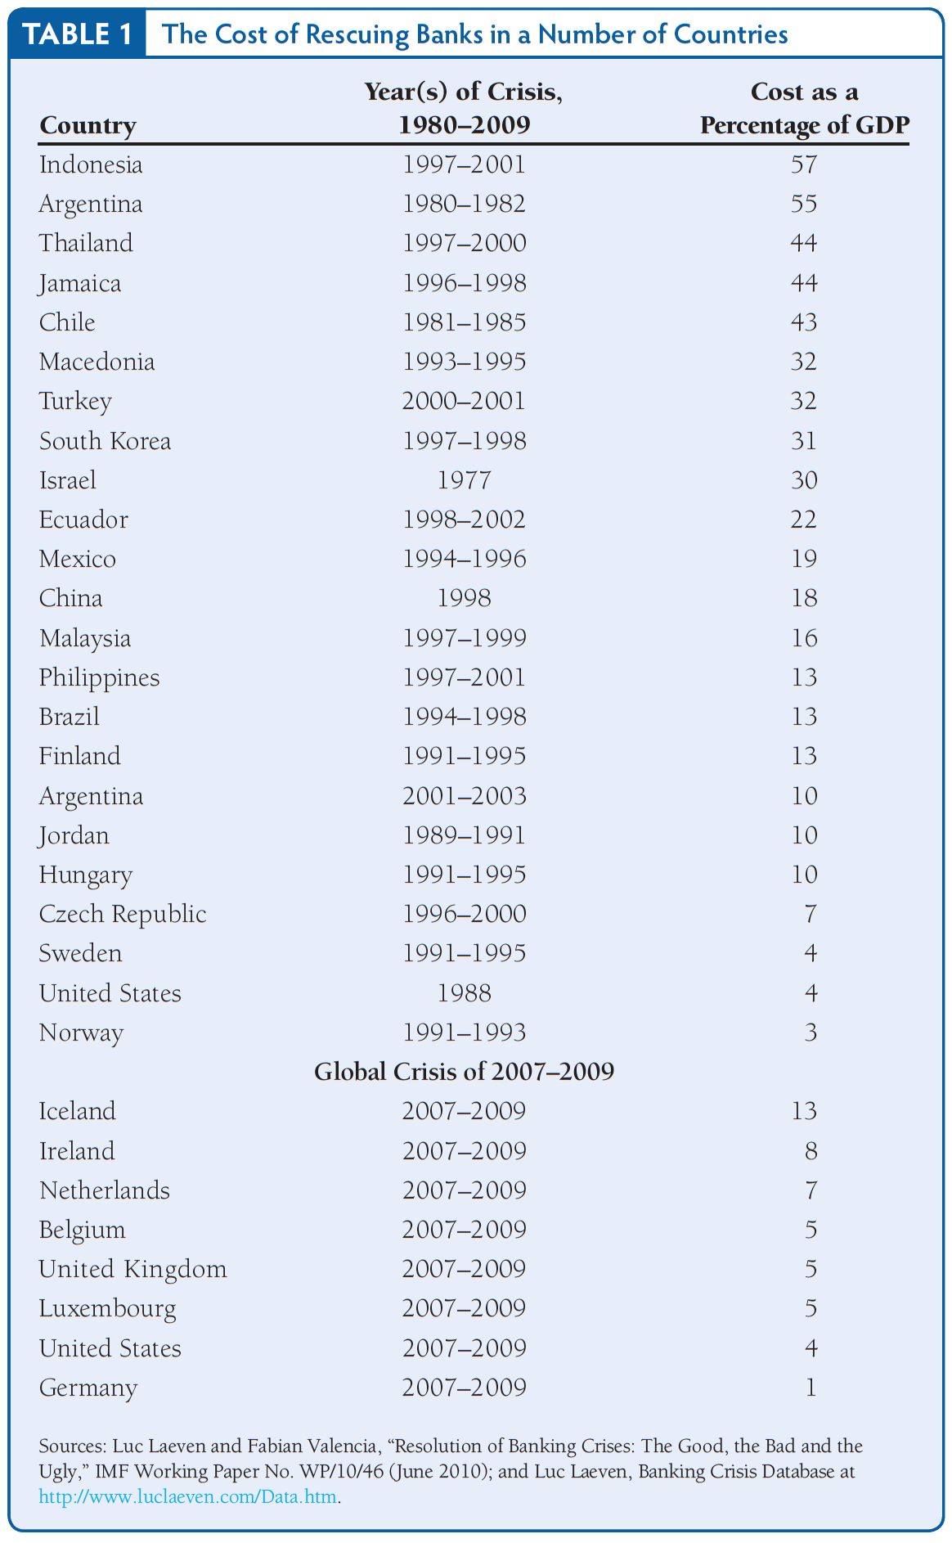
Table 2 The Cost of Rescuing Banks in a Number of Countries

