Slide 1
Chapter 11
Banking Industry: Structure and Competition

Slide 2
Preview
This chapter examines the historical trends in the banking industry that help explain the unique structure of the U.S. system.

Slide 3
Learning Objectives
Recognize the key features of the banking system and the historical context of the implementation of these features.
Explain how financial innovation led to the growth of the shadow banking system.
Identify the key structural changes in the commercial banking industry.
Summarize the factors that led to consolidation in the commercial banking industry.

Slide 4
Learning Objectives
Assess the reasons for separating banking from other financial services through legislation.
Summarize the distinctions between thrift institutions and commercial banks.
Identify the reasons for U.S. banks to operate in foreign countries and for foreign banks to operate in the United States.

Slide 5
Historical Development of the Banking System
Bank of North America chartered in 1782
Controversy over the chartering of banks
National Bank Act of 1863 creates a new banking system of federally chartered banks
Office of the Comptroller of the Currency
Dual banking system
Federal Reserve System is created in 1913.

Slide 6
Figure 1 Time Line of the Early History of Commercial Banking in the United States

Slide 7
Primary Supervisory Responsibility of Bank Regulatory Agencies
Federal Reserve and state banking authorities: state banks that are members of the Federal Reserve System.
Fed also regulates bank holding companies.
FDIC: insured state banks that are not Fed members.
State banking authorities: state banks without FDIC insurance.

Slide 8
Financial Innovation and the Growth of the “Shadow Banking System”
Financial innovation is driven by the desire to earn profits
A change in the financial environment will stimulate a search by financial institutions for innovations that are likely to be profitable
Financial engineering

Slide 9
Responses to Changes in Demand Conditions: Interest-Rate Volatility
Adjustable-rate mortgages
Flexible interest rates keep profits high when rates rise
Lower initial interest rates make them attractive to home buyers
Financial derivatives
Ability to hedge interest rate risk
Payoffs are linked to previously issued (i.e. derived from) securities.

Slide 10
Responses to Changes in Supply Conditions: Information Technology
Bank credit and debit cards
Improved computer technology lowers transaction costs
Electronic banking
ATM, home banking, ABM and virtual banking
Junk bonds
Commercial paper market

Slide 11
Securitization and the Shadow Banking System
Securitization
To transform otherwise illiquid financial assets into marketable capital market securities.
Securitization played an especially prominent role in the development of the subprime mortgage market in the mid 2000s.

Slide 12
Avoidance of Existing Regulations
Loophole Mining:
Reserve requirements act as a tax on deposits
Restrictions on interest paid on deposits led to disintermediation
Money market mutual funds
Sweep accounts

Slide 13
Financial Innovation and the Decline of Traditional Banking
As a source of funds for borrowers, market share has fallen.
Commercial banks’ share of total financial intermediary assets has fallen
No decline in overall profitability
Increase in income from off-balance-sheet activities

Slide 14
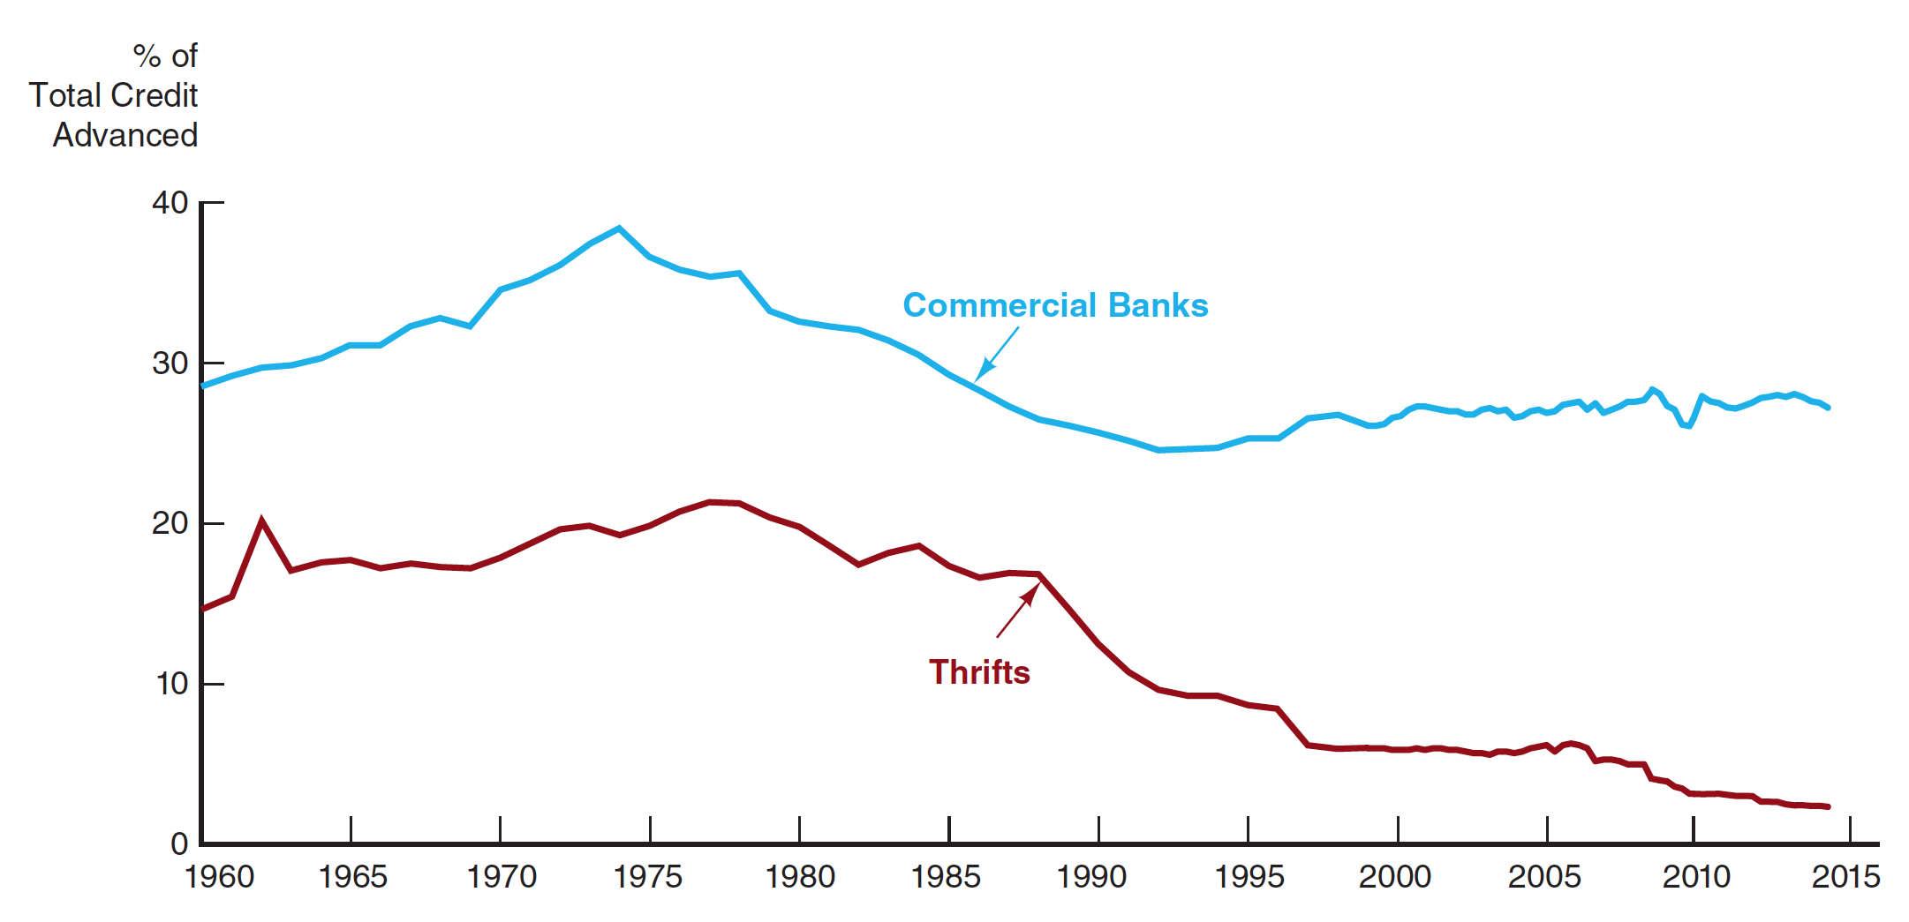
Figure 2 Bank Share of Total Nonfinancial Borrowing, 1960–2014
Source: Federal Reserve Bank of St. Louis, FRED data base: http://research.stlouisfed.org/fred2/; https://www2.fdic.gov/hsob/index.asp.

Slide 15
Financial Innovation and the Decline of Traditional Banking
Decline in cost advantages in acquiring funds (liabilities)
Rising inflation led to rise in interest rates and disintermediation
Low-cost source of funds, checkable deposits, declined in importance
Decline in income advantages on uses of funds (assets)
Information technology has decreased need for banks to finance short-term credit needs or to issue loans
Information technology has lowered transaction costs for other financial institutions, increasing competition

Slide 16
Financial Innovation and the Decline of Traditional Banking
Banks’ Responses
Expand into new and riskier areas of lending
Commercial real estate loans
Corporate takeovers and leveraged buyouts
Pursue off-balance-sheet activities
Non-interest income
Concerns about risk

Slide 17
Structure of the U.S. Commercial Banking Industry
Restrictions on branching
McFadden Act and state branching regulations
Response to ranching restrictions
Bank holding companies
Automated teller machines

Slide 18
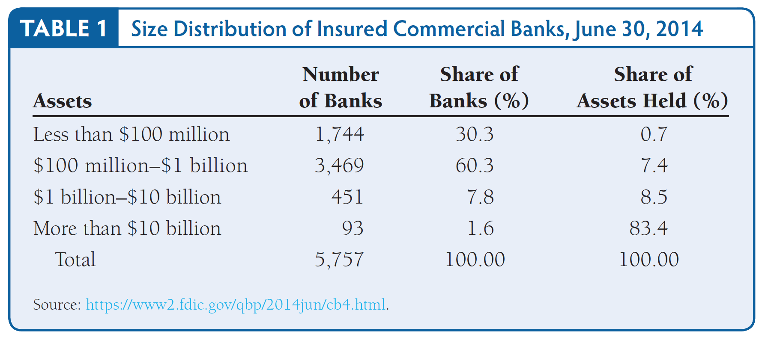
Table 1 Size Distribution of Insured Commercial Banks, June 30, 2014

Slide 19
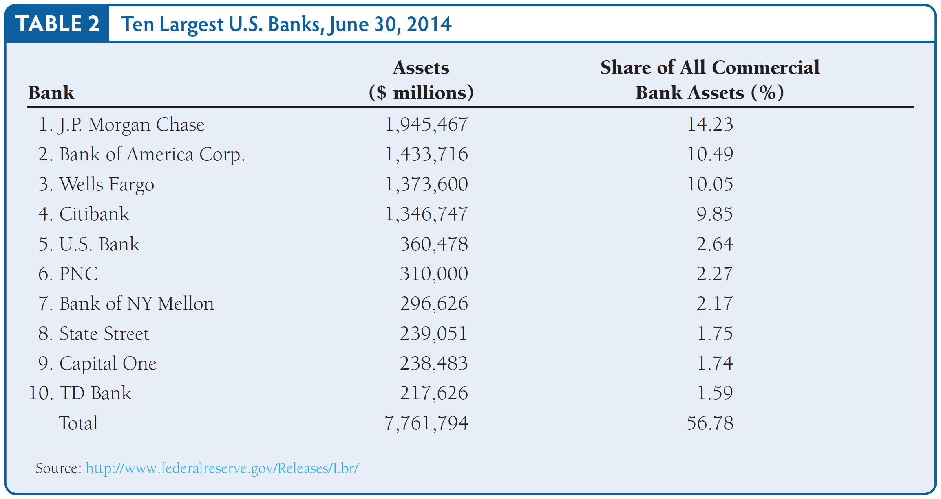
Table 2 Ten Largest U.S. Banks, June 30, 2014

Slide 20
Bank Consolidation and Nationwide Banking
The number of banks has declined dramatically over the last 30 years.
Bank failures and consolidation
Deregulation: Riegle-Neal Interstate Banking and Branching Efficiency Act of 1994
Economies of scale and scope from information technology
Results may be not only a smaller number of banks but a shift in assets to much larger banks.

Slide 21
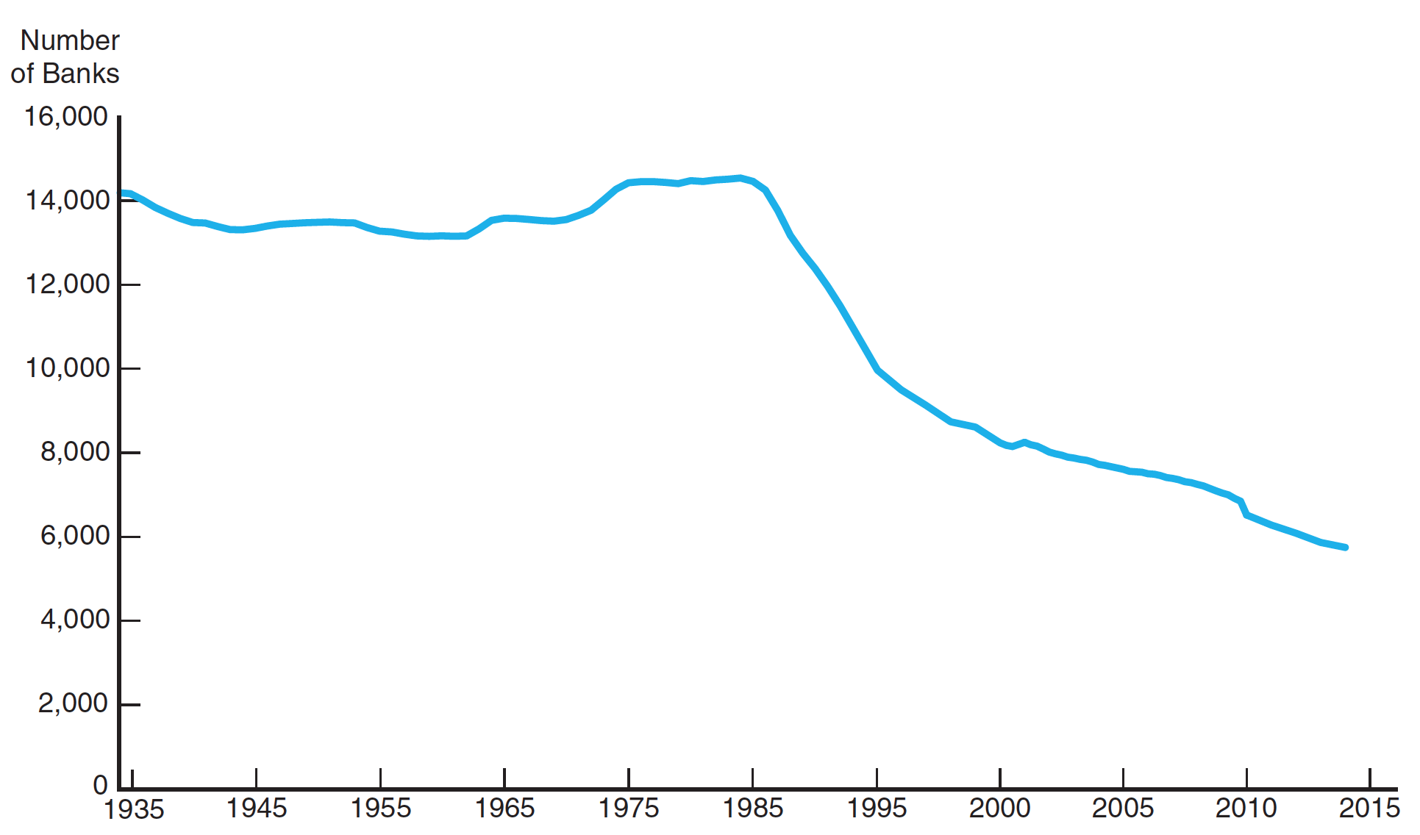
Figure 3 Number of Insured Commercial Banks in the United States, 1934–2014 (Third Quarter)
Source: Federal Reserve Bank of St. Louis, FRED database: http://research.stlouisfed.org/fred2/.

Slide 22
What will the Structure of the U.S. Banking Industry Look Like in the Future?
Although the U.S. retains a unique banking structure in possessing a large number of banks, its structure is converging with systems in Europe and Japan.
How far the convergence between banking systems will extend is the subject of ongoing academic debate

Slide 23
Are Bank Consolidation and Nationwide Banking Good Things?
Benefits
Increased competition, driving inefficient banks out of business
Also, increased efficiency from economies of scale and scope
Lower probability of bank failure from more diversified portfolios

Slide 24
Are Bank Consolidation and Nationwide Banking Good Things?
Costs
Elimination of community banks may lead to less lending to small business
Banks expanding into new areas may take increased risks and fail

Slide 25
Separation of the Banking and Other Financial Service Industries
Erosion of Glass-Steagall
Prohibited commercial banks from underwriting corporate securities or engaging in brokerage activities
Section 20 loophole was allowed by the Federal Reserve enabling affiliates of approved commercial banks to underwrite securities as long as the revenue did not exceed a specified amount
U.S. Supreme Court validated the Fed’s action in 1988

Slide 26
Separation of the Banking and Other Financial Service Industries
Gramm-Leach-Bliley Financial Services Modernization Act of 1999
Abolishes Glass-Steagall
States regulate insurance activities
SEC keeps oversight of securities activities
Office of the Comptroller of the Currency regulates bank subsidiaries engaged in securities underwriting
Federal Reserve oversees bank holding companies

Slide 27
Separation of the Banking and Other Financial Service Industries
Universal banking
No separation between banking and securities industries
British-style universal banking
May engage in security underwriting
Separate legal subsidiaries are common
Bank equity holdings of commercial firms are less common
Few combinations of banking and insurance firms

Slide 28
Separation of the Banking and Other Financial Service Industries
Some legal separation
Allowed to hold substantial equity stakes in commercial firms but holding companies are illegal

Slide 29
Thrift Industry: Regulation and Structure
Savings and loan associations
Chartered by the federal government or by states
Most are members of Federal Home Loan Bank System (FHLBS)
Deposit insurance provided by Savings Association Insurance Fund (SAIF), part of FDIC
Regulated by the Office of Thrift Supervision

Slide 30
Thrift Industry: Regulation and Structure
Mutual savings banks
Approximately half are chartered by states
Regulated by state in which they are located
Deposit insurance provided by FDIC or state insurance

Slide 31
Thrift Industry: Regulation and Structure
Credit unions
Tax-exempt
Chartered by federal government or by states
Regulated by the National Credit Union Administration (NCUA)
Deposit insurance provided by National Credit Union Share Insurance Fund (NCUSIF)

Slide 32
International Banking
Rapid growth
Growth in international trade and multinational corporations
Global investment banking is very profitable
Ability to tap into the Eurodollar market

Slide 33
Eurodollar Market
Dollar-denominated deposits held in banks outside of the U.S.
Most widely used currency in international trade
Offshore deposits not subject to regulations
Important source of funds for U.S. banks

Slide 34
Structure of U.S. Banking Overseas
Shell operation
Edge Act corporation
International banking facilities (IBFs)
Not subject to regulation and taxes
May not make loans to domestic residents

Slide 35
Foreign Banks in the United States
Agency office of the foreign bank
Can lend and transfer fund in the U.S.
Cannot accept deposits from domestic residents
Not subject to regulations
Subsidiary U.S. bank
Subject to U.S. regulations
Owned by a foreign bank

Slide 36
Foreign Banks in the United States
Branch of a foreign bank
May open branches only in state designated as home state or in state that allow entry of out-of-state banks
Limited-service may be allowed in any other state
Subject to the International Banking Act of 1978

Slide 37
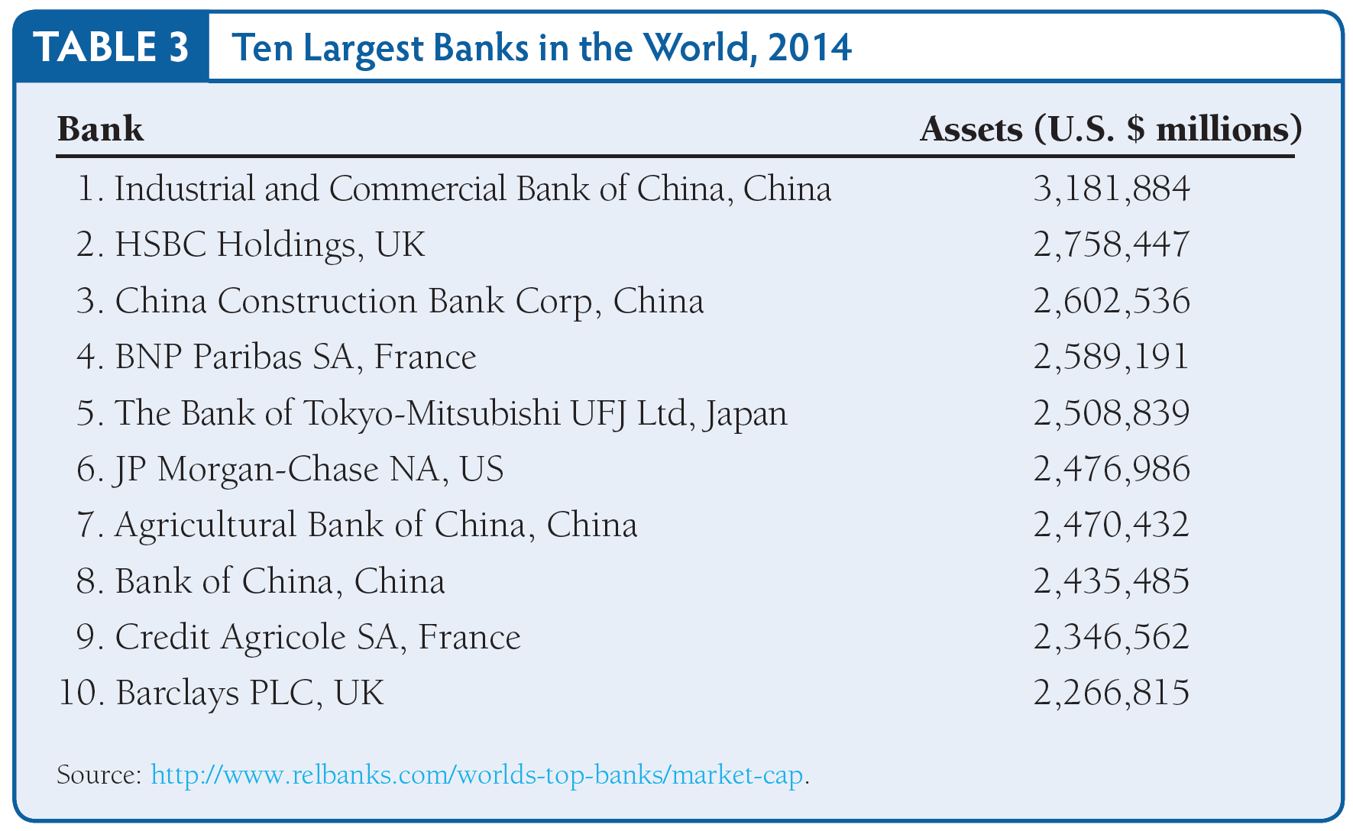
Table 3 Ten Largest Banks in the World, 2014

