Slide 1
Commercial Policy – Part III History and Practice
INTERNATIONAL ECONOMICS, ECO 486
Recommended reading:
The WTO in Brief 10 benefits 10 misunderstandings Understanding the WTO

Slide 2
Learning Objectives
Distinguish between commercial policy and industrial policy
Understand the lessons from the history of US commercial policy
Become familiar with GATT and WTO
Learn current US commercial policy
Explain why anti-dumping measures are really old-fashioned protectionism

Slide 3
Learning Objectives
Distinguish between commercial policy and industrial policy
Understand the lessons from the history of US commercial policy
Become familiar with GATT and WTO
Learn current US commercial policy
Explain why anti-dumping measures are really old-fashioned protectionism

Slide 4
Definitions
Commercial policies are regulations that govern a nation’s international commerce
Industrial policy – an activist policy whereby a government seeks to develop some specific industry

Slide 5
Head to Head
Lester Thurow popularized the idea that countries compete to “win” certain important industries
E. g., Boeing & Airbus
How large are the profits?
Where do they go?
However, trade is NOT a zero-sum game

Slide 6
Which industries?
High value added per worker?
High wage?
High tech?

Slide 7
US industrial policy
Does the US have a coherent industrial policy?
No
Where governments have tried, they have often failed (e.g., $10 billion spent to develop SST)
IMHO, it is better to create a favorable climate for investment and let the investors take the risks

Slide 8
Census Bureau
Good source of trade statistics, info & Guide to Foreign Trade Statistics:
http://www.census.gov/foreign-trade/www/tradedata.html

Slide 9
Learning Objectives
Distinguish between commercial policy and industrial policy
Understand the lessons from the history of US commercial policy
Become familiar with GATT and WTO
Learn current US commercial policy
Explain why anti-dumping measures are really old-fashioned protectionism

Slide 10
Introduction
Since WWII, trade barriers have fallen
Avoid trade wars and depression
Trade has expanded rapidly
Commercial disputes have arisen
Typically focused on specific policies
Have influenced trade laws
US & other nations
GATT & WTO

Slide 11
US Commercial Policy: History
US Constitution
Gave Congress authority to regulate imports
Forbade export tariffs
Prevented US states from restricting interstate trade

Slide 12
First Tariff Act -- 1789
To raise federal revenue
5% import duty most goods
Higher duties on luxuries
15% on carriages (highest)
Trade grew rapidly through 1807
What happened in 1808?
Britian imposed a blockade on France during the…
Jefferson responded by…
Notes:
War between England and France at first added to growing US exports. English (and French?) blockade of France was imposed. US ships boarded, goods destroyed or confiscated, US sailors “impressed” (taken hostage, forced to serve in British Navy.

Slide 13
War of 1812
Eliminated trade with Europe
High tariffs imposed to raise $ for war
Benefited US manufacturers
Tariffs remained high after war
Notes:
US tariff rates doubled, tariff revenue fell.
New manufacturing industries in the North lobbied for protection.
See time-series graph.

Slide 14
Tariff of Abominations, 1828
“Clever” political strategy backfired
Average tariff exceeded 60%
See figure on next slide
Plots average tariff rate against time
Pre-1821: tariff revenue/value of imports
1821-on: tariff rev./value of dutiable imports
Both measures tend to understate the average tariff. Why?
Volatile tariff policy

Slide 15
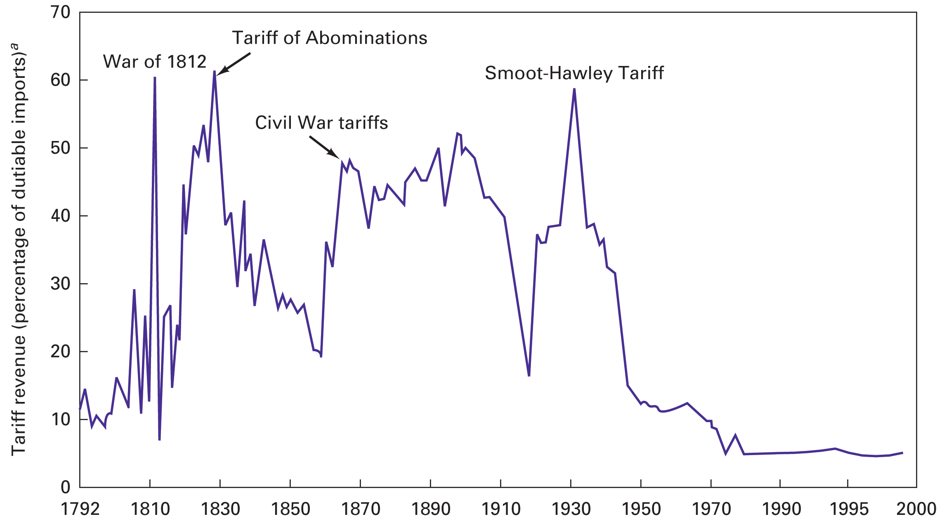
U.S. tariffs, 1792–1999.

Slide 16
Tariff Act of 1930 Smoot-Hawley
See Item 6.2, page 169, Husted & Melvin, 6th & 7th editions
1928 Republican platform promised tariffs to “help” farmers. Logrolling in Congress expanded the bill:
12,000+ products
Tariff rev./value of dutiable imports > 60%
In spite of opposition from over 1,000 economists, Hoover signed the bill on June 17, 1930
40 nations retaliated; world trade collapsed
Notes:
See Figure 6.1, page 176, Carbaugh, 10th edition

Slide 17
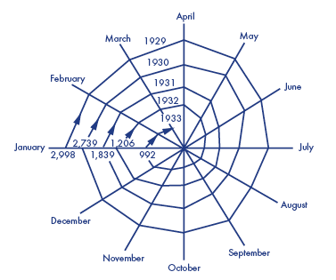
Smoot-Hawley protectionism and world trade, 1929-33 ($ millions)
Trade regulation
The figure shows the pattern of world trade from 1929 to 1933. Following the Smoot–Hawley Tariff Act of 1930, which raised U.S. tariffs to an average level of 53 percent, other nations retaliated by increasing their own import restrictions, and the volume of world trade decreased as the global economy fell into the Great Depression.
Source: Data taken from League of Nations, Monthly Bulletin of Statistics, February, 1934. See also Charles Kindleberger, The World in Depression (Berkeley, CA: University of California Press, 1973), p. 170.

Slide 18
Reciprocal Trade Agreements Act, 1934
Delegated unprecedented authority to the executive branch to negotiate bilateral trade agreements and to
cut existing tariffs by up to 50%, without Congressional approval, provided that our bilateral partner reciprocated
include a most-favored nation (MFN) clause that extended tariff cuts from bilateral negotiations to other partners with MFN status.

Slide 19
What are the lessons?
The US economy must be ____________ to weather such erratic commercial policy.
When Congress sets commercial policy, ___________________________________
When Congress has delegated authority to the executive branch, __________________ ___________________________________

Slide 20
What are the lessons?
The US economy must be rather resilient to weather such erratic commercial policy.
When Congress sets commercial policy, it is heavily influenced by special interests.
When Congress has delegated authority to the executive branch, multilateral trade liberalization has followed.

Slide 21
US Tariff-rate Quotas &VERs
In the US in 1996, milk, cream, brooms, ethyl alcohol, anchovies, tuna, olives and durum wheat were subject to tariff-rate quotas. Other quotas exist on peanuts, cotton, sugar and syrup. Source
‘50s VERs on textiles led to the MFA
VERs on Japanese automobiles: http://www.perc.org/perc.php?id=416

Slide 22
Fast track negotiating authority
President negotiates a trade agreement
Congress has an up or down vote on the entire agreement
No amendments
No filibuster
Not permanent
Clinton lost it in 1994
George W. Bush lost at midnight on July 1, 2007
Notes:
Fast track negotiating authority (also called Trade Promotion Authority, TPA) for trade agreements is the authority of the President of the United States to negotiate agreements that the Congress can approve or disapprove but cannot amend or filibuster. Fast-track negotiating authority is granted to the president by Congress. It was in effect pursuant to the Trade Act of 1974 from 1975 to 1994 and was restored in 2002 by the Trade Act of 2002. It expired at midnight on July 1, 2007.
From Wikipedia, but confirmed elsewhere.

Slide 23
Learning Objectives
Distinguish between commercial policy and industrial policy
Understand the lessons from the history of US commercial policy
Become familiar with GATT and WTO
Learn current US commercial policy
Explain why anti-dumping measures are really old-fashioned protectionism

Slide 24
Five Terms From Trade Law
MFN Principle
National Treatment
Reciprocity
Mutual Recognition
Harmonization

Slide 25
Five Terms From Trade Law
MFN Principle: nondiscrimination among supplying countries in a country’s import regime. The MFN tariff is applied by a country to imports from other members of the WTO.
Applied at the border
Example: Canadian Automotive Pact
Notes:
Canadian Automotive Pact gave preferences to certain car makers, e. g, Volvo or Ford that had links to Canadian car makers. So an imported Volvo could be imported with no tariff, regardless of what country had made that Volvo. On the face of it, there was no discrimination. Does this meet the requirements of MFN? The Appellate Body and the DS Panel both said it was de facto discrimination.

Slide 26
Does this policy discriminate?
Canadian Automotive Pact gave preferences to certain car makers (e. g, Volvo or Ford) that had links to Canadian car makers.
A Volvo could be imported with no tariff, regardless of what country had made that Volvo.
On the face of it, there was no discrimination.
Does this meet the requirements of MFN?
The WTO Appellate Body and the DS Panel both said it was de facto discrimination.

Slide 27
Article I of GATT
“ Any advantage, favour, privilege or immunity granted by any contracting party to any product originating in or destined for any other country shall be accorded immediately and unconditionally to the like product originating in or destined for the territories of all other contracting parties.”
Notes:
Two important exceptions, one to Developing Countries, one to the Least Developed Countries:

Slide 28
Article I of GATT
Two important exceptions, one to DCs,
1. The enabling clause – “…contracting parties may accord … more favorable treatment to developing countries, without according such treatment to other contracting parties.”
(Decision of 28 November 1979)
Notes:
Two important exceptions, one to Developing Countries, one to the Least Developed Countries:

Slide 29
Article I of GATT
Two important exceptions, … one to LDCs:
2. “… the provisions of paragraph 1 of Article I of the GATT 1994 shall be waived until 30 June 2009, to the extent necessary to allow developing country Members to provide preferential tariff treatment to products of Least Developed countries …”
(Decision of 15 June 1999)
Notes:
Broadly interpreted. E.g., banana disputed quotas defacto discrimination

Slide 30
MFN Clause in Services
Article II of GATS
“Each Member shall accord immediately and unconditionally to services and service suppliers of any other Member treatment no less favourable than it accords to like services and service suppliers of any other country.”

Slide 31
MFN Clause in TRIPS
Article 4 of TRIPS
“Any advantage, favour, privilege or immunity granted by a Member to the national of any other country shall be accorded immediately and unconditionally to the nationals of all other members.”
Notes:
The WTO Agreement on Trade-Related Aspects of Intellectual Property Rights (TRIPS), negotiated in the 1986-94 Uruguay Round, introduced intellectual property rules into the multilateral trading system for the first time.
MFN clause of TRIPS not tested as of Fall 2004?

Slide 32
Five Terms From Trade Law
National Treatment: Each member must treat foreign firms (or their subs.) no less favorably than it treats its own firms.
Applies after the good has crossed the border, once it is inside the country
Notes:
Examples in the internal taxation of foreign alcoholic beverages
Laws and regulations – tax rebates to Italian farmers who bought tractors from Fiat.
Especially important in services, where the obstacles are not at the border, but where the services are delivered. Hence, this is the core provision of the GATS. See article 17. For TRIPS, see article 3.

Slide 33
Five Terms From Trade Law
Reciprocity: Our country will treat your firms in the same way that your country will treat our firms.

Slide 34
Five Terms From Trade Law
Mutual Recognition: Each EU member recognizes the product standards applied by other member countries. It cannot bar a product from its market just because their standards are different from its own

Slide 35
Five Terms From Trade Law
Harmonization — the higher the tariff, the larger the cut, proportionally.
Example: The Tokyo Round of GATT, from 1973 to 1979, included 102 countries. It accomplished an average one-third cut in customs duties in the world’s major markets, reducing the average tariff on industrial products to 4.7%. The tariff reductions, phased in over a period of eight years, involved an element of “harmonization” — the higher the tariff, the larger the cut, proportionally.
http://www.wto.org/english/thewto_e/whatis_e/tif_e/fact4_e.htm

Slide 36
The GATT
After WWII, trading nations met in Havana
Agreed to form the International Trade Organization
US Senate never ratified
As a substitute, an informal association:
General Agreement on Tariffs and Trade
Senate had already ratified the Trade Agreements Legislation
GATT was seen as an instrument to carry out that legislation

Slide 37
The GATT
Established rules of conduct based on four key principles:
Trade barriers should be lowered and quotas eliminated
Nondiscrimination
Permanent* concessions without circumvention
Disputes settled by consultation, not unilateral action
Provided a forum of multilateral talks
Round I, Geneva, 1947
See Table 8.1, page 223, H&M, 7th edition (p221 6^{th)}
* tariffs cannot be raised without compensation.
Notes:
Under the WTO Agreement, and its Dispute Settlement Understanding: Panel reports work by negative consensus that is, Panel reports can only be blocked if there is a consensus not to adopt them.
See Table 6.3, page 179, Carbaugh

Slide 38
The GATT -- See Item 8.1
Part I
MFN – a tariff on an imported product should be applied equally to all GATT signatories (members).
Also known as Permanent Normal Trading Relations, PNTR
Two notable exceptions:
General System of Preferences
Regional Trading Arrangements that lead to free trade within a bloc of countries
Binding tariff schedules
Notes:
Note that the date on this information is June 1987, prior to the completion of the Uruguay Round and the formation of the WTO

Slide 39
The GATT
Part II
National treatment – no circumvention
Customs regulations – ban other impediments
Antidumping – prove dumping and injury, limits duties to dumping margin
Countervailing duties (used to offset foreign subsidies) – rules limit these duties

Slide 40
The GATT
Part II (continued)
Quantitative restrictions, QR (e.g., quotas)
Calls for an end to most QR, EXCEPT
To protect a country’s balance of payments
Temporary relief for threatened industries (Escape Clause)
For economic development
To allow for agricultural price support programs
Calls for QR to be non-discriminatory, but allows exceptions

Slide 41
The GATT
Part II (continued)
Subsidies – discourages their use
Calls for end to export subsidies on non-primary products
Export subsidies should not lead to more than an “equitable market share” on primary products
State owned enterprises – should not favor domestic suppliers
Transparency

Slide 42
The GATT
Government assistance in developing countries
specifies when developing countries are exempt
Safeguards (Escape clause) and other exceptions to protect domestic producers from injury
Consultation and dispute settlement
lengthy, slow process
Retaliation could be vetoed
Notes:
Under the WTO Agreement, and its Dispute Settlement Understanding: Panel reports work by negative consensus that is, Panel reports can only be blocked if there is a consensus not to adopt them.

Slide 43
The GATT
Part III – Procedural issues
How to establish Free-trade areas
Rules on modifying tariffs
Call for periodic negotiations
Criteria for accession of new members

Slide 44
The GATT
Part IV – Trade and Development
Developed countries should lower barriers on imports from developing countries
Developed countries should not expect reciprocity
Stabilize markets for primary products
146 separate provisions granting exceptions to developing countries

Slide 45
The WTO
Uruguay Round tackled some tough issues: (Began October 1986, Concluded December 1993)
Non-Tariff Barriers
Intellectual Property Rights
Trade in Services
Trade in Agriculture
Binding dispute resolution mechanisms

Slide 46
The WTO
Length
400 pages in agreement
22,000 pages of supplements
Most important results
Trade Liberalization
Administrative reforms

Slide 47
Trade Liberalization
Tariffs reduced on developed country trade
From 6.3 to 3.9%,
will produce a small increase in trade
World GDP up $5 trillion, 1/5 in US.
Liberalization of two important sectors
Agriculture
Clothing
Notes:
Krugman text said 40% tariff reduction, Melvin said 33% -- (6.3-3.9)/6.3 = 38%; looks consistent with what Krugman wrote -- there are different ways to calculate average tariff rates, which would then give different answers for the reduction.

Slide 48
Liberalization of Agriculture
World trade has been distorted
Japan: Price of rice, beef (& other) several x P_{w}
EU’s massive export subsidies under the CAP
US goal for Uruguay: FT in Ag. by 2000
Agreement requires:
Value of subsidies down by 36%
Volume of subsidized exports down by 21%
Both over 6 years
Tariffs replace quotas in ag.
Tariffs must not rise

Slide 49
Liberalization of Clothing
Trade distorted by Multi-Fiber Arrangement
MFA phased out over 10 years (2005)
Eliminating all QRs
Some high tariffs remain in place
“Back loaded”
Much liberalization postponed until 2003 or 2004

Slide 50
Other Liberalization
Government procurement procedures opened imported products
VERs Prohibited
Sunset clause on all safeguards
Note tariff reductions shown
Table 8.1, p. 223, 7th edition
See also nominal & effective rates, p. 175-6 in 6^{th &} 7th ed.
Significant cuts in “bound” rates – esp. in developing countries, but their rates are still high
Notes:
Note tariff reductions shown in Carbaugh
Tables 6.3-4, pp. 179-180,
Significant cuts in “bound” rates – esp. in developing countries, but their rates are still high

Slide 51
Administrative Reforms
GATT Secretariat now WTO
Broader scope, but no new large bureaucracy
Dispute Settlement Understanding
Multilateral, settlement-oriented procedure with enforceable deadlines
Licenses limited retaliatory tariffs
A small country only hurts itself
Fines would avoid these problems, but challenge sovereignty of members
Notes:
Name change, but no new large bureaucracy.
DSU -- after appeal, DS body hears what the defendant will do -- if it is not enough, DSB may sanction retaliatory tariffs, proportional to the harm caused. Note that this is multilateral, not unilateral (compare to US trade law section 301.
From January 1995-2000 there were 190+ dispute cases concerning about 150 distinct issues. This was more than 50% of all GATT disputes filed 1947-1994.
32 settled or inactive; 32 reviewed by appellate panel; 22 had received initial decision with about 11 of these under review by appellate panel.
UPDATE

Slide 52
Administrative Reforms
General Agreement on Trade in Services
No prior rules. GATS is first set
Services now 25% of world merchandise trade
Many countries discriminate
GATS only requires negotiations to start in 2000
Notes:
Update stats, negotiations

Slide 53
WTO - Benefits and Costs
World output up by $500 billion per year
US output up by $100 billion per year
Estimates may ignore dynamic gains
Distributional implications
Benefits widely distributed
Costs imposed on smaller groups
Notes:
Given the distributional implications, it is surprising that an agreement was reached was reached at all.
Some concessions would have been made anyway. For example, CAP would have been cut because it is so expensive.

Slide 54
The WTO
Environmental concerns
Three disputes (dolphins, turtles & gasoline)
Rules do not constrain regulation of domestic production or consumption
Rules do prohibit making domestic market access contingent on changes in an exporting country’s policies
Countries not powerless
Multilateral negotiations (Multilateral Environmental Agreements, MEAs)
Waivers
Notes:
Arguably, there is a stronger moral and economic justification for “tuna quotas” than for anti-dumping provisions.
Who owns the problem? Who should pay for the more expensive fishing methods?
See Trade Policy Case Study I on page 227-9 6th edition of H&M. 231-233 of

Slide 55
US Tuna Quotas Save Dolphins
(1972) Marine Mammal Protection Act
Amendments in 1984, 1988 & 1990 made it increasingly difficult for foreign producers to comply
(1991) GATT panel agreed with MX that restrictions amounted to prohibited quotas
US & Mexico negotiated

Slide 56
US Tuna Quotas Save Dolphins
(1992) US Congress passed International Conservation Act
Five year moratorium on seine nets
La Jolla Agreement
US, Mexico & 8 other countries set a goal: dolphin kill < 5000/year (out of 9.6 million) by 2000. In return, US will lift quotas…
Actual deaths < 2,700 in 1996.

Slide 57
US Consumers Save Dolphins
(1995) Panama Declaration
Changed definition of “Dolphin-Safe Tuna” to include tuna caught in encircling nets provided no dolphins were killed.
(1997) US Congress passed International Dolphin Conservation Program Act
Repealed quota
Made above definition legally binding
(2002) National Marine Fisheries Service study

Slide 58
Learning Objectives
Distinguish between commercial policy and industrial policy
Understand the lessons from the history of US commercial policy
Become familiar with GATT and WTO
Explain why anti-dumping measures are really old-fashioned protectionism
Learn current US commercial policy

Slide 59
Dumping
Selling a product in a foreign country at a price that is “less than fair value.”
the price charged in the home market
the price charged in a third country, or
below the costs of production
Notes:
“cost of production” rarely used here -- but it is a very artificial calculation, since they lack data

Slide 60
Dumping Benefits the Importing Country
Domestic Supply
10
Price
5
World price
a
b
c
d
3
Dumping price
2
Predatory dumping?
Domestic demand
0
1
3
5
7
10
Quantity

Slide 61
Welfare Effects of Dumping

Slide 62
Welfare Effects of Dumping

Slide 63
Successful Predatory Dumping
Requires the existence of significant economies of scale
Requires a large, protected home market
Excluded rivals at a significant disadvantage
Must force foreign producers out of business and keep them out long enough to recoup losses
Unlikely to succeed unless it’s a natural monopoly.

Slide 64
Dumping
Predatory dumping is a myth
No evidence that it has ever occurred
Unlikely to be a profitable strategy

Slide 65
International Price Discrimination
Charging a higher price in one country than another
Profit maximization can lead to this result
Where demand is less elastic, price will be higher
Must be able to prevent resale

Slide 66
Dumping
Cost, C and
Price, P
3
P_{DOM}
MC
2
1
P_{FOR}
D_{FOR} = MR_{FOR}
D_{DOM}
MR_{DOM}
Q_{DOM}
Q_{MONOPOLY}
Quantities produced
and demanded, Q
Domestic sales
Exports
Total output

Slide 67
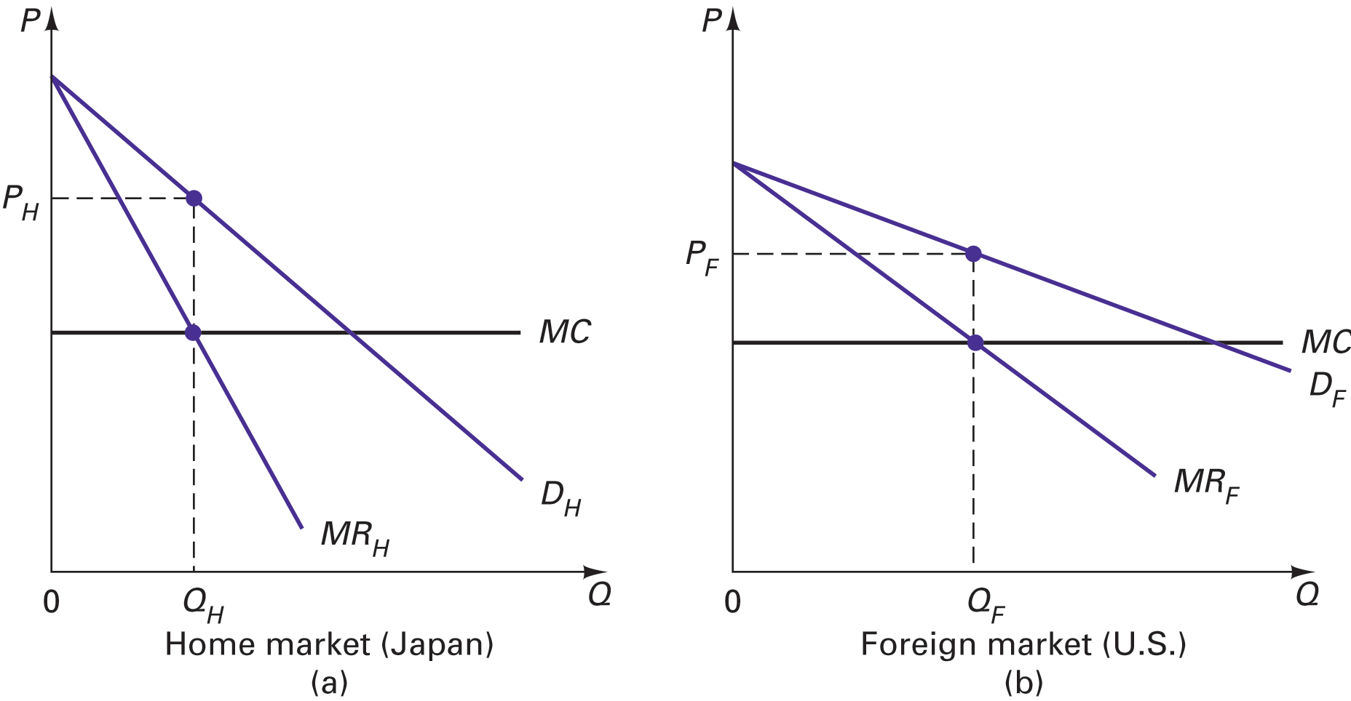
International price discrimination.
Figure 8.3, H&M, p.232

Slide 68
Learning Objectives
Distinguish between commercial policy and industrial policy
Understand the lessons from the history of US commercial policy
Become familiar with GATT and WTO
Explain why anti-dumping measures are really old-fashioned protectionism
Learn current US commercial policy

Slide 69
US Antidumping Law
When dumping is “proven”, a tariff equal to the dumping margin may be imposed
Injury test -- Must also demonstrate that the allegedly unfair foreign practice either has injured or threatens injury to the domestic industry
Offers no discretion to US officials, even if the tariff will harm more US industries than it helps
See Table 8.2, page 235, Husted & Melvin
Notes:
See Table 8.2, page 235, Husted & Melvin for US Anti-dumping cases. Source: US ITC “Antidumping and CVD Handbook, Dec 2001”
See Carbaugh’s Table 6.6, page 191 -- a summary

Slide 70
US Antidumping Law
How many antidumping duties have been imposed by the US?
How large is the average duty?
Do these duties reduce volume of US imports?

Slide 71
US Antidumping Law
As of 31 Dec ‘01, 350 duties in place, 271 imposed post 1985.
The average duty is 10 to 20 times the MFN tariff.
Prasa estimated a reduction of 30 to 50% in the value of US imports.

Slide 72
US Countervailing Duty Law
When a foreign government provides either production or export subsidies, Congress views this as an unfair practice, whether or not there is price discrimination. In some cases, no injury test required.
Countervailing duties (CVD) are imposed to offset the subsidy
Raise price of import to “fair market value”

Slide 73
WTO & Subsidies
Uruguay Round
Subsidies categorized
Prohibited (red light)
Actionable (yellow light)
Non-actionable (green light)
CVD expire after five years
Exemptions for developing countries

Slide 74
WTO & Subsidies
Prohibited (red light)
Export subsidies (“Peace Clause”)
Import-substitution subsidies
Must be withdrawn (repaid?)
All other subsidies are permitted, but are also actionable (through CVD or DSU) if they are
Specific: limited to a firm, industry or group
And cause
Material injury to another member’s industry, or
Serious prejudice to the trade interests of another WTO member
Notes:
(“Peace Clause”) Grandfathered subsidies (until __________), provided they were not raised. US Cotton subsidies found in violation in dispute filed by Brazil. “peace clause”, inserted into the Agreement on Agriculture in 1995. But under the terms of the peace clause, countries only enjoyed that immunity provided they capped their subsidies at their 1992 levels. In 1992, America paid cotton producers $1.62 billion. But in 1999 and 2001 it breached that cap, paying its cotton farmers $2.3 billion in 1999 and $2.06 billion in 2001, according to the Department of Agriculture.
On prohibited subsidies: One WTO ruling said that the company would have to pay it back. The Australian automobile leather company would have gone bankrupt.

Slide 75
WTO & Subsidies
Non-actionable: Presently, only subsidies that are not specific, as defined above
Update as of 1/1/2000 -- expired
Originally three kinds of specific assistance were non-actionable (article 8): R&D; regional development; environmental compliance
No agreement was reached to extend these
http://www.wto.org/english/thewto_e/whatis_e/tif_e/agrm8_e.htm#subsidies
Notes:
Dear Mr. Eastwood,
I found the following on the WTO website. I guess you have to mention in your slide (Commercial Policy: History and Practice, slide 64) that the third category (non-actionable subsidies) does not exist anymore.
Here is the excerpt from http://www.wto.org/english/thewto_e/whatis_e/tif_e/agrm8_e.htm#subsidies
“The agreement defines two categories of subsidies: prohibited and action able. It originally contained a third category: non-actionable subsidies. This category existed for five years, ending on 31 December 1999, and was not extended. The agreement applies to agricultural goods as well as industrial products, except when the subsidies are exempt under the Agriculture Agreement’s “peace clause”, due to expire at the end of 2003.”
Kind regards,
Daniela Luib

Slide 76
WTO & Subsidies
Also expired -- Article 6.1 dark amber subsidies: presumed to cause serious prejudice
Subsidies (or repeated subsidies) to cover an industry’s operating losses
Direct forgiveness of debt (including grants to cover debt repayment)
When the ad valorem subsidization of a product exceeds 5 percent.
Subsidizing government had the burden of proving that serious prejudice had not resulted from the subsidy

Slide 77
Section 201– Escape Clause
Offers temporary protection against fairly traded goods (began in early 1940s)
Harley Davidson case
Restrictions last five years or less, and are phased out
Rarely used
Protection through alleged dumping or subsidies is easier to obtain and more permanent
Alternatively, . . .
Notes:
The escape clause first appeared in the Reciprocal Trade Agreement with Mexico in 1943. It was codified as section 201 of the 1974 Trade Act and has been amended several times since then. Source: http://internationalecon.com/Trade/Tch20/T20-4.php

Slide 78
Trade Adjustment Assistance
Compensate those who lose from trade (since ‘62)
TAA to workers supports
Retraining, job search & relocation
TAA to firms supports industry-wide restructuring
Product, process or export development
Notes:
Is it the equitable or the efficient response?
Maybe Both!
Recipients similar to other unemployed workers
Raises the equity question: Why should those displaced by foreign competition be treated better than those displaced by other causes?
Some question the need: Is there a factor market failure that keeps resources from being reallocated at the optimal rate?
One example of such a failure is downward rigidity in wages: When an industry is losing employment (demand for labor decreasing with demand for its product), it is generally efficient for wages to be reduced somewhat. This slows job losses. However, downward rigidity increases job losses.

Slide 79
Trade Adjustment Assistance
Is it the equitable or the efficient response?
Peaked under Carter Administration
1980: $1,600 million; 532,000 workers
Mostly in autos, steel and apparel
Few retrained
Recipients similar to other unemployed workers
Reagan cut program
1984: $50 million; 16,000 workers
NAFTA provided for TAA
Notes:
Is it the equitable or the efficient response?
Maybe Both!
Recipients similar to other unemployed workers
Raises the equity question: Why should those displaced by foreign competition be treated better than those displaced by other causes?
Some question the need: Is there a factor market failure that keeps resources from being reallocated at the optimal rate?
One example of such a failure is downward rigidity in wages: When an industry is losing employment (demand for labor decreasing with demand for its product), it is generally efficient for wages to be reduced somewhat. This slows job losses. However, downward rigidity increases job losses.

Slide 80
Wage Insurance
On average, a displaced industrial worker earns 13% less. One third earn more. One fourth earn at least 30% less
Kletzer & Litan (Brookings) proposed:
Give eligible workers ½(W_{new}-W_{old}), but < $10,000/year, for up to two years.
Estimated cost in 1997 was $4 billion, when u= 4.9%.
Could limit benefits to those over 50 who earned less than $50,000/year to reduce cost.
In 2002, George W. Bush agreed to a 5-year trial, with benefits limited to $10,000 over two years.
Notes:
Is it a moe efficient response?
On average, a displaced industrial worker earns 13% less. One third earn more – they do not need help. One fourth earn at least 30% less – given that the gains to consumers from free trade are substantial, we could afford to help these people.
Kletzer & Litan (Brookings) propose:
Give eligible workers ½(W_{new}-W_{old}), but < $10,000/year, for up to two years. Eligibility requires at least two years on the job lost, and benefits do not begin until the new job is taken.
Estimated cost in 1997 was $4 billion, when u= 4.9% -- That’s expensive.
Could limit benefits to those over 50 who earned less than $50,000/year to reduce cost.

Slide 81
Section 301
Trade Act of 1974 authorized the President to list unfair foreign practices
WTO members
Others
Administered by the office of the US Trade Representative (USTR)
From 1975-1995, 101 cases accepted
Roughly half resulted in a change in the foreign practice. Only ¼ resulted in increases US exports
Often most likely to fail when most justified
Notes:
Negotiate removal within three years or retaliate. Twelve cases have resulted in retaliation. (p247)

Slide 82
Aggressive Unilateralism
Impatient with slow progress of Multi-lateral Trade Negotiations (MTN)
Some nations now pursue a results-oriented trade policy
The strengthened dispute settlement process under the WTO has – as intended – reduced unilateral retaliation
Notes:
See handwritten Chapter 8 notes for more details
Super 301 (expired 12/31/1990)

Slide 83
1988 Omnibus Trade & Competitiveness Act
Special 301 (encourage developing nations to implement TRIPS -- to protect US IPR)
Super 301 – customs valuation (expired 12/31/1990, reinstated by executive order 3/31/99)
Structural Impediments Initiative (modify working of US & Japanese economy

Slide 84
1988 Omnibus Trade & Competitiveness Act
Section 1377 to further the implementation of telecommunications agreements
Title VII enables the USTR to challenge the discriminatory procurement barriers of foreign governments
Notes:
See handwritten Chapter 8 notes for more details
Super 301 (expired 12/31/1990)

Slide 85
WTO Oversight Committees
Help secure implementation of members’ WTO commitments
Committee on Agriculture
Committee on Customs Valuation
Committee on Technical Barriers to Trade
Committee on BOP Restrictions
Trade Policy Review process identifies practices inconsistent with the agreements

Slide 86
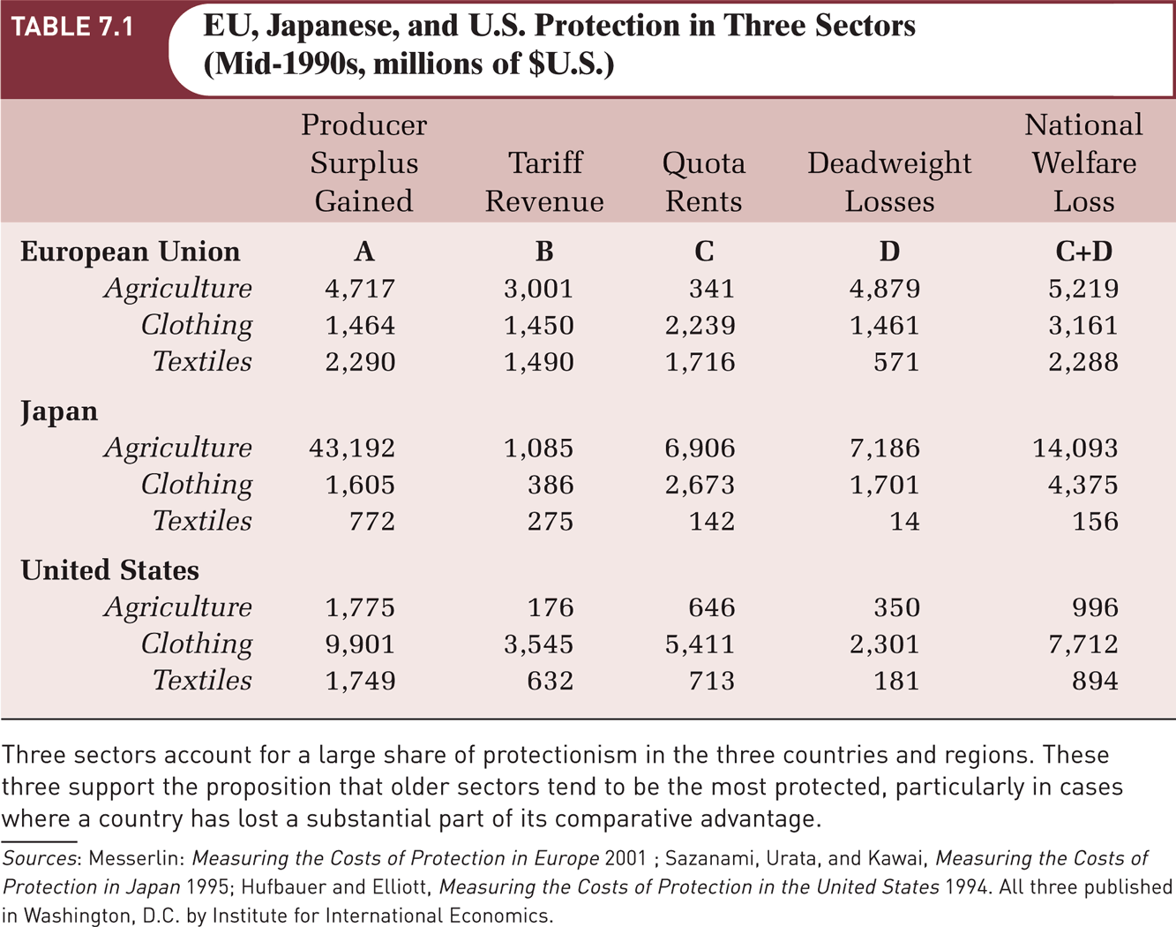
Direct Costs and Jobs “Saved”
Notes:
From Gerber’s International Economics

Slide 87
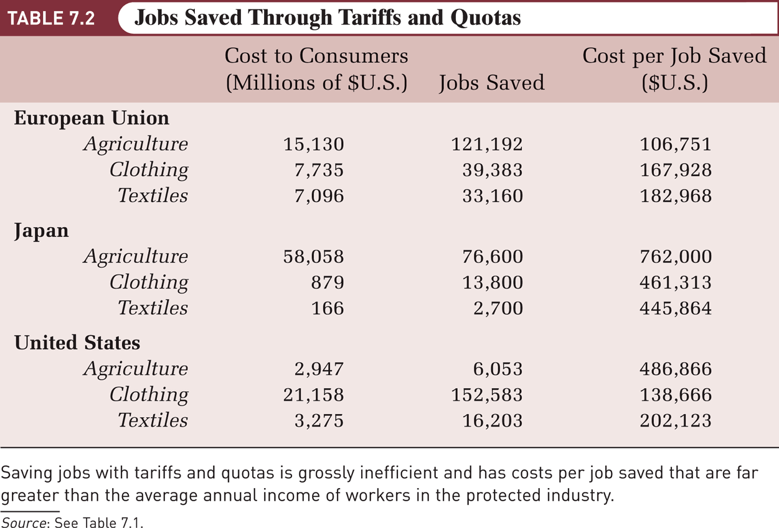
Direct Costs and Jobs Saved (Cont.)
Insert Updated Table 7.2 Here

Slide 88
Globalization
The Anti-Globalization Movement
It became a highly visible presence chronologically:
1980s
Alleged threat of competition from Japan in the United States
Early 1990s
Substantial concern in both the United States and Europe over the effects of imports from low-wage countries on the wages of less-skilled workers at home.
Second half of the 1990s
Alleged harm that world trade was doing to workers in the developing countries.
1999
Demonstrations disrupted the meeting of the World Trade Organization in Seattle.

Slide 89
Globalization
Trade and Wages Revisited
Activists argue that globalization makes workers in developing-country export industries worse off.
Example: Wages in Mexico’s maquiladoras were below $5 per day, and conditions were appalling by U.S. standards.
Economists argue that despite the low wages earned by workers in developing countries, those workers are better off than they would be if globalization had not taken place.

Slide 90
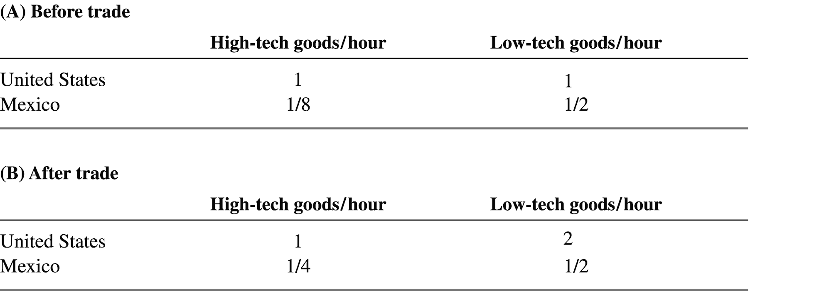
Globalization
Real Wages

Slide 91
Globalization
Labor Standards and Trade Negotiations
International trade agreements can improve wages and working conditions in poor countries by incorporating:
A system that monitors wages and working conditions and makes the results of this monitoring available to consumers.
Formal labor standards
They are conditions that export industries are supposed to meet as part of trade agreements.
They have considerable political support in advanced countries.
They are strongly opposed by most developing countries.

Slide 92
Globalization
Environmental and Cultural Issues
Environmental standards in developing-country export industries are much lower than in advanced-country industries.
The incorporation of environmental standards in trade agreements can cause:
Improvements in the environment
Potential export industries in poor countries to shut down
Globalization has led to a homogenization of cultures around the world.
Example: McDonald’s is now found almost everywhere.

Slide 93
Globalization
The WTO and National Independence
Free trade and free flow of capital has undermined national sovereignty.
WTO monitors not only the traditional instruments of trade policy, but also domestic policies that are de facto trade policies.

Slide 94
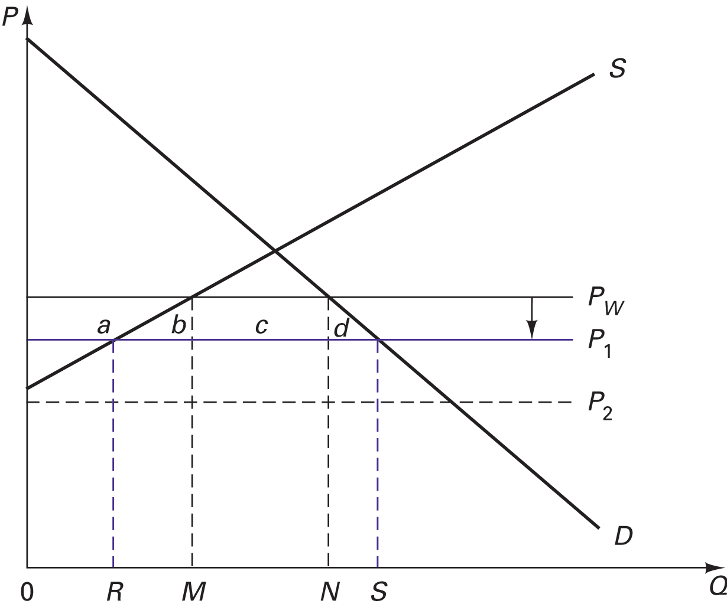
Dumping.

Slide 95
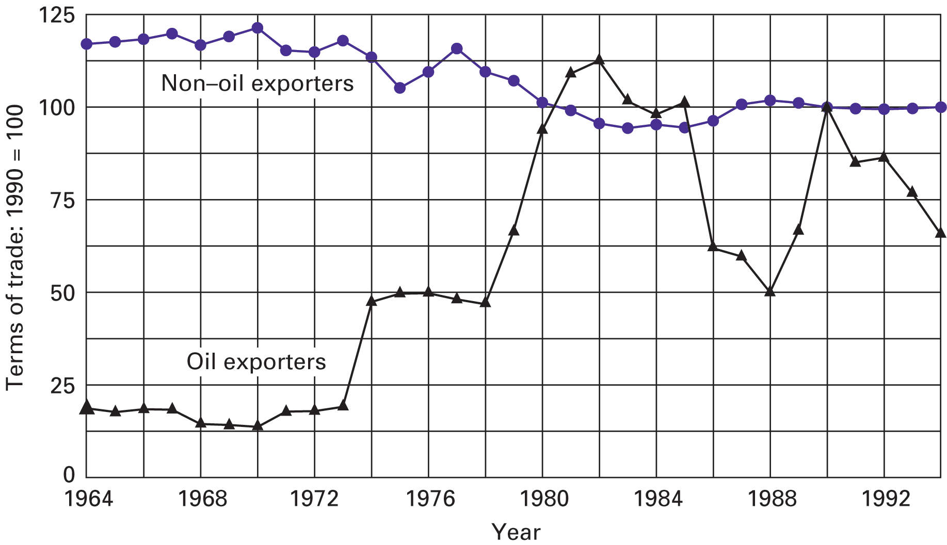
Terms of trade of developing countries.

Slide 96
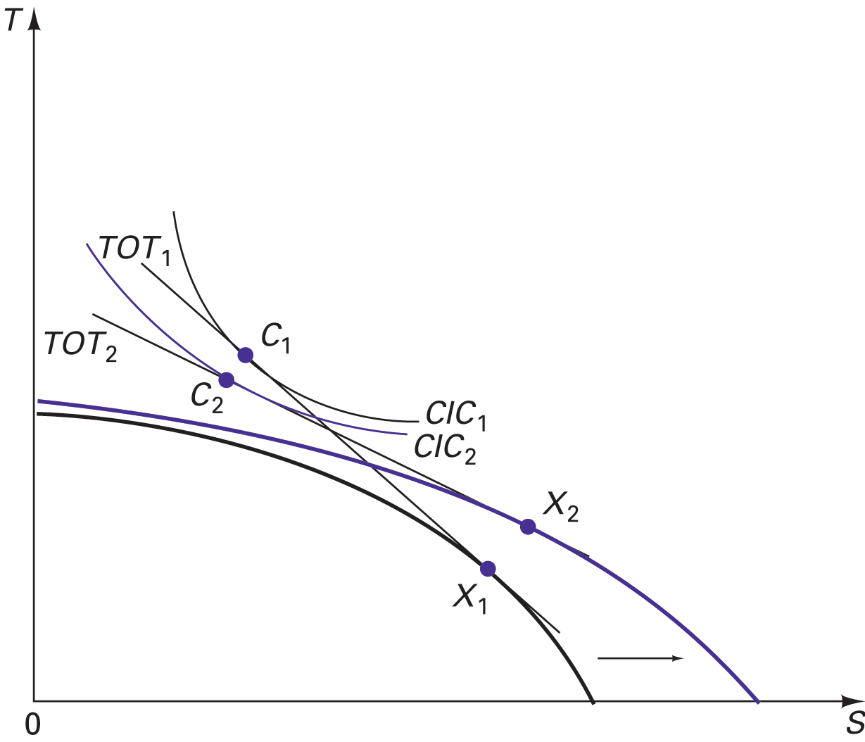
Immizerizing growth

Slide 97
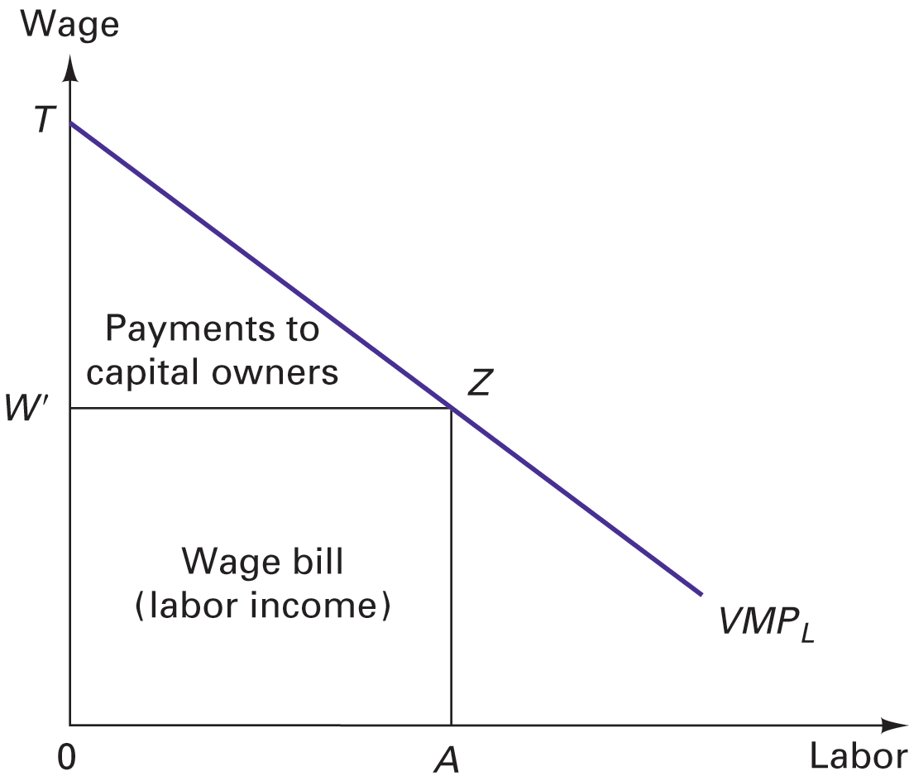
Distribution of income between labor and capital.

Slide 98
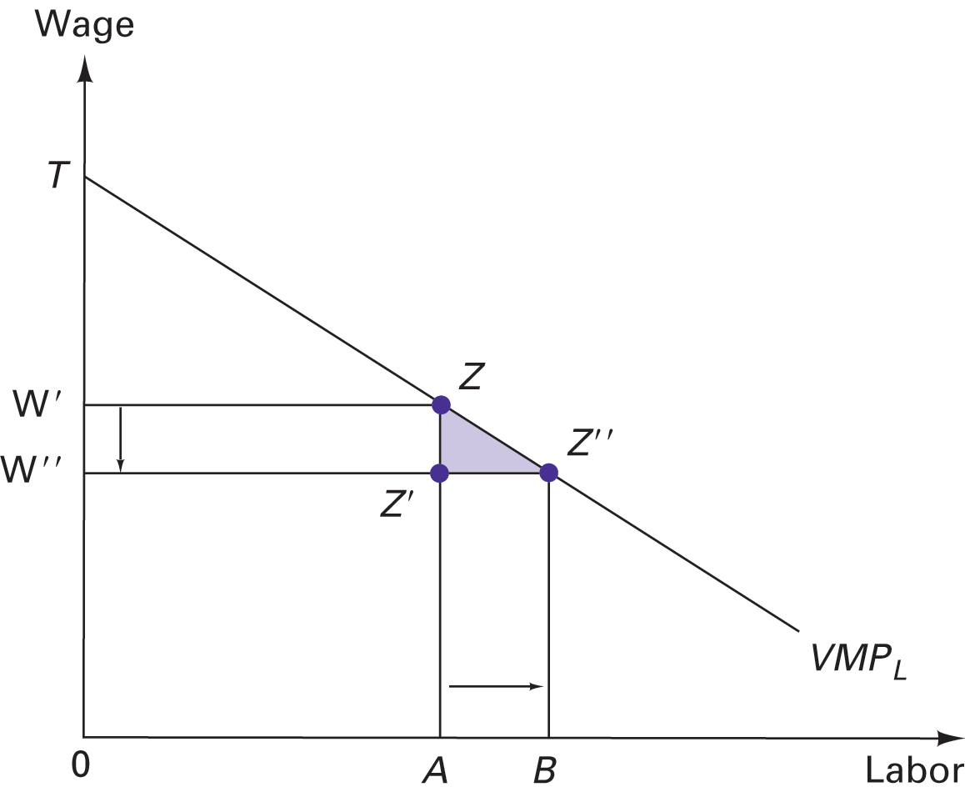
The economic effects of labor immigration.

Slide 99
Reciprocity in Trade Negotiations
Protectionist reciprocity
Liberal reciprocity
Aggressive reciprocity

Slide 100
Effects of dumping, subsidies, and remedies
Trade regulation

Slide 101
Effects of dumping, subsidies, and remedies
Trade regulation

Slide 102
The Doha Round of Trade Negotiations
See page 229 H&M, 7th edition
See Table 6.5, page 189, Carbaugh
Notes:
Table 6.5, page 189, Carbaugh

Slide 103
The Doha Round of Trade Negotiations
A history of negotiations through 2006, and a discussion of the issues, from a European point of view:
http://www.euractiv.com/en/trade/wto-doha-development-round/article-157082.

Slide 104
Doha Round: Dispute Settlement
Read about proposals to improve the process.
http://www.wto.org/english/thewto_e/minist_e/min05_e/brief_e/brief10_e.htm
Includes: 3rd party rights; remand authority; sequencing; post-retaliation; transparency; time savings; composition of panels

Slide 105
Wage Insurance
On average, a displaced industrial worker earns 13% less. One third earn more. One fourth earn at least 30% less
Kletzer & Litan (Brookings) proposed:
Give eligible workers ½(W_{new}-W_{old}), but < $10,000/year, for up to two years.
Estimated cost in 1997 was $4 billion, when u= 4.9%.
Could limit benefits to those over 50 who earned less than $50,000/year to reduce cost.
In 2002, George W. Bush agreed to a 5-year trial, with benefits limited to $10,000 over two years.
Notes:
Is it a moe efficient response?
On average, a displaced industrial worker earns 13% less. One third earn more – they do not need help. One fourth earn at least 30% less – given that the gains to consumers from free trade are substantial, we could afford to help these people.
Kletzer & Litan (Brookings) propose:
Give eligible workers ½(W_{new}-W_{old}), but < $10,000/year, for up to two years. Eligibility requires at least two years on the job lost, and benefits do not begin until the new job is taken.
Estimated cost in 1997 was $4 billion, when u= 4.9% -- That’s expensive.
Could limit benefits to those over 50 who earned less than $50,000/year to reduce cost.

