Slide 1
Money and Banking
Dr. Andrew L. H. Parkes
SS I 2017
“How do financial markets work?”
卜安吉

Slide 2
First, A Look Back and at Friday
Chinese shares end more than 7% lower – Tuesday, Jan. 22
The benchmark Shanghai Composite Index tumbled 7.22% to close at 4,559.75 points.
·… Friday, February 15:
Mainland China's benchmark Shanghai Composite Index, which tracks both Class A and Class B shares, ended down 1.2% at 4497.13.
China’s stocks did they fall?
Before Friday, the Shanghai Composite was actually higher than on Jan. 22 !!!

Slide 3
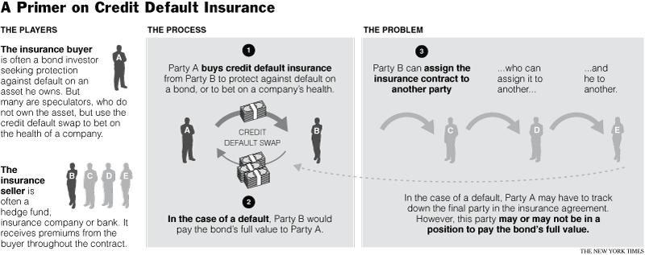
Credit Default Insurance
Courtesy source: NY Times, accessed on February 17, 2008 http://www.nytimes.com/2008/02/17/business/17swap.html?hp

Slide 4
Credit Default Insurance
FGIC – Privately held (including Blackstone Group – China)
Ambac – the first
MBIA – the largest and most important due to its size. Is not yet willing to go along with the FGIC plan.
The Three Credit Insurance Companies

Slide 5
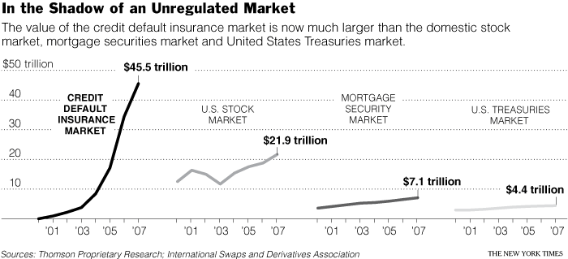
Credit Default Insurance
Notice that the Credit Default Insurance Market is 2x the U.S. Stock Market!

Slide 6
Credit Default Insurance
Points to take note of that we will consider during the day:
What is a swap?
What is a derivative?
What is the Credit Default Insurance Market?
How does the market operate?

