Slide 1
Economics
A CONTEMPORARY INTRODUCTION
11e
William A. McEachern
University of Connecticut

Slide 2
1
The Art and Science
of Economic Analysis

Slide 3
Why are comic-strip and TV characters like those in FoxTrot, The Simpsons, and Family Guy missing a finger on each hand? And where is Dilbert’s mouth?
Which college majors pay the most?
In what way are people who pound on vending machines relying on theory?
Why is a good theory like a California Closet?
What’s the big idea with economics?
Finally, how can it be said that in economics “what goes around comes around”?

Slide 4
The Economic Problem
The economic problem
  Unlimited wants
    Our wants, our desires are virtually unlimited
  Scarce resources
    The resources available to satisfy those wants are scarce
    Not freely available
    Its price exceeds zero

Slide 5
The Economic Problem
Because of scarcity
  You must choose from among your many wants
  You must forgo satisfying some other wants
Economics
  The study of how people use their scarce resources to satisfy their unlimited wants

Slide 6
Resources
Goods and services are scarce
  Because resources are scarce
Resources: inputs or factors of production
  Used to produce the goods and services that people want
Labor
Capital
Natural resources
Entrepreneurial ability

Slide 7
Resources
Labor
  Physical and mental effort used to produce goods and services
We allocate our time to different uses
  Sell it as labor
  Spend it doing other things
Wages
  Payment to resource owners for their labor

Slide 8
Resources
Capital
  Buildings, equipment, and human skills used to produce goods and services
Interest
  Payment to resource owners for the use of their capital

Slide 9
Resources
Physical capital
  Human creations used to produce goods and services
Human capital
  Knowledge and skill people acquire to increase their productivity

Slide 10
Resources
Natural resources
  All gifts of nature used to produce goods and services
  Renewable
  Exhaustible
Rent
  Payment to resource owners for the use of their natural resources

Slide 11
Resources
Renewable resource
  Can be drawn on indefinitely if used conservatively
Exhaustible resource
  Does not renew itself
  Available in a limited amount

Slide 12
Resources
Entrepreneurial ability
  The talent required to dream up a new product or find a better way to produce an existing one
  Comes from an entrepreneur
Profit
  Reward for entrepreneurial ability
  Sales revenue minus resource cost

Slide 13
Resources
Entrepreneur
  Profit-seeking decision maker who starts with an idea
  Organizes an enterprise to bring that idea to life
  Assumes the risk of the operation

Slide 14
Goods and Services
Good
  Tangible product used to satisfy human wants
Service
  Activity, or intangible product, used to satisfy human wants
A good or service is scarce
  If the amount people desire exceeds the amount available at a zero price

Slide 15

Exhibit 1
Scarcity Means You Must Choose Among Options

Slide 16
Goods and Services
Making choices in a world of scarcity
  Means we must pass up some goods and services
Bads
  We want none of them
  Not even at a zero price
“The best things in life are free”
  Most goods and services are scarce, not free

Slide 17
Goods and Services
“There is no such thing as a free lunch”
  All goods and services involve a cost to someone
  May seem free to you
    But it draws scarce resources away from the production of other goods and services
  Whoever provides a free lunch
    Often expects something in return

Slide 18
Economic Decision Makers
Decision makers in the economy
    Households
    Firms
    Governments
    The rest of the world
  Their interaction determines how an economy’s resources are allocated

Slide 19
Economic Decision Makers
Households
  As consumers
    Demand the goods and services produced
  As resource owners
    Supply resources to firms, government, and the rest of the world
Firms, Governments, Rest of the World
  Demand resources
  Produce goods and services

Slide 20
Markets
Market
  Set of arrangements by which buyers and sellers carry out exchange at mutually agreeable terms
Product market
  A market in which a good or service is bought and sold
Resource market
  A market in which a resource is bought and sold

Slide 21
A Simple Circular-Flow Model
Circular-flow model
  A diagram that traces the flow of resources, products, income, and revenue
  Among economic decision makers
Simple circular-flow model
  Shows the interaction between households and firms

Slide 22
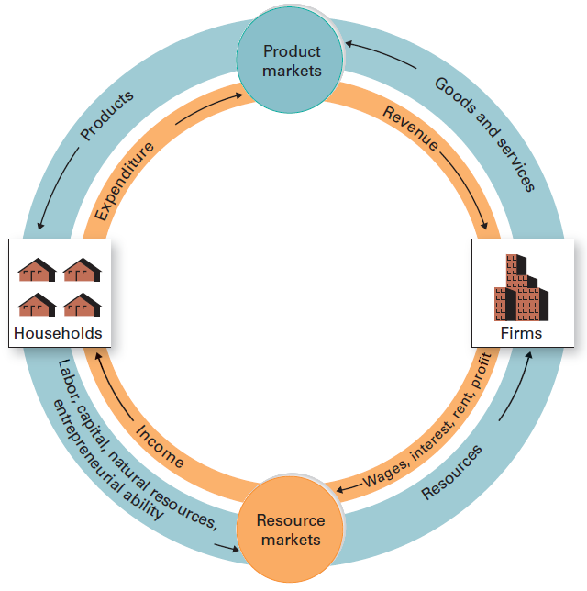
Exhibit 2
The Simple Circular-Flow Model for Households and Firms
Households earn income by supplying resources to resource markets, as shown in the lower portion of the model.
Firms demand these resources to produce goods and services, which they supply to product markets, as shown in the upper portion of the model.
Households spend their income to demand these goods and services. This spending flows through product markets as revenue to firms.

Slide 23
Rational Self-Interest
Individuals are rational
  Make the best choice given the available information
  Maximize expected benefit achieved with a given cost
  Minimize expected cost of achieving a given benefit
The lower the personal cost of helping others, the more help we offer

Slide 24
Choice Requires Time & Information
Rational choice
  Takes time and requires information
Time and information
  Are themselves scarce and therefore valuable
Rational decision makers
  Willing to pay for information
  Acquire information if the additional benefit expected exceeds the additional cost

Slide 25
Economic Analysis Is Marginal Analysis
Comparison
  Expected marginal benefit
  Expected marginal cost
Marginal
  Incremental, additional, extra
Rational decision maker changes the status quo
  If the expected marginal benefit exceeds the expected marginal cost

Slide 26
Microeconomics
Microeconomics
  Study of the economic behavior in particular markets
    Individual economic choices
    Markets coordinate the choices of economic decision makers
    Individual pieces of the puzzle

Slide 27
Microeconomics
Macroeconomics
  Study of the economic behavior of entire economies
  Performance of the economy as a whole
  Business cycles: Rise and fall of economic activity
    Relative to the long-term growth trend of the economy

Slide 28
The Science of Economic Analysis
Economic theory, or economic model
  A simplification of economic reality
  Used to make predictions about cause and effect in the real world
A good theory
  Helps us understand a messy and confusing world
  Offers a helpful guide to sorting, saving, and understanding information

Slide 29
The Role of Theory
Most people don’t understand the role of theory
  People may substitute their own theory for a theory they either do not believe or do not understand
All of us employ theories, however poorly defined or understood
  Pounding on the Pepsi machine

Slide 30
The Scientific Method
Step 1
  Identify the question
  Define relevant variables
Variable
  A measure that can take on different values at different times

Slide 31
The Scientific Method
Step 2: Specify assumptions
Other-things-constant assumption
  Focus on the relation among key variables
  Other variables remain unchanged
  Ceteris paribus
Behavioral assumption
  Describes the expected behavior of economic decision makers
  What motivates them

Slide 32
The Scientific Method
Step 3: Formulate the hypothesis
  How key variables relate to each other
  To help make predictions about cause and effect in the real world
Hypothesis
  Theory about how key variables relate

Slide 33
The Scientific Method
Step 4: Test the hypothesis
  Compare its predictions with evidence
  Test the validity of a hypothesis
  Reject the hypothesis
    If it predicts worse than the best alternative theory
  Use the hypothesis
    Until a better one comes along

Slide 34
Exhibit 3
The Scientific Method: Step by Step
The steps of the scientific method are designed to develop and test hypotheses about how the world works. The objective is a theory that predicts outcomes more accurately than the best alternative theory. A hypothesis is rejected if it does not predict as accurately as the best alternative. A rejected hypothesis can be modified or reworked in light of the test results.

Slide 35
Normative Versus Positive
Positive economic statement
  Can be proved or disproved by reference to facts
  ‘What is’
Normative economic statement
  Reflects an opinion
  Cannot be proved or disproved by reference to the facts
  ‘What should be’

Slide 36
Economists Tell Stories
Economic analysis
  Is as much art as science
Economists explain their theories
  By telling stories about how they think the economy works
  Case studies, anecdotes, parables, the personal experience of the listener, and supporting data

Slide 37
Predicting Average Behavior
Individual behavior
  Difficult to predict
  But the random actions of individuals
    Tend to offset one another
Average behavior of groups
  Predicted more accurately than behavior of one individual
Economists focus on typical or average behavior of people in a group

Slide 38
Some Pitfalls of Faulty Economic Analysis
Fallacy: an incorrect idea or belief
The fallacy that association is causation
  The incorrect idea that if two variables are associated in time, one must necessarily cause the other
The fallacy of composition
  The incorrect belief that what is true for the individual, or part, must necessarily be true for the group, or the whole

Slide 39
Some Pitfalls of Faulty Economic Analysis
The mistake of ignoring the secondary effects
  Ignoring the unintended consequences
Secondary effects
  Unintended consequences of economic actions that may develop slowly over time as people react to events

Slide 40
If Economists Are So Smart, Why Aren’t They Rich?
Some are
  Earning over $25,000 per appearance on the lecture circuit
  Earn $2 million a year as consultants and expert witnesses
Economists in federal cabinet posts
  Secretaries of commerce, defense, labor, state, and treasury
  Head the U.S. Federal Reserve System

Slide 41
If Economists Are So Smart, Why Aren’t They Rich?
Economics
  The only social science and the only business discipline for which the prestigious Nobel Prize is awarded
Pronouncements by economists
  Are reported in the media daily
Economic models
  Usually do a better job of making economic sense out of a confusing world than do alternative approaches

Slide 42
College Major and Annual Earnings
Some factors that affect earnings among college graduates
  General ability
  Effort
  Occupation
  College attended
  College major
  Highest degree earned

Slide 43
College Major and Annual Earnings
Major in economics (bachelors)
  Rank: #6 of 20 majors (Exhibit 4)
  Median wage
    For 0-5 years experience: $51,400
    For 10-20 years experience: $97,700
  Rank among top 10% of 207 majors

Slide 44
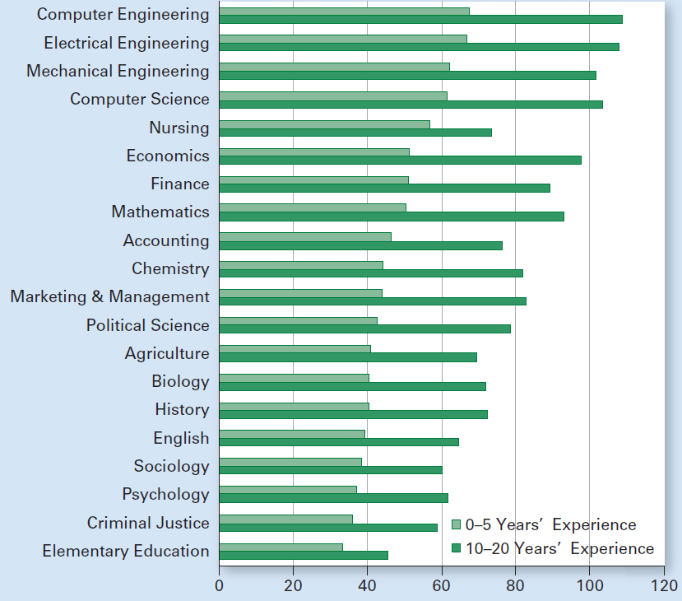
Exhibit 4
Median Annual Pay by College Major

Slide 45
Understanding Graphs
Origin
  Point of departure
Horizontal axis
  Straight horizontal line starting at the origin
Vertical axis
  Straight vertical line starting at origin

Slide 46
Exhibit 5
Basics of a graph
Any point on a graph represents a combination of particular values of two variables. Here point a represents the combination of 5 units of variable x (measured on the horizontal axis) and 15 units of variable y (measured on the vertical axis). Point b represents 10 units of x and 5 units of y.

Slide 47
Understanding Graphs
Graph
  A picture showing how variables relate
  Conveys information in a compact and efficient way
Time-series graph
  Shows the value of a variable over time
Functional relation
  The value of the dependent variable depends on the value of the independent variable

Slide 48
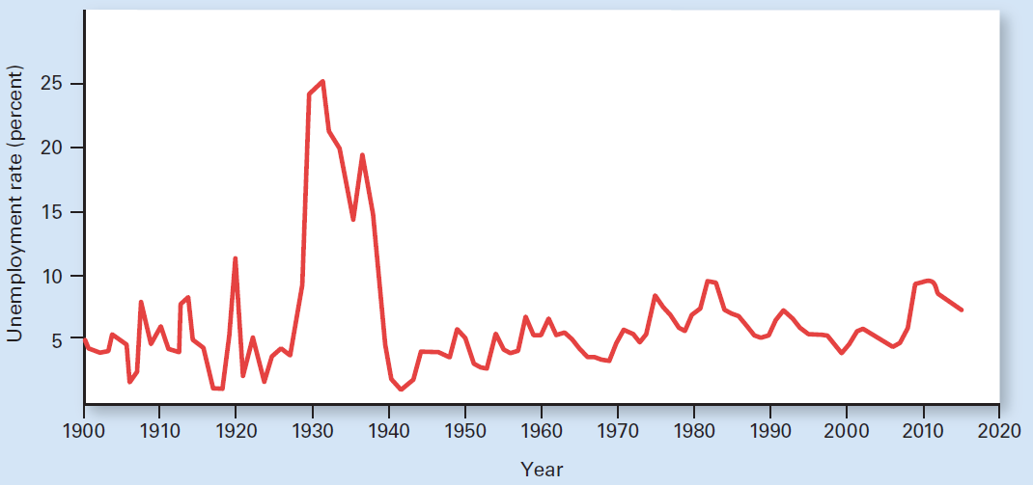
Exhibit 6
U.S. Unemployment rate since 1900
A time-series graph depicts the behavior of some economic variable over time. Shown here are U.S. unemployment rates since 1900.

Slide 49
Drawing Graphs
Types of relations between variables
  Positive, or direct, relation
    As one variable increases, the other increases
  Negative, or inverse, relation
    As one variable increases, the other decreases
  Independent, or unrelated, variables
    As one variable increases, the other remains unchanged

Slide 50
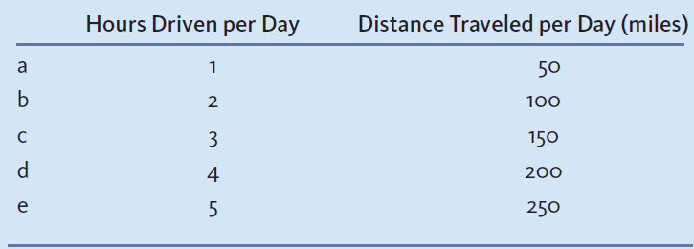
Exhibit 7
Schedule Relating Distance Traveled to Hours Driven
The distance traveled per day depends on the hours driven per day, assuming an average speed of 50 miles per hour. This table shows combinations of hours driven
and distance traveled. These combinations are shown as points in Exhibit 8.

Slide 51
Exhibit 8
Graph Relating Distance Traveled to Hours Driven
Points a through e depict different combinations of hours driven per day and the corresponding distances traveled. Connecting these points creates a graph.
250
e
200
d
Distance traveled per day (miles)
150
c
100
b
50
a
0
1
2
3
4
5
Hours driven per day

Slide 52
The Slope of a Straight Line
Slope
  Change in vertical variable for a given increase in horizontal variable
Slope
  Change in the vertical distance
  Divided by the increase in the horizontal distance
Slope of a straight line
  A constant value along the line

Slide 53
Exhibit 9 (a), (b)
Alternative slopes for straight lines
The slope of a line indicates how much the vertically measured variable changes for a given increase in the variable measured along the horizontal axis. Panel (a) shows a positive relation between two variables; the slope is 0.5, a positive number. Panel (b) depicts a negative, or inverse, relation. When the x variable increases, the y variable decreases; the slope is - 0.7, a negative number.

Slide 54
Exhibit 9 (c), (d)
Alternative slopes for straight lines
Panels (c) and (d) represent situations in which two variables are unrelated. In panel (c), the y variable always takes on the same value; the slope is 0. In panel (d), the x variable always takes on the same value; the slope is mathematically undefined but we simplify by assuming the slope is infinite.

Slide 55
Slopes
Value of slope
  Depends on units of measurement
  Measures marginal effects
Slope of a curved line
  Differs along the curve
Slope of a curved line at one point
  Slope of the tangent

Slide 56
Exhibit 10
Slope depends on the unit of measure
(a) Measured in feet
(b) Measured in yards
Total
cost
Total
cost
Slope = 1/1 = 1
Slope = 3/1 = 3
$6
$6
1
5
3
1
3
1
0
5
6
0
1
2
Feet of copper tubing
Yards of copper tubing
The value of the slope depends on the units of measure. In panel (a), output is measured in feet of copper tubing; in panel (b), output is measured in yards. Although the cost is $1 per foot in each panel, the slope is different in the two panels because copper tubing is measured using different units.

Slide 57
Exhibit 11
Slopes at different points on a curved line
y
40
A
The slope of a curved line varies from point to point. At a given point, such as a or b, the slope of the curve is equal to the slope of the straight line that is tangent
to the curve at the point.
30
20
a
10
B
b
x
0
10
20
30
40

Slide 58
Exhibit 12
Curves with both positive and negative slopes
y
a
b
0
x
Some curves have both positive and negative slopes. The hill-shaped curve (in red) has a positive slope to the left of point a, a slope of 0 at point a, and a negative slope to the right of that point.
The U-shaped curve (in blue) starts off with a negative slope, has a slope of 0 at point b, and has a positive slope to the right of that point.

Slide 59
Line Shifts
Change in the assumption
  Changes the relationship between variables
  Expressed by a line shift

Slide 60
Exhibit 13
Shift of line relating distance traveled to hours driven
Line T appeared originally in Exhibit 8 to show the relation between hours driven and distance traveled per day, assuming an average speed of 50 miles per hour. If the average speed is only 40 miles per hour, the entire relation shifts to the right to T, indicating that any given distance traveled requires more driving time. For example, 200 miles traveled takes 4 hours of driving at 50 miles per hour but 5 hours at 40 miles per hour. This figure shows how a change in assumptions, in this case, the average speed assumed, can shift the entire relationship between two variables.
T
250
T′
d
200
f
Distance traveled per day (miles)
150
100
50
0
1
2
3
4
5
Hours driven per day

