Slide 1
13
Money and the Financial System

Slide 2
If Russia can’t pay its bills, why don’t officials there simply print more rubles?
Why are you willing to exchange a piece of paper bearing Alexander Hamilton’s portrait and the number 10 in each corner for a pepperoni pizza with extra cheese?
Why do dimes and quarters have notched edges?
What’s the difference between the Fed and the Feds?
Because money is banned in federal prisons, what do inmates use instead?
Why was someone able to cash a check written on a clean but frayed pair of underpants?

Slide 3
The Birth of Money
No exchange, self-sufficient families
No money
Specialization
Exchange: Barter
Barter
Discover a double coincidence of wants
Two traders are willing to exchange their products directly
Agree on exchange rate

Slide 4
The Birth of Money
The earliest money
Certain goods – easily traded later
High degree of acceptability
Money
Anything that is generally accepted in exchange for goods and services

Slide 5
Functions of Money
1. Medium of exchange
Anything that facilitates trade
By being generally accepted by all parties in payment for goods or services
Commodity money
Anything that serves both as a commodity and as money
Money that has intrinsic value
Gold or silver coins

Slide 6
Functions of Money
2. Unit of account
Common unit for measuring the value of each good or service
3. Store of value
Anything that retains its purchasing power over time

Slide 7
Properties of the Ideal Money
Durable
Maintain its quality for long periods of time
Portable
Easily carried
Divisible
Easily divisible into smaller units

Slide 8
Properties of the Ideal Money
Uniform quality
If money is not of uniform quality, people trade away inferior money and hoard the best, so money is circulation is of poor quality
Low opportunity cost
Money shouldn’t tie up valuable resources
Maintain a relatively stable value over time
Avoid erratic fluctuations

Slide 9
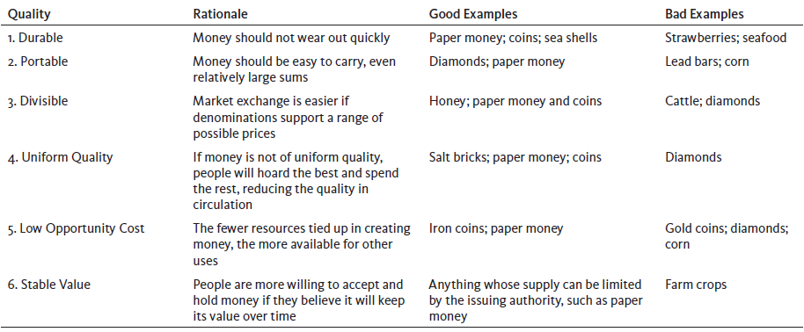
Exhibit 1
Six Properties of Ideal Money

Slide 10
Mackerel Economics in Federal Prisons
Prisoner-of-war camps, World War II
No official currency
Cigarettes as money:
Medium of exchange, unit of account, store of value
Cigarettes
Uniform quality, limited supply, reasonably durable

Slide 11
Mackerel Economics in Federal Prisons
U.S. federal prison system
Prisoners are not allowed to hold cash
Money - commissary accounts
Buy items such as snacks and toiletries
Cigarettes = commodity money
Until 2004, when smoking was banned in all federal prisons
Other commodity money
Postage stamps, cans of tuna, and Power Bars, cans of mackerel

Slide 12
Mackerel Economics in Federal Prisons
U.S. federal prison system
“Macks” - cans of mackerel - commodity money
Settle gambling debts
Buy services from other inmates: ironing, shoe shining, and cell cleaning
Buy goods from other inmates: special foods, home-brewed “prison hooch”
Banned metal cans – makeshift knives

Slide 13
Mackerel Economics in Federal Prisons
U.S. federal prison system
“Macks” - Plastic and foil pouches of mackerel
Commodity money
Each pouch costs about $1 at the commissary
Most prisoners would rather trade macks than eat them

Slide 14
Coins
Coinage
Determined quality and quantity of metal
Allowed payment by count
Problems
Getting clipped
Counterfeiting
Token money
Money whose face value exceeds its cost of production

Slide 15
Early Banking
Banks = Goldsmith
Safekeeping
Earn interest
Checks
Extend loans
Create medium of exchange, money
Public confidence
Fractional reserve banking system

Slide 16
Early Banking
Check
A written order instructing the bank to pay someone from an amount deposited
Fractional reserve banking system
Bank reserves amount to only a fraction of funds on deposit with the bank
Reserve ratio
Reserves as a percentage of total deposits

Slide 17
Bank Notes and Fiat Money
Bank notes
Originally, pieces of paper
Promising a specific amount of gold or silver
To anyone who presented them to issuing banks for redemption
Today, Federal Reserve notes are mere paper money

Slide 18
Bank Notes and Fiat Money
Fiat money
Money not redeemable for any commodity
Status as money is conferred initially by government decree
Eventually by common experience
Legal tender
U.S. currency that constitutes a valid and legal offer of payment of debt

Slide 19
The Value of Money
Purchasing power of money
Rate of exchange for goods and services
Higher price level in economy
Lower purchasing power
Purchasing power of $ in a year
100 ÷ Price index in same year
Evolution over time
Exhibit 2 shows steady decline since 1960

Slide 20
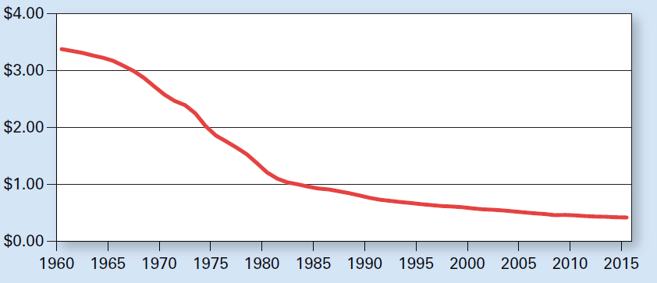
Exhibit 2
Purchasing Power of $1.00 Measured in 1982–1984 Constant Dollars
An increase in the price level over time reduces what $1.00 buys. Since 1960 the price level has risen every year except 2009, so the purchasing power of $1.00 (measured in 1982–1984 constant dollars) has fallen from $3.38 in 1960 to $0.42 in 2015.

Slide 21
When Money Performs Poorly
Hyperinflation in Zimbabwe
Prices grow by the hour
Not reliable store of value
Exchange for more stable currency
Barter
Poorly functioning monetary system
Increases the transaction costs of exchange

Slide 22
Financial Institutions in the U.S.
Financial intermediaries
Institutions such as banks, mortgage companies, and finance companies
Serve as go-betweens
Borrowing from people who have saved
To make loans to others
Depository institutions
Commercial banks and thrift institutions
Accept deposits from the public

Slide 23
Financial Institutions in the U.S.
Commercial banks
Depository institutions
Historically made short-term loans primarily to businesses
Thrift institutions, or thrifts
Savings banks and credit unions
Depository institutions that historically lent money to households

Slide 24
Birth of the Fed
Before 1863: State banks
Chartered by states
National Banking Act of 1863
National banks, issue notes
Regulated by the Office of the Comptroller of the Currency, part of the U.S. Treasury
Dual banking system: State and National
19th century
Panic ‘runs’ on banks

Slide 25
Birth of the Fed
1913 Federal Reserve System
Central bank
Monetary authority
12 Federal Reserve districts
National banks
Had to join the Fed
State banks
Voluntary membership to the Fed

Slide 26
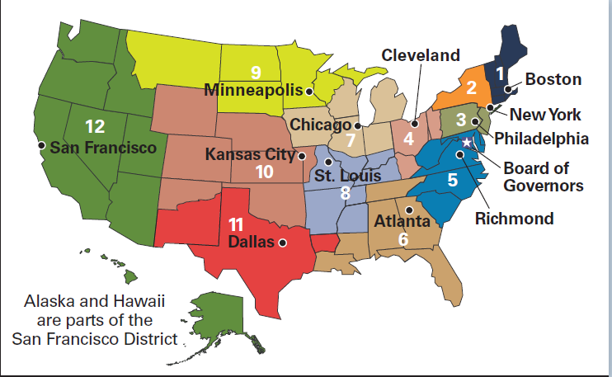
Exhibit 3
The Twelve Federal Reserve Districts
The map shows by color the area covered by each of the 12 Federal Reserve districts. Black dots note the locations of the Federal Reserve bank in each district. Identified with a white star is the Board of Governors headquarters in Washington, DC.

Slide 27
Powers of the Federal Reserve System
The Federal Reserve
Issue bank notes
Buy and sell government securities
Extend loans to member banks
Clear checks in the banking system
Require that member banks hold reserves
Equal to at least some specified fraction of their deposits
Do not deal with the public directly

Slide 28
Powers of the Federal Reserve System
Reserves
Funds that banks use to satisfy
Cash demands of their customers
Reserve requirements of the Fed
Cash held by banks + deposits at the Fed
Member banks
Required to own stock in its district Fed
Entitled to a 6% annual dividend

Slide 29
Powers of the Federal Reserve System
Federal Reserve bank
Responsibility to hold member bank reserves on deposit
Authorized to lend to banks that need reserves
The interest rate charged: the discount rate
Any additional profit earned: turned over to the U.S. Treasury

Slide 30
Powers of the Federal Reserve System
The Fed
Owned by the member banks in the district (technically)
Not-for-profit, independent agency of the federal government
When the Fed Chairman gets grilled
It’s by Congress, not by member banks

Slide 31
Banking Troubles, the Great Depression
1913 – 1929
The Federal Reserve System and the national economy performed relatively well
Stock market crash of 1929
Followed by the Great Depression
Bank runs caused by panicked depositors
The Fed
Failed to act as a lender of last resort

Slide 32
Banking Troubles, the Great Depression
1930 – 1933
About 10,000 banks failed
About one-third of all U.S. banks
Most banks were sound as long as people had confidence in the safety of their deposits
Bank legislation passed during the Great Depression
Shored up the banking system and centralized power with the Fed in Washington

Slide 33
Banking Troubles, the Great Depression
Board of Governors: 7 members
Appointed by the President and confirmed by the Senate
14-year nonrenewable term
Insulated from political pressure
1 chair: 4 years renewable term
Set and implement monetary policy
Oversees the 12 reserve banks

Slide 34
Banking Troubles, the Great Depression
Federal Open Market Committee, FOMC
Open-market operations
The Fed buys, sells government securities
7 board governors
5 of the 12 presidents of reserve banks
New York Federal Reserve president always on FOMC
Advise the board

Slide 35
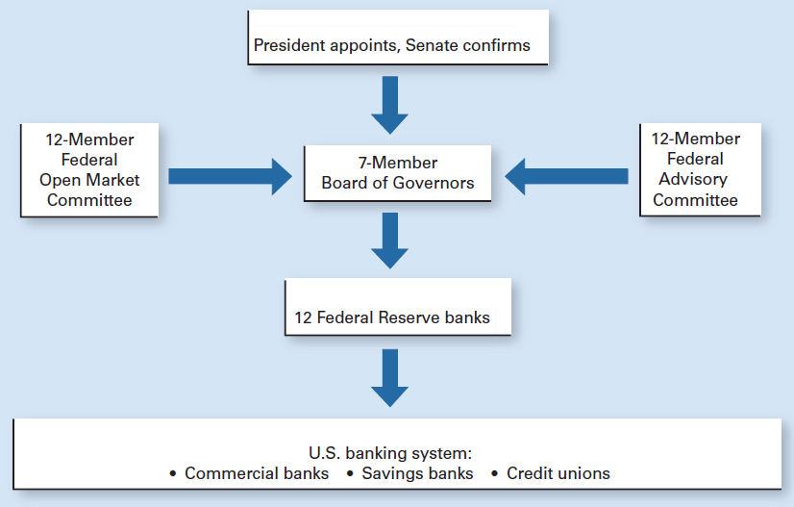
Exhibit 4
Organization Chart of the Federal Reserve System
Members of the Board of Governors are appointed by the president and confirmed by the Senate. The 7 board members also belong to the 12-member Federal Open Market Committee, which advises the board. The Board of Governors controls the Reserve banks in each of the 12 districts, which in turn control the U.S. banking system.

Slide 36
Banking Troubles, the Great Depression
Regulating the money supply
Conduce open-market operations
Set the discount rate
Set the legal reserve requirements
Federal Deposit Insurance Corporation, FDIC
$250,000 per depositor per bank
More than 90% banks purchase FDIC insurance

Slide 37
Banking Troubles, the Great Depression
Goals of the Fed
Economic growth
Interest rate stability
Financial market stability
Exchange rate stability
Low inflation
High employment

Slide 38
Banks Lost Deposits
Before 1930s
Banks could own corporate stock and bonds
After 1930s
Banking: heavily regulated
Loans, government securities
Ceiling on interest rates for deposits
Reduced interest-rate competition for deposits among banks

Slide 39
Banks Lost Deposits
1970s: Inflation
High interest rates in the economy
Above what banks could legally offer
Many depositors withdrew their deposits and put them into higher-yielding alternatives
Money market mutual fund
Collection of short-term interest-earning assets purchased with funds collected from many shareholders
Banks lost deposits when inflation increased

Slide 40
Banking Deregulation
Congress tried to ease regulations
Banks - greater discretion in their operations
Eliminated interest-rate ceilings for deposits
All depository institutions were allowed to offer money market deposit accounts
Money market deposit accounts
Grew from $8 billion in 1978 to $200 billion in 1982

Slide 41
Banking Deregulation
Banks: compete for large deposits in national markets
Because of
Deposit insurance, unregulated interest rates,
Wider latitude in the kinds of assets that savings banks could purchase
Moral hazard problem
Tendency of bankers to take unwarranted risks in making loans because deposits were insured

Slide 42
Banking Deregulation
Zombie banks
Banks that were virtually bankrupt
Able to attract deposits because of deposit insurance
Offered higher interest rates
Drew deposits away from healthier banks

Slide 43
Banking Deregulation
Deposit insurance
Originally introduced during the Great Depression to prevent bank panics
Caused depositors to become complacent about the safety of their deposits
Caused those who ran troubled banks to take wild gambles to survive

Slide 44
Banks on the Ropes
Wild gambles
Insolvency and collapse of a growing number of banks
1989 largest financial bailout
$180 billion in today’s dollars
Taxpayers paid 80%; Banks paid 20%
Close down failing banks
Pay off insured depositors
Healthier banks - take over deposit accounts

Slide 45
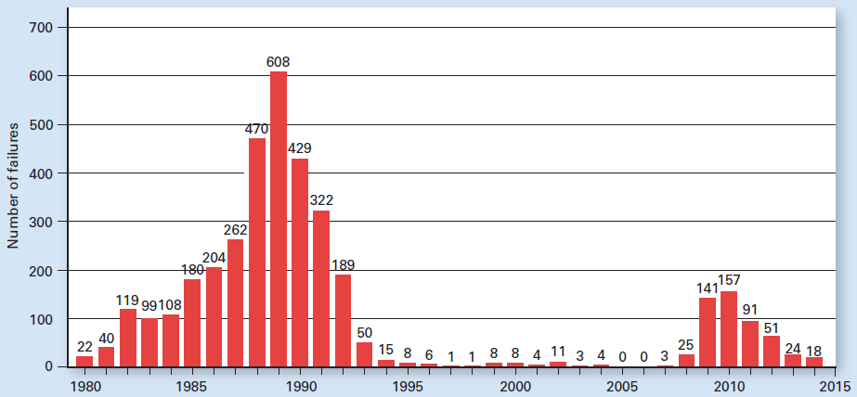
Exhibit 5
Failures of U.S. Banks Peaked in 1989

Slide 46
Banks Recover
5,600 FDIC-insured commercial banks
Reflects past restrictions on bank branches
Bank branches
A bank’s additional offices that carry out banking operations
Bank holding company
Owns several banks
Offers other services

Slide 47
Banks Recover
Bank mergers
Expand geographically
More customers
Expect the higher volume of transactions to reduce operating costs per customer
Avoiding the concentration of bad loans that sometimes occur in one geographical area

Slide 48
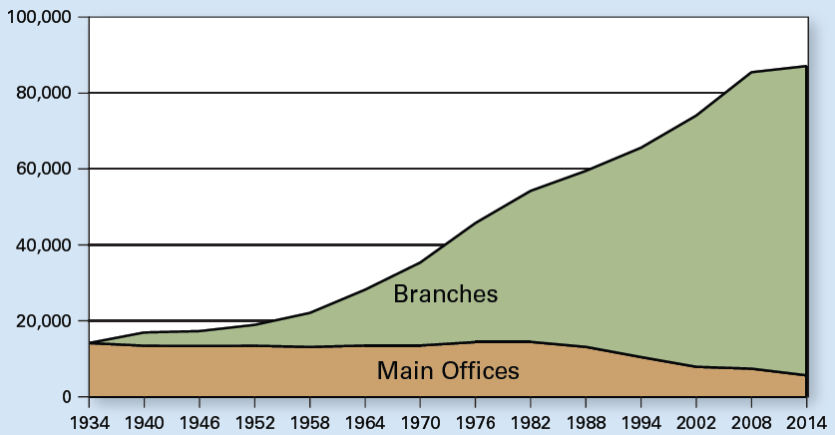
Exhibit 6
The Number of Commercial Banks Declined over the Last Three
Decades, but the Number of Branches Has Grown

Slide 49
Banking During and After the Great Recession of 2007–2009
Subprime mortgage
Mortgage for a borrower with a not-so-good credit rating
Mortgage-backed-security
Bundle together hundreds of mortgages
Based on credit scores
Claim on the monthly payments made on those mortgages

Slide 50
Subprime Mortgages and Mortgage-Backed Securities
Prior to 2000
Only a credit-worthy (prime) borrower could get a home mortgage
Lenders
New statistical techniques, better computers
Increased ability to assess the risk of a subprime mortgage
Credit score - to predict how likely a borrower would be to default on mortgage payments
Borrowers more likely to default: higher interest rate

Slide 51
Subprime Mortgages and Mortgage-Backed Securities
Subprime mortgages
Blended with other mortgages
To arrive at a particular level of default risk for the security
Mortgage-backed-security
Opened up new sources of financing for subprime borrowers
Securities-rating agency
Analyze the mix of mortgages
Assign that security an overall credit rating

Slide 52
Subprime Mortgages and Mortgage-Backed Securities
Higher proportion of subprime loans
Higher risk security, higher return for investors
Subprime mortgages
Grew in popularity after the U.S economy recovered from the recession of 2001
Cash flows coming into the U.S. from abroad
Subprime market
A trillion dollar business by 2007
More households - mortgage credit

Slide 53
Subprime Mortgages and Mortgage-Backed Securities
Availability of subprime mortgages
Turned some renters into homeowners
Federal regulators
Pressured financial institutions into lending
Groups that before the advent of subprime mortgages had been underserved

Slide 54
Subprime Mortgages and Mortgage-Backed Securities
Subprime loans
Increased the demand for housing
Raised housing prices
Fueled a boom in subprime loans
Reinforcing cycle
As home prices rose
Borrowers - opportunity to refinance
Bigger mortgage

Slide 55
Subprime Mortgages and Mortgage-Backed Securities
Home prices
Had been increasing for at least two decades
Mortgage-backed securities
Considered a safe investment
Attractive return
Sold around the world
Banks and other financial institutions bought a lot of them

Slide 56
Bad Incentives Fueled the Financial Crisis
Subprime mortgage
Originated with a mortgage broker (two-thirds) – earned a fee
Sold to an underwriter - bundled it with other mortgages
Sold them as a mortgage-backed security to investors
The riskier the loan
The higher the interest rate
The more the broker made on that loan

Slide 57
Bad Incentives Fueled the Financial Crisis
Brokers
Incentive to encourage borrowers to apply for mortgages they could not afford
Some, falsified information on mortgage applications
Some borrowers exaggerated their income
Lax regulations of mortgage originators
Not required to tell borrowers whether or not they could afford the loans

Slide 58
Bad Incentives Fueled the Financial Crisis
Banks and other financial institutions
Earning attractive fees creating and selling mortgage-backed securities
Underwriters of mortgage-backed securities
Little incentive to make sure that those who bought the securities would ultimately get paid
Credit-rating agencies
Conflict of interest
Fees: assessing the riskiness of securities
Underwriters - shop around

Slide 59
Bad Incentives Fueled the Financial Crisis
22% drop in home prices between 2006 and mid 2008
Borrowers owed more than the house was worth
Stopped making payments
Foreclosures
Mortgage-backed securities
“Troubled assets”
Value plummeted

Slide 60
Bad Incentives Fueled the Financial Crisis
Full-scale global financial panic in September 2008
Collapse of Lehman Brothers - major investment bank
Other financial institutions could soon follow
Collapsing stock market
Nobody wanted to lend money
Credit dried up
Panic spread to consumers

Slide 61
The Troubled Asset Relief Program
Troubled Asset Relief Program, TARP
Government program that invested in financial institutions and automakers
To help stabilize markets
October 2008
Budgeted at $700 billion but expected to cost much less

Slide 62
The Troubled Asset Relief Program
U.S. Treasury
Authorized to purchase up to $700 billion in mortgage-backed securities
Buy these illiquid, difficult-to-value, assets and get them off the banks’ books
Invest directly into financial institutions (sound except for their troubled assets)
Infuse new financial capital
Prevent more failures
Get banks lending again

Slide 63
The Troubled Asset Relief Program
Too big to fail
Financial institution had become so large and so interconnected with others
Its failure would be a disaster for the wider economy
Its collapse had to be prevented even if that required a bailout

Slide 64
The Troubled Asset Relief Program
TARP money
Buy stakes in banks large and small
Bought government stakes in General Motors and Chrysler
Financial markets stabilized a bit
Stock market recovered some ground
Housing prices continued to fall
Homes continued to slip under water

Slide 65
The Troubled Asset Relief Program
Banks - suffer from mortgage defaults
Spike in bank failures
From 25 bank failures in 2008
To 157 in 2010; to 18 in 2014
Number of banks
Declined from about 18,000 in 1984
To about 6,500 in 2015
87% commercial banks; 13% savings banks

Slide 66
The Dodd-Frank Act
Dodd-Frank Wall Street Reform and Consumer Protection Act
Sweeping regulatory changes aimed at preventing another financial crisis
July 2010, 2,300 pages long
Authorized 10 regulatory agencies to write and interpret hundreds of new rules governing financial markets

Slide 67
The Dodd-Frank Act
Provisions
Mortgage originator
Must verify income, credit history, and job status
Cannot be paid more for funneling borrowers to riskier loans
Issuers of mortgage-backed securities
Must retain at least 5% of the credit risk
Credit-rating agencies - new regulations

Slide 68
The Dodd-Frank Act
Provisions
The Federal Reserve – authorized to regulate companies other than banks
Insurance companies and investment firms
Regulations on banks
Limited the ability to trade on their own behalf
Restricting their investments in hedge funds and private equity funds

Slide 69
The Dodd-Frank Act
Financial Stability Oversight Council
Monitor Wall Street’s largest firms and other market participants
Spot & respond to emerging systemic risks
9-member panel
Treasury Department
Regulators from other agencies
Regulators - authority to seize and liquidate troubled financial firms

Slide 70
The Dodd-Frank Act
Bureau of Consumer Financial Protection
Broad powers to write consumer-protection rules for banks and other firms
Financial regulators
More funding, more information, and more power
Supporters
Reduce the likelihood of another financial crisis
Handle it better if one should occur

Slide 71
The Dodd-Frank Act
Others
There are many ways a firm can take risks
Unintended consequences
Unintended consequences?
Stifle financial innovation
Lose business to foreign competitors
Credit availability; New financial products
Credit flows – get choked by regulatory bureaucracy and politics
How will capitalism change

Slide 72
Top Banks in America and the World
Top banks in the U.S.
Domestic deposits
Mergers and acquisitions
National banks
Top 10 banks – worldwide assets
China: 4
France: 2
United States: 1

Slide 73
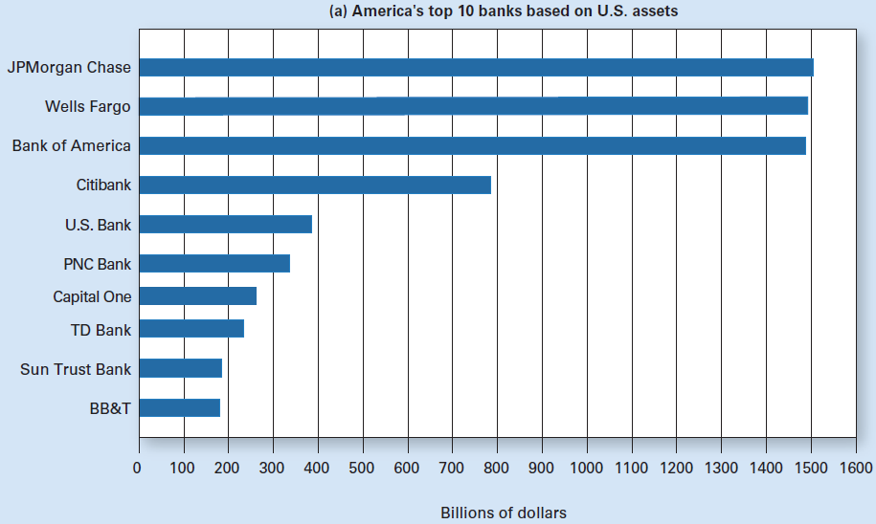
Exhibit 7 (a)
Top 10 Banks in America and the World

Slide 74
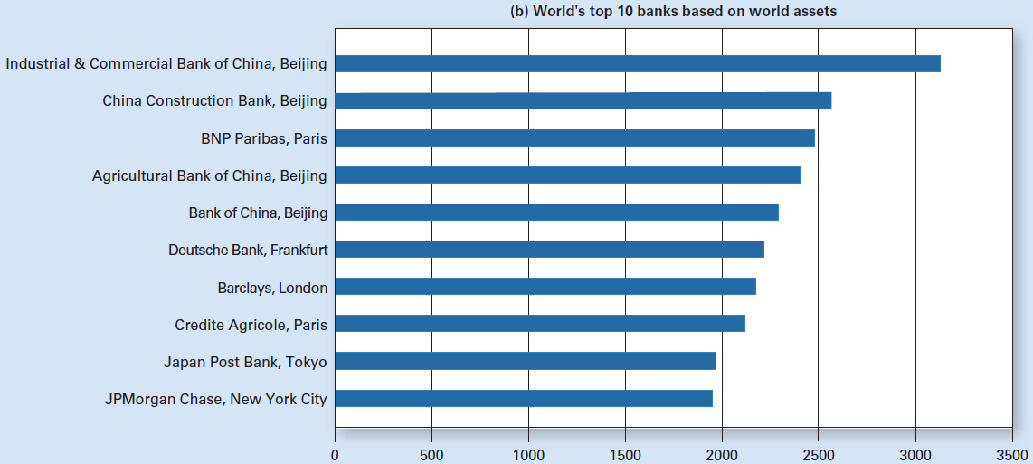
Exhibit 7 (b)
Top 10 Banks in America and the World

