Slide 1
15
Monetary Theory and Policy

Slide 2
Why do people maintain checking accounts and have cash in their pockets, purses, wallets, desk drawers, piggy banks, coffee cans—wherever?
In other words, why do people hold money?
How does the stock of money in the economy affect your ability to find a job, get a student loan, buy a car, or pay credit card bills?
What have economic theory and the historical record taught us about the relationship between the amount of money in the economy and other macroeconomic variables?

Slide 3
The Demand for Money
Demand for money
Relationship between the interest rate and how much money people want to hold
People demand money
To make purchases
Money
Carry out economic transactions
Easily and efficiently

Slide 4
The Demand for Money
More active economy
More goods and services exchanged
More money demanded
The higher the price level
Greater the demand for money
Money
Medium of exchange
Store of value: liquidity

Slide 5
The Demand for Money
Opportunity cost of holding money
Interest forgone
Quantity of money demanded
Inversely related to market interest rate
Money demand curve
Downward sloping
The lower the interest rate, the lower opportunity cost of holding money

Slide 6
Exhibit 1
Demand for Money
Interest rate
The money demand, D_{m}, slopes downward. As the interest rate falls, other things constant, so does the opportunity cost of holding money; the quantity of money demanded increases.
D_{m}
0
Quantity of money

Slide 7
The Supply of Money
Supply of money
The stock of money
Available in the economy
At a particular time
Determined by the Fed
Vertical line
Independent of interest rate

Slide 8
Equilibrium Interest Rate
Equilibrium interest rate
Demand for money
Supply of money
Interest rates
Above equilibrium
Higher opportunity cost of holding money
Below equilibrium
Lower opportunity cost of holding money

Slide 9
Equilibrium Interest Rate
For a given money demand curve
An increase in the money supply
Drives down the interest rate
A decrease in the money supply
Drives up the interest rate

Slide 10
Exhibit 2
Effect of an Increase in the Money Supply
Interest
rate
S_{m}
S′_{m}
i
a
i′
b
D_{m}
0
Quantity of
money
M
M′
Because the money supply is determined by the Federal Reserve, it can be represented by a vertical line. At point a, the intersection of the money supply, S_{m}, and the money demand, D_{m}, determines the market interest rate, i.
Following an increase in the money supply to S′_{m}, the quantity of money supplied exceeds the quantity demanded at the original interest rate, i. The new equilibrium occurs at point b.

Slide 11
Money and AD in the Short Run
Short run
Money affects the economy through changes in interest rate
The Fed
Wants to stimulate output and employment
By increasing the money supply
Open-market purchases

Slide 12
Money and AD in the Short Run
Open-market purchases
Money supply: increase
Interest rate: reduced
Investment: stimulated
Aggregate demand: increase
Real GDP: increase

Slide 13
Exhibit 3
Effects of an Increase in the Money Supply on Interest
Rates, Investment, and Aggregate Demand
(a) Supply and demand
for money
(b) Demand for
investment
(c) Aggregate demand
Interest rate
S_{m}
Interest rate
S′_{m}
Price level
a
a
i
i
b
b
b
P
i′
i′
a
AD’
D_{m}
D_{I}
AD
0
M
M′
Money
0
I
I′
Investment
0
Y
Y′
Real GDP
In panel (a), an increase in the money supply forces the interest rate down to i′.
With the cost of borrowing lower, the amount invested increases from I to I′, as shown in panel (b). This sets off the spending multiplier process, so the aggregate output demanded at price level P increases from Y to Y′.
The increase is shown by the shift of the aggregate demand curve to the right in panel (c).

Slide 14
Money and AD in the Short Run
If the Fed
Wants to cool down the economy
Decrease the money supply
Open-market sale
Money supply: decrease
Interest rate: increase
Investment: reduced
Aggregate demand: decrease
Real GDP: decrease

Slide 15
Adding the SRAS Curve
Aggregate supply curve in the short run (SRAS)
Slopes upward
The quantity supplied increases only if the price level increases
For a given shift of AD curve
The steeper the SRAS curve
The smaller the increase in real GDP
The larger the increase in the price level

Slide 16
Adding the SRAS Curve
Contractionary gap
Output < potential
Price level < expected
Real wages > negotiated
The Fed: expansionary monetary policy
Stimulate AD
Increase money supply
Equilibrium

Slide 17
Exhibit 4
Expansionary Monetary Policy to Close a Recessionary Gap
Potential output
LRAS
At point a, the economy is producing less than its potential in the short run, resulting in a recessionary gap of $0.2 trillion.
If the Federal Reserve increases the money supply by just the right amount, the aggregate demand curve shifts rightward from AD to AD’. A short-run and long-run equilibrium is established at point b, with the price level at 110 and output at the potential level of $17.0 trillion.
Price
level
SRAS₁₁₀
110
b
a
105
AD′
AD
0
16.8
17.0
Real GDP
(trillions of dollars)
Recessionary gap

Slide 18
Recent History: the Federal Funds Rate
December 16, 2008
FOMC: lower federal funds rate to between 0 and 0.25%
The 10th reduction in 15 months
Kept it close to 0% for the next seven years
FOMC authorized the New York Fed to make open-market purchases
Increase bank reserves
Until the federal funds rate fell to the target level

Slide 19
Recent History: the Federal Funds Rate
The Fed’s focus on the federal funds rate
By changing bank reserves through open-market operations
Direct lever on the federal funds rate
Benchmark for determining other short-term interest rates in the economy
Affects monetary and financial conditions
Employment, aggregate output, price level
Promote price stability and maximum employment

Slide 20
Recent History: the Federal Funds Rate
1999; 4.75 % to 6.5%
Robust economic growth - higher inflation
2001 – mid 2003; 6.5% to 1.0%
Waning consumer confidence
Weaker capital spending
9/11 terrorist attacks
Most concentrated monetary stimulus ever
1.0% for a year

Slide 21
Recent History: the Federal Funds Rate
June 2004 - June 2006
1.0% to 5.25% in 17 steps
Inflationary pressure
June 2006 – September 2007
5.25% for more than a year
September 2007
First in a series of federal funds rate cuts
Troubles in the housing sector
Rising mortgage default rate

Slide 22
Recent History: the Federal Funds Rate
December 2008
Between 0 and 0.25%
10 cuts in over 15 months
Remained at a record low for seven years
Another policy tool
That the Fed relied upon more after 2008
Is the way it communicates with the public
Particularly its intentions about future policy

Slide 23
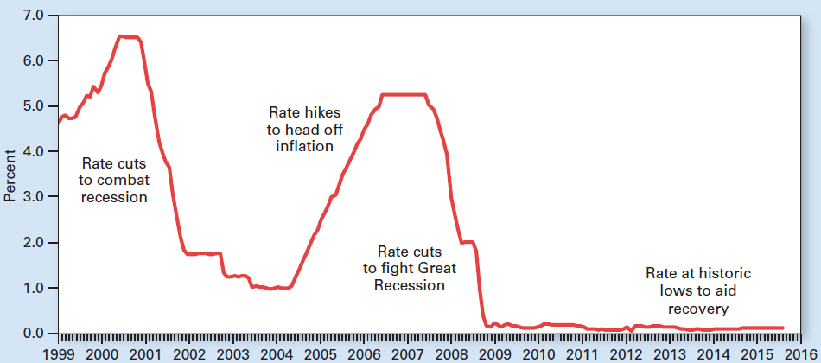
Exhibit 5
Recent Ups and Downs in the Federal Funds Rate
Since the early 1990s, the Fed has pursued monetary policy primarily through changes in the federal funds rate, the rate that banks charge one another for borrowing and lending excess reserves overnight.

Slide 24
Greater Fed Transparency as a Policy Tool
Decades ago, the Fed was a black box
FOMC would meet regularly
Release a cryptic statement about what they were up to
The Fed’s intentions were purposely vague
Fed statements and testimony
Often designed to obscure more than to reveal

Slide 25
Greater Fed Transparency as a Policy Tool
1990s
The Fed began to signal its intentions more clearly
1995, FOMC started issuing a brief statement after each meeting
Target for the federal funds rate
Since 2000, FOMC
Future increase, decrease, or leave the rate unchanged

Slide 26
Greater Fed Transparency as a Policy Tool
2005, FOMC
Provides Minutes three weeks after meeting
April 2011, Fed Chairman Ben Bernanke
Began holding press conferences after about half of the FOMC meetings
This practice continued with Chairwoman Janet Yellen, 2014
August 2011, the FOMC
Began projecting just how long it expected to keep its federal funds rate so low

Slide 27
Greater Fed Transparency as a Policy Tool
The Fed also communicates its intentions:
The chairman testifies before Congress several times a year
All Fed governors and all district bank presidents give speeches and interviews many times a year
Several times a year, each Fed governor and district president offers a three-year forecast of inflation, unemployment, and real GDP

Slide 28
Money and AD in the Long Run
Equation of exchange
Buyer: exchanges money for goods
Seller: exchanges goods for money
M – quantity of money in economy
V – velocity of money
P – average price level
Y – real GDP

Slide 29
Money and AD in the Long Run
Quantity theory of money
If V is stable (predictable)
Equation of exchange
Predicts effects of
Changes in money supply
On Nominal GDP, P ˣ Y
Long-run, stable velocity
An increase in money supply
Higher prices

Slide 30
Exhibit 6
In the Long Run, an Increase in the Money Supply Results
in a Higher Price Level, or Inflation
Potential output
LRAS
The quantity theory of money predicts that if velocity is stable, then an increase in the money supply in the long run results in a higher price level, or inflation. Because the long-run aggregate supply curve is fixed, increases in the money supply affect only the price level, not real output.
Price level
120
b
110
a
AD′
AD
0
17.0
Real GDP
(trillions of dollars)

Slide 31
Money and AD in the Long Run
Velocity depends on
Customs and convention of commerce
Innovations facilitate exchange
Higher velocity
Frequency
The more often workers get paid, the higher the velocity
Stability (store of value)
The better store of value, the lower the velocity

Slide 32
Money and AD in the Long Run
Velocity
M1 velocity: bouncy
M2 velocity: more stable
The Fed, since 1993
Equation of exchange
Rough guide linking changes in the money supply to inflation in the long run

Slide 33
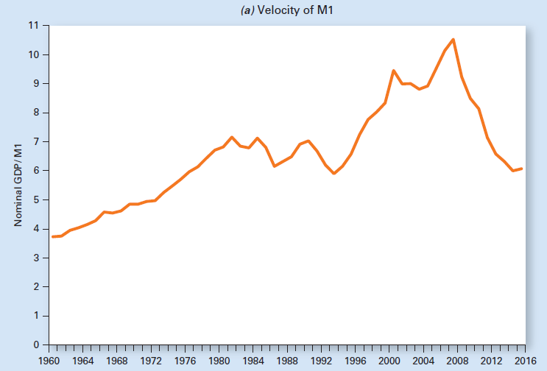
Exhibit 7 (a)
The Velocity of Money
M1 velocity fluctuated so much during the 1980s that M1 growth was abandoned as a short-run policy target.

Slide 34
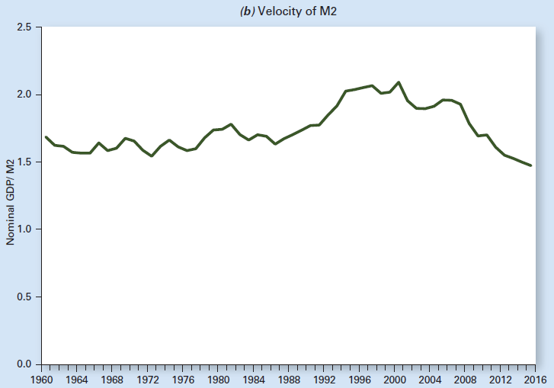
Exhibit 7 (b)
The Velocity of Money
M2 velocity appears more stable than M1 velocity, but both are now considered by the Fed as too unpredictable for short-run policy use.

Slide 35
Targets for Monetary Policy
Short-run: Interest rate
Long-run: Price level
Money market: equilibrium
Increase money demand curve
The Fed – target money supply: Does nothing, increase interest rate
The Fed – target interest rate: increase money supply

Slide 36
Exhibit 8
Targeting Interest Rates Versus Targeting the Money Supply
S_{m}
S′_{m}
An increase in the price level or in real GDP, with velocity stable, shifts rightward the money demand curve from D_{m} to D′_{m}.
If the Federal Reserve holds the money supply at Sm, the interest rate rises from i (at point e) to i′ (at point e′).
Alternatively, the Fed could hold the interest rate constant by increasing the money supply to S′_{m}. The Fed may choose any point along the money demand curve D′_{m}.
i′
e′
Interest rate
e
i
e″
D′_{m}
D_{m}
0
M
M′
Quantity of money

Slide 37
Targets for Monetary Policy
Targets before 1982
Stabilize interest rates
October 1979: target money aggregates
Volatile interest rates
Sharp reduction in money growth, 1981
Recession, 1982
Declining inflation
Rising unemployment

Slide 38
Targets for Monetary Policy
Targets after 1982
Financial innovations
Deregulation
Not a target: money aggregates to guide policy in the short run
In the long run, changes in the money supply influence the price level and inflation
Target: federal funds rate

Slide 39
Other Fed Responses to Financial Crisis
Bailing out AIG
Spreading global financial crisis
AIG - interconnected with other financial entities
Regulators believed they could not risk another bankruptcy
$182.5 billion package from the Fed and the U.S. Treasury

Slide 40
Other Fed Responses to Financial Crisis
Bailing out AIG
The Fed purchased some of AIG’s troubled assets, taking them off AIG’s balance sheet
The Fed and the Treasury also lent AIG enough money to keep the company running
AIG survived
By June 2012 it had paid back the Fed with interest

Slide 41
Other Fed Responses to Financial Crisis
Bailing out AIG
Critics: AIG and some other large financial institutions should not have been bailed out
Because they helped cause the crisis
Chairman Bernanke: the Fed tried to protect U.S. workers and consumers
Groups that would have been hurt the most by a collapse of the financial system

Slide 42
Other Fed Responses to Financial Crisis
Chairman Bernanke: the Fed’s investments that seemed like bailouts
Actually paid off well enough
The Fed sent $80 billion in “profit” to the U.S. Treasury in 2010
And $77 billion in 2011, record amounts at the time
A share of AIG stock
$1,400 before the financial crisis
$10 by early 2009

Slide 43
Other Fed Responses to Financial Crisis
Reducing the risk of “Too big to fail”
The Fed and other regulators
Tougher supervisory oversight
Greater capital requirements,
The Fed: helped conduct a stress test
The 19 largest banks
To determine which ones needed additional financial capital to weather a bad economy

Slide 44
Other Fed Responses to Financial Crisis
Reducing the risk of “Too big to fail”
The Dodd-Frank Act: gave the Fed and the FDIC expanded oversight of large financial institutions
Especially the shadow banking system
Not depository institutions
Mortgage companies, insurance companies, brokerage firms, money market mutual funds, hedge funds

Slide 45
Other Fed Responses to Financial Crisis
Reducing the risk of “Too big to fail”
Objective of regulations: to reduce the probability that a large financial institution will collapse
But if one of these financial giants should get into serious trouble
Let it fail through an orderly liquidation of the firm’s assets

Slide 46
Other Fed Responses to Financial Crisis
Reducing the risk of “Too big to fail”
The Fed and the FDIC have set out rules for so-called living wills
Requiring each large financial institution,
To prepare a blueprint for how it should be taken apart in the event of bankruptcy

Slide 47
Other Fed Responses to Financial Crisis
Quantitative easing
Feds purchase of long-term assets
Government bonds
Mortgage-backed securities
To:
Stabilize financial markets
Reduce long-term interest rates
Improve the investment environment

Slide 48
Other Fed Responses to Financial Crisis
Quantitative easing
Aggressive purchases since late 2008: the Fed added over $3 trillion in assets to its balance sheet
Directly lowered long-term interest rates
Indirectly raised bank reserves: $2.5 trillion
Possible only if the central bank controls the money supply

Slide 49
Other Fed Responses to Financial Crisis
Risks of quantitative easing
The Fed could lose money on its purchases if these assets are sold back for less
How much quantitative easing is too much?
Unconventional tool and not well tested
Too much money creation could trigger inflation

Slide 50
What about Inflation?
The Fed’s twin statutory mandates
Price stability
Maximum employment
Price stability; target 2%
Why not zero percent? Risk of deflation
Maximum employment; target unemployment rate 5.0 – 5.2%
Why not lower? Risk of higher inflation

Slide 51
What about Inflation?
Asset purchases by the Fed
From about $0.9 trillion, before the financial crisis; summer 2007
To about $4.5 trillion; summer of 2015
Major source: quantitative easing
No increase in inflation
Most of the funds that the Fed created to buy these assets became idle bank reserves on account with the Fed

Slide 52
What about Inflation?
Banks were lending less because
The demand for loans was down
Lending standards had tightened
Banks were earning interest on their deposits at the Fed
The financial crisis made banks more wary of lending
Summer of 2015
$2.6 trillion on deposit with the Fed
From just $13 billion in the summer of 2007

Slide 53
What about Inflation?
2007 – 2015
M1 increased by 117%
Real GDP grew by a total of only 11%
Lower interest rate: people held more cash
Velocity of M1 slowed down considerably
From 10.5 in 2007 to 6.1 in 2015

Slide 54
What about Inflation?
Future Fed actions
Once the recovery picks up speed: the Fed will begin selling assets to reduce bank reserves
Once banks tap their huge reserves to make loans, the money supply will grow quickly

Slide 55
International Considerations
Mexico, financial difficulties1982, 1994
The Fed: helped arranged loans to prevent a financial crisis
1998, defaults on Russian bonds
Worldwide financial panic
The Fed: lower federal funds rate
To supply more liquidity here and abroad

Slide 56
International Considerations
2007-2009, world-wide shortage of credit
Caused by mortgage defaults in the United States
The Fed: supply additional liquidity to the banking system
To ensure the orderly functioning of financial markets

Slide 57
International Considerations
Central banks around the world
Begun coordinating their activities
Particularly during economic turmoil
October 2008, during the global financial crisis
Six major central banks reduced interest rates to restore financial stability to world markets
Chairman Bernanke: frequent contact with other central bankers

