Slide 1
18
International Finance

Slide 2
Why does a Big Mac cost four times more in Switzerland than in India?
How can the United States export more than nearly any other country yet still have the world’s highest trade deficit?
Are high trade deficits a worry?
What’s the official “fudge factor” used in estimating the balance of payments?
What’s meant by a “strong dollar”?
Why does a nation try to influence the exchange value of its currency?

Slide 3
Balance of Payments
International economic transactions
Flow of transactions per period of time
May involve more than cash payments
Double-entry bookkeeping
Credits: inflow of receipts from the rest of the world
Debits: outflow of payments to the rest of the world
Several individual accounts

Slide 4
Merchandise Trade Balance
Merchandise trade balance
‘Trade balance’
Reflects trade in goods
Value of merchandise exports minus the value of merchandise imports
Credits: value of U.S. merchandise exports
Debits: value of U.S. merchandise imports

Slide 5
Merchandise Trade Balance
Trade balance is in surplus
If merchandise exports exceed merchandise imports
Trade balance is in deficit
If merchandise imports exceed merchandise exports

Slide 6
Merchandise Trade Balance
Merchandise trade balance, reported monthly
Influences foreign exchange markets, the stock market, and other financial markets
Depends on a variety of factors
Relative strength and competitiveness of the domestic economy compared with other economies
Relative value of the domestic currency compared with other currencies

Slide 7
Merchandise Trade Balance
Trade deficits as a percentage of GDP
1991, 1.3%
2006, 6.3%
2009, 3.6%
2014, 4.2% ($735.8 billion)
$343 billion trade deficit with China

Slide 8
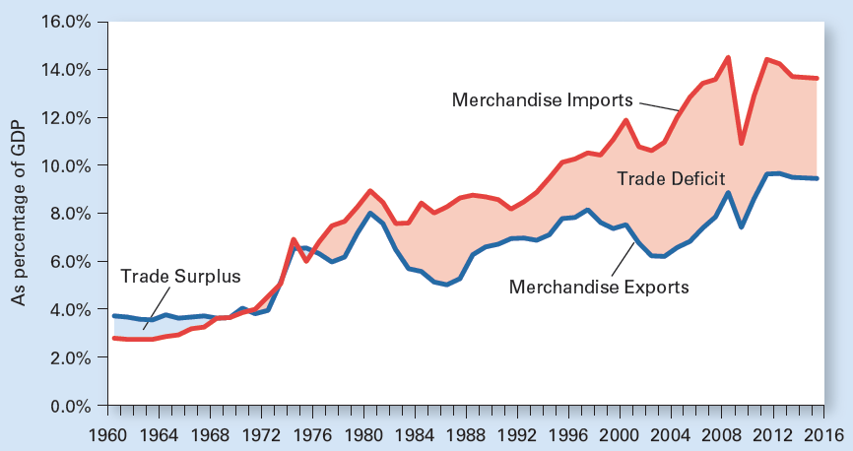
Exhibit 1
U.S. Imports Have Topped Exports Since 1976, but Both Dropped During the Great Recession
Note that since 1980, merchandise exports have remained in the range of about 5 percent to 10 percent of GDP. But merchandise imports have trended up from about 9 percent in 1980 to about 15 percent in 2008, before dropping off to 11 percent in 2009, the year following the financial crisis. Imports were back up to about 14 percent relative to GDP by 2011 and have remained there.

Slide 9
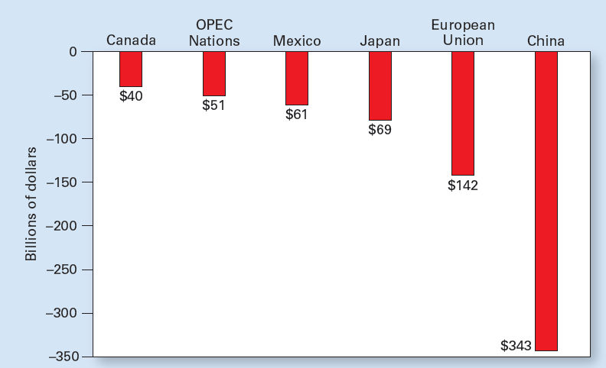
Exhibit 2
U.S. Merchandise Trade Deficits in 2014 by Country or Region
The United States imports more goods from each of the world’s major economies than it exports to them. The largest U.S. trade deficit is with China, which sold nearly four times more to the United States in 2014 than it bought from the United States.

Slide 10
Balance on Goods and Services
Balance on goods and services
Portion of a country’s balance-of-payments account
Measures the value of a country’s exports of goods and services minus the value of its imports of goods and services
Net exports

Slide 11
Balance on Goods and Services
The value of U.S. service exports
Credit in U.S. balance-of-payments
The value of U.S. service imports
Debit in U.S. balance-of-payments
2014, $231.1billion surplus in the services account
U.S. exports more services than it imports
Services have been in surplus for the last three decades

Slide 12
Balance on Goods and Services
Net exports of goods and services
Have been in deficit for decades
Deficits in the merchandise trade account dominated surpluses in the services account
U.S. goods-and-services deficit was $504.7 billion in 2014

Slide 13
Net Investment Income
Net investment income from abroad
Investment earnings by U.S. residents from their foreign assets (Credit)
Minus investment earnings by foreigners from their assets in the U.S. (Debit)
$217.9 billion net investment income from foreign holdings, 2014

Slide 14
Unilateral Transfers
Unilateral transfers
Money sent abroad
Government transfers to foreign residents
Foreign aid
Money sent to families abroad
Personal gifts sent abroad
Contributions of foreign charities
Debit in the balance of payments

Slide 15
Unilateral Transfers
Net unilateral transfers abroad
Unilateral transfers received from abroad by U.S. residents
Minus the unilateral transfers U.S. residents send abroad
2014, negative $123.8 billion
About $1,000 per U.S. household

Slide 16
Unilateral Transfers
Balance on current account
The portion of the balance-of-payments account
That measures that country’s
Balance on goods and services
Net investment income from abroad
Plus net unilateral transfers abroad
2014, the current account deficit was $410.6 billion

Slide 17
The Financial Account
Financial account
International purchases or sales of assets
Financial assets: stocks, bonds, bank balances
Real assets: land, housing, factories, and other physical assets
Deficit, 1917-1982
U.S. residents purchased more foreign assets than foreigners purchased U.S. assets

Slide 18
The Financial Account
Surplus since 1983
Foreigners bought more U.S. assets than U.S. residents purchased abroad
Foreign purchases of assets in the U.S. add to America’s productive capacity, promote employment and labor productivity here
But any income from these assets flows to their foreign owners
$141.6 billion in 2014

Slide 19
Trade Deficits and Surpluses
Credits on balance of payments (+)
Transactions requiring payments from foreigners to U.S. residents
Debits on balance of payments (-)
Transactions requiring payments to foreigners from U.S. residents
Statistical discrepancy
“Fudge factor”

Slide 20
Trade Deficits and Surpluses
Foreign exchange
Currency of another country needed to carry out international transactions
Current account deficit
Foreign exchange received
From exports, foreign assets, unilateral transfers
Falls short of the amount needed to pay
For imports, foreign holders of U.S. assets, and unilateral transfers

Slide 21
Trade Deficits and Surpluses
Current account deficit
Needs net inflow in the financial account
Borrowing from foreigners
Selling domestic stocks and bonds to foreigners
Selling real assets to foreigners

Slide 22
Trade Deficits and Surpluses
Current account surplus
Foreign exchange received
From exports, foreign assets, and unilateral transfers from abroad
Exceeds the amount needed to pay
For imports, foreign holders of U.S. assets, and unilateral transfers abroad
Net outflow in the financial account
Lending abroad, buying foreign stocks and bonds, buying real foreign assets

Slide 23
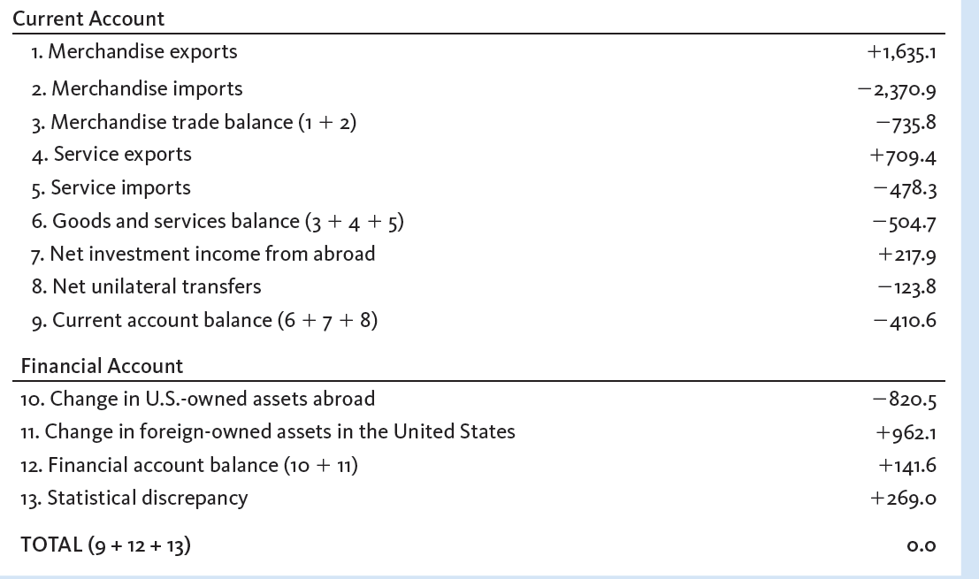
Exhibit 3
U.S. Balance of Payments for 2014 (billions of dollars)

Slide 24
Foreign Exchange Rates and Markets
Foreign exchange
Foreign money
To carry out international transactions
Exchange rate
Price (measured in one country's currency) of buying one unit of another country’s currency
Determined on foreign exchange market

Slide 25
Foreign Exchange Rates and Markets
Foreign exchange market
Buy and sell foreign exchange
Exchange rate of Euro
Number of dollars to purchase one euro
Determined by demand and supply
Dollar depreciation; weakening
Increase in number of dollars for one euro
Dollar appreciation; strengthening
Decrease in number of dollars for one euro

Slide 26
Demand for Foreign Exchange
Demand curve
Inverse relationship
Dollar price of euro
Quantity of euros demanded
Assumed constant
Income; preferences (US consumers)
Expected inflation (US and euro area)
Price of goods (euro area)
Interest rates (US and euro area)

Slide 27
Supply of Foreign Exchange
Supply curve
Positive relationship
Dollar price of euro
Quantity of euros supplied
Assumed constant
Income, taxes (euro area)
Expected inflation (euro area and US)
Interest rates (euro area and US)

Slide 28
Exhibit 4
The Foreign Exchange Market
The fewer dollars needed to purchase one unit of foreign exchange, the lower the price of foreign goods and the greater the quantity of foreign goods demanded. Thus, the demand curve for foreign exchange slopes downward.
An increase in the exchange rate makes U.S. products cheaper for foreigners. This implies an increase in the quantity of foreign exchange supplied. The supply curve of foreign exchange slopes upward.
S
$1.15
Exchange rate (dollars per euro)
1.10
1.05
D
0
800
Foreign exchange (billions of euros per day)

Slide 29
Determining the Exchange Rate
Equilibrium exchange rate
Demand intersect the supply
Floating exchange rate
Adjust freely
Increase in demand for foreign exchange
Increase of equilibrium exchange rate
Euro increases in value (appreciates)
Dollar falls in value (depreciates)

Slide 30
Exhibit 5
Effect on the Foreign Exchange Market of an Increased
Demand for Euros
The intersection of the demand curve for foreign exchange, D, and the supply curve for foreign exchange, S, determines the exchange rate.
At an exchange rate of $1.10 per euro, the quantity of euros demanded equals the quantity supplied.
An increase in the demand for euros from D to D’ increases the exchange rate from $1.10 to $1.12 per euro.
Exchange rate
(dollars per euro)
S
1.12
1.10
D′
D
0
800
820
Foreign exchange (billions of euros per day)

Slide 31
Arbitrageurs and Speculators
Arbitrageurs
Dealers who take advantage of any tiny difference in exchange rates across markets
By buying low and selling high
Ensure equality of exchange rates on different markets
Little risk involved

Slide 32
Arbitrageurs and Speculators
Speculators
Buy or sell foreign exchange in hopes of profiting
By trading the currency at a more favorable exchange rate later
Take risks, to profit from market fluctuations
Try to buy low and sell high

Slide 33
Purchasing Power Parity
The purchasing power parity (PPP) theory
Predicts that the exchange rate between two currencies
Will adjust in the long run
To equalize the cost across countries of an internationally traded basket of goods
As long as trade across borders is unrestricted
And as long as exchange rates are allowed to adjust freely

Slide 34
Purchasing Power Parity
The purchasing power parity (PPP) theory
A given basket of internationally traded goods
Should sell for about the same around the world (except for differences reflecting transportation costs and the like)
Does not explain exchange rates at a particular point in time
Trade barriers; Central bank intervention
Products not traded; Product differentiation

Slide 35
The Big Mac Index
Market basket: one McDonald’s Big Mac
Price in local currency
Convert to $: exchange rate
Overvalued currencies
The Swiss franc, 57% above U.S. price
Undervalued currencies
The Russian rupee, 72% below U.S. price
Differences
Rent, taxes, trade barriers, wages

Slide 36
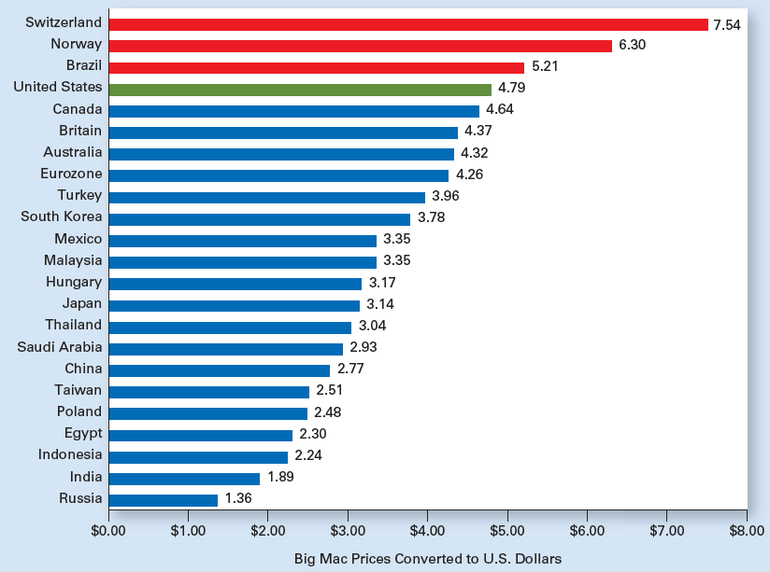
Exhibit 6
In January 2015, a Big Mac Cost More in the United States Than in Most Other Countries

Slide 37
Flexible Exchange Rates
Floating/flexible exchange rates
Determined by demand and supply in foreign exchange markets
Balance of payment accounts
Current or financial accounts
Debit entries: increase D for foreign exchange, and $ depreciation
Credit entries: increase S of foreign exchange, and $ appreciation

Slide 38
Fixed Exchange Rates
Fixed exchange rate
Rate of exchange between currencies
Pegged within a narrow range
Maintained by the central bank’s ongoing purchases and sales of currencies

Slide 39
Fixed Exchange Rates
Central Bank: If euro was fixed in dollars
Sell euros, buy dollars to keep euro’s value down
Sell dollars, buy euros to keep euro’s value up
Increase pegged exchange rate
Devaluation
Decrease pegged exchange rate
Revaluation

Slide 40
Fixed Exchange Rates
Eliminate exchange rate disequilibrium
Change the pegged exchange rate
Restriction on imports or on financial outflows
Policies to slow the economy, increase interest rates, or reduce inflation
Foreign exchange control

Slide 41
International Monetary System
1879 – 1914: Gold Standard
Currencies convert into gold at fixed rate
Collapsed during WWI
1944: Bretton Woods Agreement
Exchange rates: fixed in terms of dollars
Dollar standard
Fixed rate: dollars exchanged for gold
Created the International Monetary Fund, IMF

Slide 42
International Monetary System
Late 1960s: U.S. inflation
Overvalued dollar
1971
US merchandise imports exceeded merchandise exports
Gold outflow
Washington meeting: $ devalued 8%
1972
US trade deficit: tripled

Slide 43
International Monetary System
1973
$ devalued 10%
Dollars exchanged for German marks
Bretton Woods system collapsed
Current system: Managed float
Freely floating exchange rate with sporadic intervention by central banks
The ideal system
Foster international trade, lower inflation, and promote a more stable world economy

