Slide 1
6
Tracking the U.S. Economy

Slide 2
How do we track one of the most complex economies in world history?
What’s gross about the gross domestic product?
What’s domestic about it?
If you make yourself a tuna sandwich, how much does your effort add to the gross domestic product?
Because prices change over time, how can we compare the economy’s production in one year with that in other years?

Slide 3
The Product of a Nation
17th and 18th century: Mercantilism
Belief that economic prosperity: stock of precious metals in public treasury
Restrictions on international trade
Reduced gains from comparative advantage
1758, François Quesnay
Circular flow of output and income through different sectors of the economy
National income accounting system

Slide 4
National Income Accounts
GDP, gross domestic product
Market value
All final goods and services
Produced during a year
By resources located in US
One person’s spending
Is another person’s income

Slide 5
National Income Accounts
Expenditure approach to GDP
Spending on all final goods and services
Produced in the nation
Within the year
Income approach to GDP
Earnings by those who produce all output
In the nation
During the year

Slide 6
National Income Accounts
Final goods and services
Sold to the final user
Intermediate goods and services
Purchased by firms for further processing and resale
Not included in GDP to avoid double counting
Counting the same production more than once

Slide 7
GDP: Expenditure Approach
Consumption, C
Household purchases of final goods and services
Except for new residences (that’s investment)
Personal consumption expenditures
Services, nondurable goods, durable goods
Averaged 68% of GDP during this past decade

Slide 8
GDP: Expenditure Approach
Investment, I
Gross private domestic investment
New construction
New capital goods
New software
Net additions to inventories
Averaged 16% of GDP during this past decade

Slide 9
GDP: Expenditure Approach
Physical capital
Manufactured items used to produce goods and services
New plants, new equipment
Residential construction
Building new homes or dwelling places
Net changes in inventories
Producers’ stocks of finished and in-process goods

Slide 10
GDP: Expenditure Approach
Government purchases, G
Government consumption and gross investment
Spending for goods and services
By all levels of government
Excludes transfer payments
Government outlays minus transfer payments
Averaged 20% of GDP during this past decade

Slide 11
GDP: Expenditure Approach
Net exports, X - M
Exports (X) minus imports (M)
Physical items
And services (so called, invisibles)
Negative since the 1960s
U.S. Imports > U.S. Exports
Averaged negative 4% of GDP for the last decade
C+I+G+(X-M)=Aggregate expenditure=GDP

Slide 12
GDP: Expenditure Approach
Aggregate expenditure
Total spending on final goods and services in an economy
During a given period, usually a year
The sum of consumption, investment, government purchases, and net exports
C+I+G+(X-M)=Aggregate expenditure=GDP

Slide 13
Composition of Aggregate Expenditure
Consumption, C
Relatively stable from year to year
Long term trend: increase as share of GDP
From and average of 62% during the 1960s
To an average of 68% during the most recent decade
Investment, I
Fluctuates more than consumption from year to year
No long term trend up or down

Slide 14
Composition of Aggregate Expenditure
Government purchase, G
Long-term trend: declined from 22% of GDP in the 1960s to 20% of GDP during the most recent decade
Mostly because of decrease in defense spending since 1960s
Not included: transfer payments (increased)
Net exports, X-M
Averaged negative 4% during last decade, as imports (M) exceeded exports (X)

Slide 15
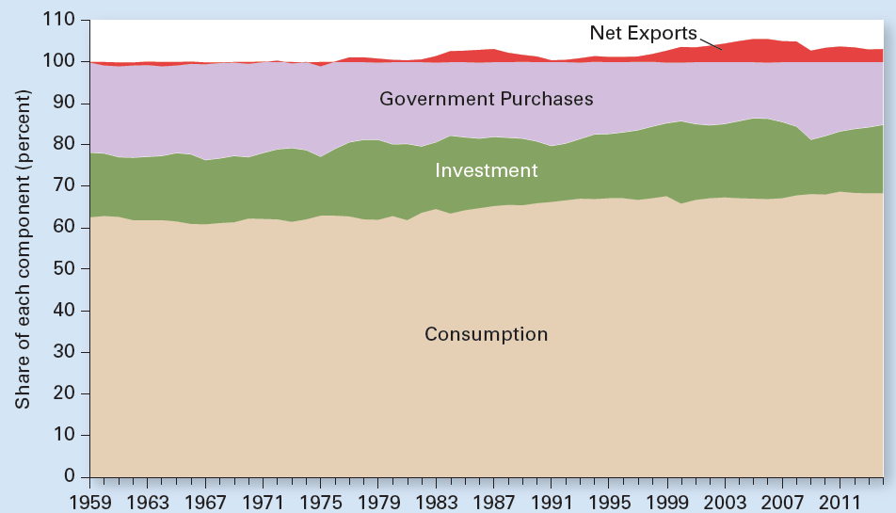
Exhibit 1
U.S. Spending Components as Percent of GDP Since 1959
The composition of U.S. GDP has not changed that much since 1959. Consumption’s share edged up from an average of 62 percent during the 1960s to 68 percent during the most recent decade. Investment has fluctuated from year to year but with no clear long-term trend up or down. Government purchases declined slightly from an average of 22 percent of GDP during the 1960s to an average of 20 percent in the most recent decade. And net exports have become more negative, expressed in red by that portion exceeding 100 percent of GDP.

Slide 16
GDP: Income Approach
Aggregate income
All earnings of resource suppliers in an economy
During a given period, usually a year
Wages
Interest
Rent
Profit
Aggregate expenditure = GDP = Aggregate income

Slide 17
GDP: Income Approach
Value added at each stage of production
Selling price of a product
Minus the cost of intermediate goods purchased from other firms
Income earned by resource suppliers at that stage

Slide 18
Exhibit 2
Computing Value Added for a New Desk
The value added at each stage of production is the sale price at that stage minus the cost of intermediate goods, or column (1) minus column (2). The values added at each stage sum to the market value of the final good, shown at the bottom of column (3).

Slide 19
Circular Flow of Income and Expenditure
Circular flow
Of income and spending in the economy
For household, firms, government, and the rest of the world
Assumptions
Capital doesn’t wear out
Firms pay out all profits to firm owners
We can say
GDP = aggregate income

Slide 20
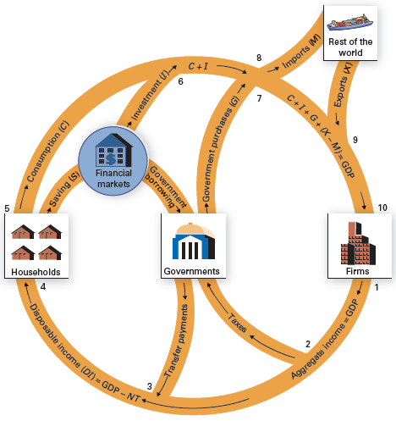
Exhibit 3
Circular Flow of Income and Expenditure
The circular-flow model captures important relationships in the economy. The bottom half depicts the income arising from production. At juncture (1), GDP equals aggregate income. Taxes leak from the flow at (2), but transfer payments enter the flow at (3). Taxes minus transfers equals net taxes, NT. Aggregate income minus net taxes equals disposable income, DI, which flows to households at juncture (4). The top half of the model shows the flow of expenditure. At (5), households either spend disposable income or save it. Consumption enters the spending flow directly. Saving leaks from the spending flow into financial markets, where it is channeled to borrowers. At (6), investment enters the spending flow. At (7), government purchases enter the spending flow. At (8), imports leak from the spending flow, and at (9), exports enter the spending flow. Consumption plus investment plus government purchases plus net exports add up to the aggregate expenditure on GDP received by firms at (10).

Slide 21
Circular Flow of Income and Expenditure
Income flow
Income arising from production
GDP = Aggregate income
Net taxes, NT = Taxes - Transfer payments
Disposable income, DI = GDP - NT
GDP = DI + NT

Slide 22
Circular Flow of Income and Expenditure
Disposable income (DI)
Income households have available to spend or to save
After paying taxes and receiving transfer payments
Net taxes (NT)
Taxes minus transfer payments
Any unsold production
Gets added to inventories

Slide 23
Circular Flow of Income and Expenditure
Expenditure flow
DI = C + S
Consumption, C
Savings, S, to financial markets
Investment, I (borrowed)
Firms – new capital purchases
Households – residential construction
Government spending, G
Net exports = X – M

Slide 24
Circular Flow of Income and Expenditure
Government outlays
Transfer payments plus purchases of goods and services
If they exceed government revenue: deficit (must borrow)
C+I+G+(X-M) = Aggregate Expenditure = GDP
Financial markets
Banks and other financial institutions
Facilitate the flow of funds from savers to borrowers

Slide 25
Leakages Equal Injections
C+I+G+(X-M)=DI+NT
C+I+G+(X-M)=C+S+NT
I+G+X=S+NT+M
Injections
I, G, X
Leakages
S, NT, M
NT = net taxes = taxes – transfer payments

Slide 26
Leakages Equal Injections
Injection
Any spending other than by households
Any income other than from resource earnings
Investment, government purchases, exports, and transfer payments
Leakage
Any diversion of income from the domestic spending stream
Saving, taxes, and imports

Slide 27
Limitations of National Income Accounting
Some production is not counted in GDP
Do-it-yourself production
Underground economy
Underground economy
Market transactions that go unreported
Illegal
People involved want to evade taxes
About 15% of GDP
$2.7 trillion in 2015

Slide 28
Limitations of National Income Accounting
GDP includes some economic production that does not involve market exchange
Imputed rental income from home ownership
Imputed dollar amount for wages paid in kind
Imputed dollar amount for food produced by a farm family for its own consumption

Slide 29
Limitations of National Income Accounting
Leisure, quality, and variety
More leisure
Higher quality products
Greater variety of products
Not captured in GDP
Net domestic product
GDP minus depreciation
Net investment = I – depreciation

Slide 30
Limitations of National Income Accounting
Depreciation
Value of capital stock used up to produce GDP or that becomes obsolete during the year
GDP does not reflect all costs
Negative externalities
Air pollution, water pollution
Depletion of natural resources
Soil depletion, loss of other natural resources

Slide 31
Limitations of National Income Accounting
Green accounting, green GDP
Now being developed
By the U.S. Commerce Department
Trying to register the impact of production on air pollution, water pollution, soil depletion, and the loss of other natural resources
GDP is a number
No information about its composition
Best measure of the nation’s economic welfare?

Slide 32
Accounting for Price Changes
Nominal GDP
GDP based on prices prevailing at the time of production
Price index
A number that shows the average price of products
In base period = 100
= (Price in current year / Price in base year)*100

Slide 33
Accounting for Price Changes
Changes in a price index over time
Show changes in the economy’s average price level
Consumer price index, or CPI
Measure of inflation
Based on the cost of a fixed market basket of goods and services

Slide 34
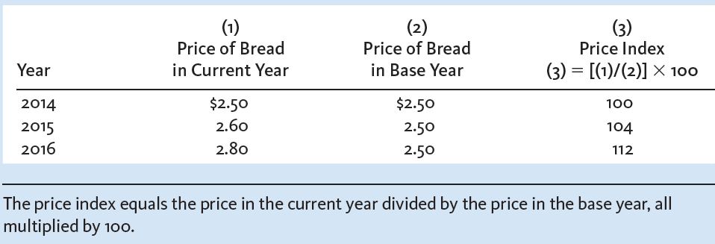
Exhibit 4
Hypothetical Example of a Price Index (base year=2014)

Slide 35
Accounting for Price Changes
Consumer price index, CPI
Market basket
= (Cost of basket in current year / Cost in base year)x100
Overstates inflation, more than 1 percentage point per year
Quality bias; Substitution
Discount stores
Widely used products

Slide 36
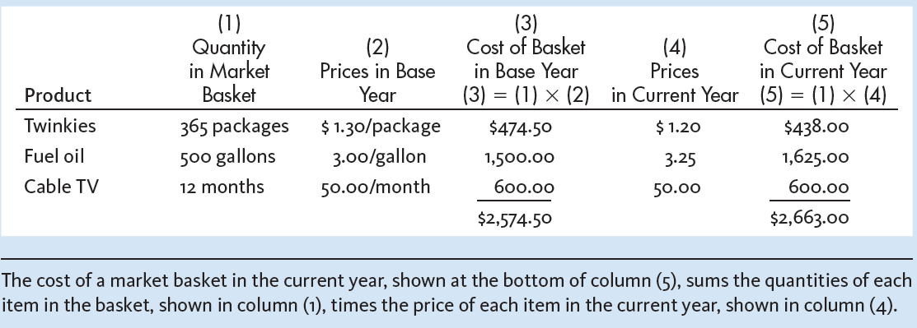
Exhibit 5
Hypothetical Market Basket Used to Develop the
Consumer Price Index

Slide 37
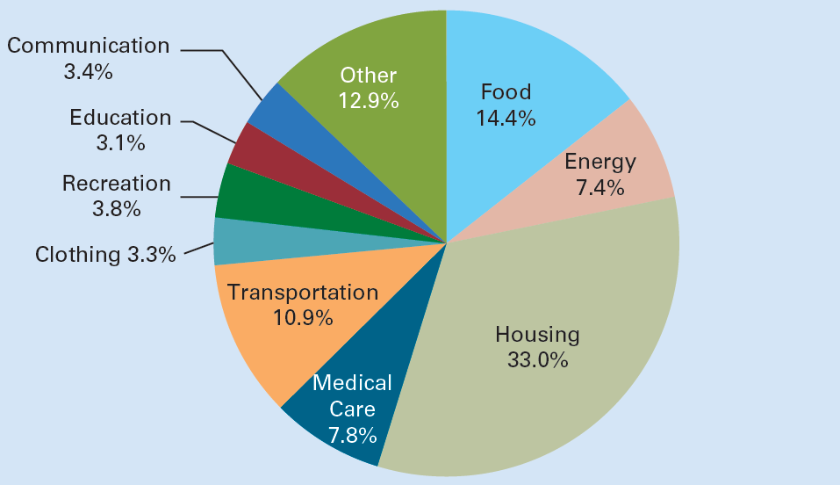
Exhibit 6
Relative Importance of Items in CPI Market Basket

Slide 38
Accounting for Price Changes
Overstating the CPI Affects
Changes in tax brackets
Changes in an array of payments
Wage agreements, Social Security benefits ($900 billion annually), welfare benefits, even alimony
About one-third of federal outlays are tied to changes in the CPI
Distorts other measures that use the CPI to adjust for inflation

Slide 39
Price Check on Aisle 2
BLS, each month:
400 data collectors visit stores
To record 85,000 prices
For 211 item categories in the CPI basket
Price adjustments
Some products are no longer on the market
Greatest challenge
Identify substitutes for products that are no longer available

Slide 40
Accounting for Price Changes
GDP price index
Comprehensive inflation measure
Of all goods and services included in GDP
= (Nominal GDP/Real GDP)*100
Before 1995
Fixed-weighted system; base year 1987
Chain-weighted system; base year 2009

Slide 41
Accounting for Price Changes
Chain-weighted system
An inflation measure
Adjusts the weights from year to year in calculating a price index
Thereby reducing the bias caused by a fixed-price weighting system

Slide 42
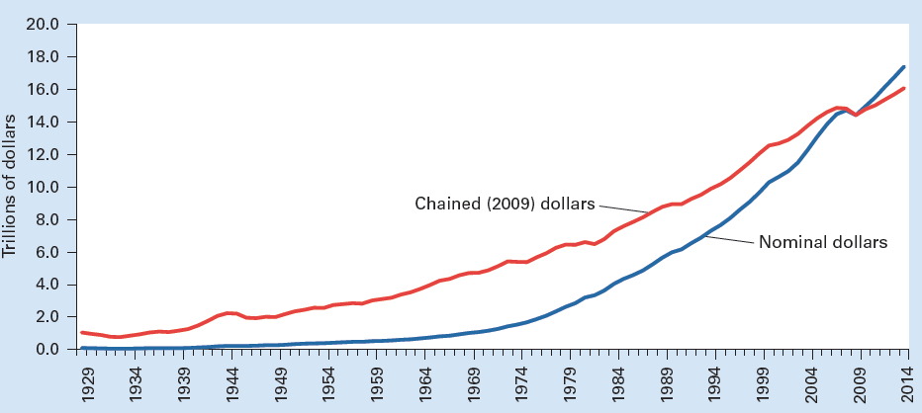
Exhibit 7
U.S. Gross Domestic Product in Nominal Dollars and Chained (2009) Dollars Since 1929
Real GDP, the red line, shows the value of output measured in chained (2009) dollars. The blue line measures GDP in nominal dollars of each year shown. The two lines intersect in 2009, when real GDP equaled nominal GDP. Year-to-year changes in nominal-dollar GDP reflect changes in both real GDP and in the price level. Year-to-year changes in chained-dollar GDP reflect changes in real GDP only. Nominal-dollar GDP grows faster than chained-dollar GDP. Prior to 2009, nominal-dollar prices are less than chained-dollar prices, so nominal-dollar GDP is less than chained-dollar GDP.

Slide 43
National Income Accounts
Gross national product, GNP
Market value
Of all final goods and services
Produced by resources supplied by U.S. residents and firms
Regardless where those resources are located
GNP
= GDP + net earnings of American resources abroad

Slide 44
National Income Accounts
Net earnings of American resources abroad
Income earned by American resources abroad
Minus income earned by resources in the United States owned by those outside the country

Slide 45
National Income Accounts
Net national product
= GNP minus Depreciation
National income
= Net national product + Any statistical discrepancy

Slide 46
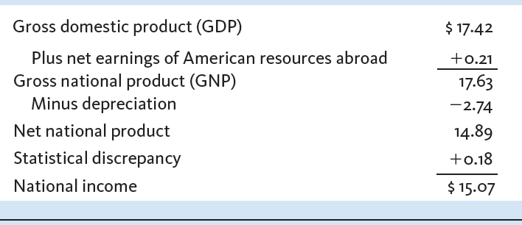
Exhibit 8
Deriving Net Domestic Product and National Income
in 2014 (trillions)

Slide 47
National Income Accounts
Personal income
National income
Plus income received but not earned
Minus income earned but not received
Income earned but not received
Employer’s share of Social Security taxes
Taxes on production
Net of subsidies
Corporate income taxes
Undistributed corporate profits

Slide 48
National Income Accounts
Income received but not earned
Government transfer payments
Receipts from private pension plans
Interest paid by government and by consumers
Disposable income
Personal income minus taxes
Spend or save

Slide 49
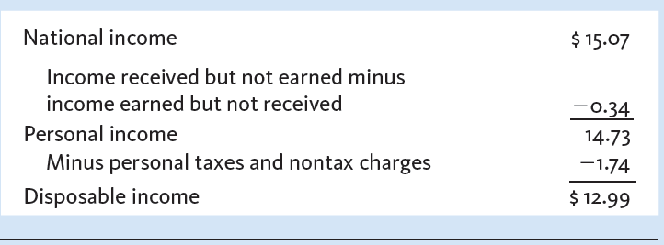
Exhibit 9
Deriving Personal Income and Disposable Income
in 2014 (trillions)

Slide 50
National Income Accounts
Summary income statement of the economy
Aggregate expenditure
Consumption
Gross investment
Government purchases
Net exports (negative)

Slide 51
National Income Accounts
Summary income statement of the economy
Aggregate income
Employee compensation
Proprietors’ income
Corporate profits
Net interest
Rental income of persons

Slide 52
National Income Accounts
Employee compensation
Money wages
Employer contributions
Social Security taxes, medical insurance, and other fringe benefits
Proprietors’ income
Earnings of unincorporated businesses

Slide 53
National Income Accounts
Corporate profits
Net revenues received by incorporated businesses
Before subtracting corporate income taxes
Net interest
Interest received by individuals
Excludes
Interest paid by consumers to businesses
Interest paid by government

Slide 54
National Income Accounts
Rental income of persons
Imputed rental value of owner-occupied housing
Minus the cost of owning that property
Property taxes, insurance, depreciation
Interest paid on the mortgage

Slide 55
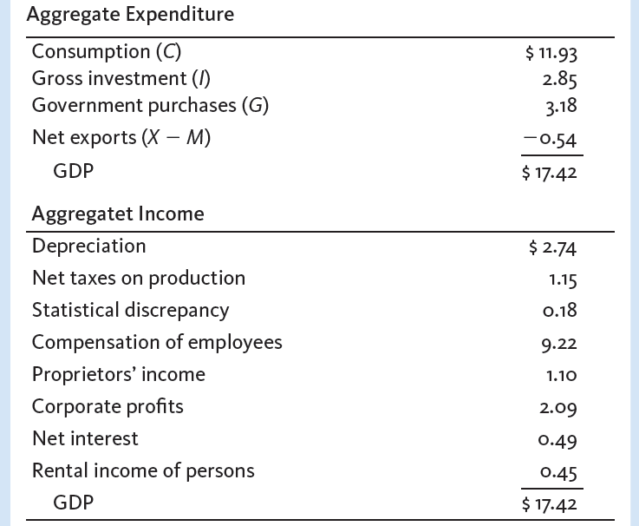
Exhibit 10
Expenditure and Income Statement for the U.S. Economy
in 2014 (trillions)

