Slide 1
8
Productivity and Growth

Slide 2
Why is the standard of living so much higher in some countries than in others?
How does an economy increase its living standard?
Why is the long-term growth rate more important than short-term fluctuations in economic activity?
What’s labor productivity, why is it important, and why has it varied so much over time?
What’s been the impact of computers and the Internet on labor productivity?

Slide 3
Theory of Productivity and Growth
Increased standard of living
Increase in amount and quality of resources
Especially labor and capital
Better technology and know-how
Improvement in the rules of the game that facilitate production and exchange
Tax laws, property rights, patent laws, the legal system, and the manners, customs, and conventions of the market

Slide 4
Growth and the PPF
PPF, production possibilities frontier
Economy’s production
Efficient use of resources
Assumptions
Fixed quantity of resources, technology and know-how, and rules of the game
Two categories of products
Consumer goods
Capital goods

Slide 5
Growth and the PPF
PPF, production possibilities frontier
Inside: Inefficient
Outside: Unattainable
On the PPF: Efficient
Bowed out
Some resources are specialized
Economic growth
Outward shift of PPF

Slide 6
Growth and the PPF
Economic growth
Greater availability of resources
Improvement in the quality of resources
Technological change that makes better use of resources
Improvements in the rules of the game that enhance production

Slide 7
Exhibit 1
Economic Growth Shown by Shifts Outward of the PPF
(a) Lower growth
(b) Higher growth
C″
C′
C
C
A
Consumer goods
Consumer goods
B
I
I′
I
I″
Capital goods
Capital goods
An economy that produces more capital goods will grow more, as reflected by a shift outward of the production possibilities frontier. More capital goods are produced in panel (b) than in panel (a), so the PPF shifts out more in panel (b).

Slide 8
Growth and the PPF
To invest more in capital this year
To produce more capital this year
Must give up some consumer goods this year
Must save more now: investment cannot occur without saving
The opportunity cost of producing more capital goods this year
Is producing fewer consumer goods

Slide 9
What is Productivity?
Production
Process that transform resources into goods and services
Productivity
Efficient use of resources
Ratio of a specific measure of output to a specific measure of input
Labor productivity
Output per unit of labor

Slide 10
Labor Productivity
Labor
Most commonly used to measure productivity
Accounts for about 70% of production costs
Easily measured
Available statistics
Labor productivity
Increases with human and physical capital per worker

Slide 11
Labor Productivity
Poorer countries
Labor is cheap, capital is dear
Producers substitute labor for capital
In an economy that accumulates more capital per worker
Labor productivity increases
Standard of living grows

Slide 12
Per-Worker Production Function
Per-worker production function, PF
The relationship between the amount of capital per worker in the economy
And average output per worker
Upward sloping with a diminishing slope
Diminishing marginal returns from capital
Increased productivity
More capital per worker: move along PF

Slide 13
Exhibit 2
Per-Worker Production Function
PF
Output per worker
y
0
k
Capital per worker
The per-worker production function, PF, shows a direct relationship between the amount of capital per worker, k, and the output per worker, y. The bowed shape of PF reflects the law of diminishing marginal returns from capital, which holds that as more capital is added to a given number of workers, output per worker increases but at a diminishing rate and eventually could turn negative.

Slide 14
Per-Worker Production Function
Capital deepening
Increase in the amount of capital per worker
Contributes to labor productivity and economic growth
Law of diminishing marginal returns from capital
Beyond some level of capital per worker
Increases in capital add less and less to output per worker

Slide 15
Technological Change and Know-How
Technological change and better know-how
Improves the quality of capital
Additional sources of increased productivity
Upward rotation of PF
Higher standard of living

Slide 16
Exhibit 3
Impact of a Technological Breakthrough on the Per-Worker Production Function
PF′
y′
Output per worker
PF
y
0
k
Capital per worker
A technological breakthrough increases output per worker at each level of capital per worker. Better technology makes workers more productive. This is shown by a rotation upward in the per-worker production function from PF to PF′. An improvement in know-how or the rules of the game would have a similar effect.

Slide 17
Technological Change and Know-How
Changes in capital improve worker productivity
An increase in the quantity of capital per worker
Movement along the per-worker production function
An improvement in the quality of capital per worker
Technological change and know-how that rotates the curve upward

Slide 18
Rules of the Game
Rules of the game
Laws, customs, manners, conventions, other institutional elements
That determine transaction costs
And thereby affect people’s incentive to undertake production and exchange
Stable political climate
Benefit productivity
Upward rotation of PF

Slide 19
Rules of the Game
Advanced economies
Developed a reliable and respected system of property rights, customs, and conventions that nurture productive activity
Cultivated the social capital that helps an economy run more smoothly
Social capital
The shared values and trust that promote cooperation in the economy

Slide 20
Rules of the Game
Low-income economies
Typically have poorly defined property rights, less social capital
And in the extreme, customs and conventions where violence, bribery, and government corruption are common
Civil wars have ravaged some of the poorest countries on Earth

Slide 21
Productivity and Growth in Practice
Industrial market countries
Developed countries
The first to experience long-term economic growth during the 19th century
Highest standard of living
Abundant human and physical capital
18% of world population produce 52% of world’s output

Slide 22
Productivity and Growth in Practice
Industrial market countries
Economically advanced capitalist countries of
Western Europe, North America, Australia, New Zealand, and Japan
Newly industrialized Asian economies
Taiwan, South Korea, Hong Kong, and Singapore

Slide 23
Productivity and Growth in Practice
Developing countries
Poor countries
Lower standard of living
Less human and physical capital
Low labor productivity
82% of world’s population

Slide 24
Education and Economic Development
Education
Human capital
Higher productivity
Industrial market economies
Higher education levels
Developing countries
Lower education levels

Slide 25
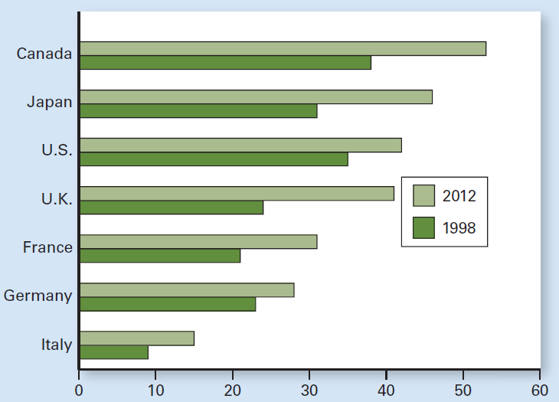
Exhibit 4
Percent of Adult Population With at Least a Post-High
School Degree: 1998 and 2012
The share of the U.S. population ages 25 to 64 with at least a degree beyond high school increased from 35 percent in 1998 to 42 percent in 2012. The United States slipped from second among the seven major industrial market economies in 1998 to third in 2012.

Slide 26
U.S. Labor Productivity
Annual productivity growth
Averaged 2.1% per year, since 1870 (by more than 1,900%)
Over long periods, small differences in productivity can make huge differences in the economy’s ability to produce and therefore in the standard of living

Slide 27
U.S. Labor Productivity
Growth in U.S. labor productivity:
Technological advances
Increase in capital
Reduction in racial and gender discrimination
More efficient labor markets

Slide 28
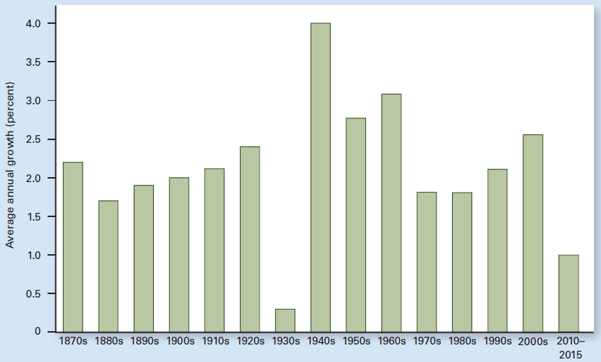
Exhibit 5
Long-Term Trend in U.S. Labor Productivity Growth: Annual
Average by
Decade
Annual productivity growth, measured as the growth in real output per work hour, is averaged by decade. For the entire period since 1870, labor productivity grew an average of 2.1 percent per year. Note the big dip during the Great Depression of the 1930s and the big bounce back during World War II. Productivity growth slowed during the 1970s and 1980s but recovered slightly during the 1990s and 2000s before dropping more recently.

Slide 29
Slowdown and Rebound
1948-1973: Golden days
Productivity growth: 2.8% per year
1973-1982: Slowdown to 0.9%
Oil pieces jumped (1973-1974, 1979-1980)
Inflation, stagflation, three recessions
Legislation
Protect the environment
Improve workplace safety

Slide 30
Slowdown and Rebound
1982 - 2005: Rebound
1.8% from 1982 to 1995
3.0% from 1995 to 2005
Reasons: the information revolution powered by the computer chip and the Internet started paying off
The greater the penetration of broadband Internet service, the higher the economic growth per capita

Slide 31
Slowdown and Rebound
2005 - 2015: slow growth
Labor productivity growth averaged 1.3%
BLS – measures labor productivity
In only about 60% of all industries
Leaving out some of the newest ones
New apps – make life easier and more enjoyable, but little of this is captured in productivity measures

Slide 32
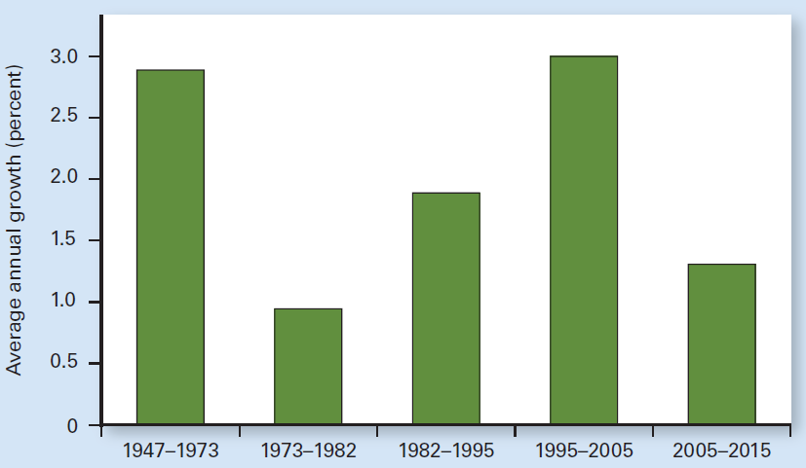
Exhibit 6
U.S. Labor Productivity Growth Since 1947
The growth in labor productivity declined from an average of 2.8 percent per year between 1947 and 1973 to only 0.9 percent between 1973 and 1982. A jump in the price of oil contributed to three recessions during that stretch, and new environmental and workplace regulations, though necessary and beneficial, slowed down productivity growth temporarily. The information revolution powered by the computer chip and the Internet boosted productivity between 1982 and 2005.

Slide 33
Output per Capita
Standard of living
Output per capita
Real GDP divided by population
The U.S., GDP per capita
$54,800 in 2014
General upward trend
During recessions
Decrease in productivity
GDP per capita, world: $16,100 in 2014

Slide 34
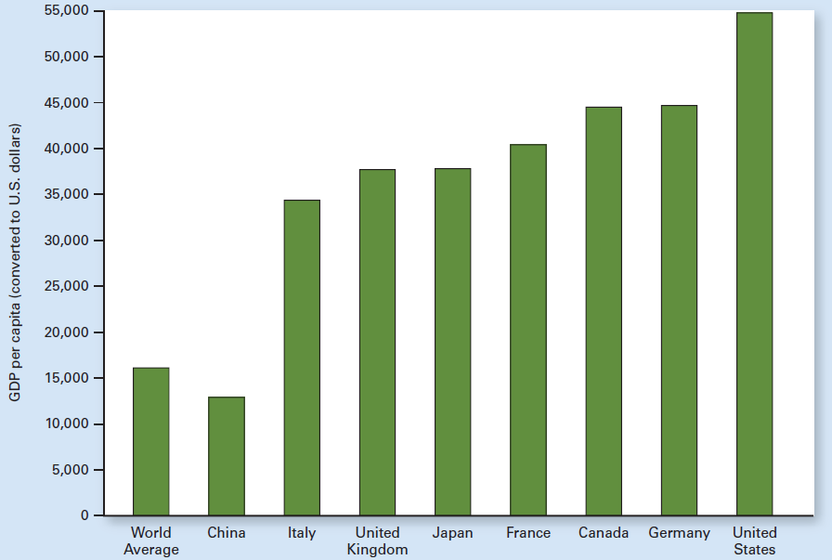
Exhibit 7
U.S. GDP Per Capita in 2014 Was Highest of G-7 Economies and Four Times China’s

Slide 35
Other Issues of Technology and Growth
Does technological change lead to unemployment?
Technological change can create job dislocations and displaced workers
But also new products and job opportunities
More affordable products, higher demand
Increased employment and production
Long-run benefits: higher real incomes and more leisure
A higher standard of living

Slide 36
Research and Development
Basic research
General search for knowledge
First step for technological advancement
Yields a higher return to society as a whole than does applied research
Applied research
Answer particular questions
Develop specific products

Slide 37
Research and Development
Technological change
Is the fruit of research and development (R&D)
Investment in R&D
Improves productivity through technological discovery
Tracking R&D spending
Measure it relative to gross domestic product, or GDP

Slide 38
Research and Development
Overall R&D spending in the U.S.
Remained constant, averaging 2.7% of GDP in the 1980s, in the 1990s, and 2.8% in the 2000s
Tied for second with Germany among the major economies, behind Japan
Manufacturing
Accounts for only 11% of U.S. GDP
Responsible for 68% of R&D spending

Slide 39
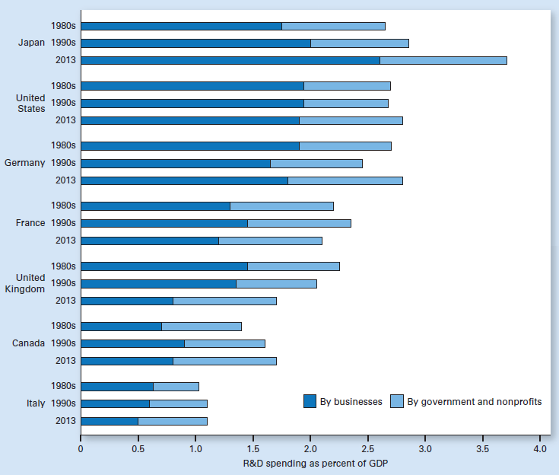
Exhibit 8
R&D Spending as a Percentage of GDP for G-7
Economies
During the
1980s, 1990s,
and in 2013

Slide 40
Industrial Policy
Industrial policy
The view that the government
Using taxes, subsidies, regulations, coordination
Should nurture the industries and technologies of the future
Thereby giving these domestic industries an advantage over foreign competition

Slide 41
Industrial Policy
Clustering
Locating in a region already thick with firms in the same industry or related industries
Facilitate communication and promote healthy competition among cluster members
A firm can also tap into established local markets for specialized labor and for other inputs
Stimulates regional innovation and propels growth

Slide 42
Industrial Policy
Critics of industrial policy say
Markets allocate scarce resources better
Industrial policy could evolve into a government giveaway program
To the politically connected
How wise it is to sponsor corporate research
When beneficiaries may share their expertise with foreign companies or even build factories abroad

Slide 43
Income and Happiness
Happiness index
Based on:
Living conditions, Income
Environment, Social welfare
Employment
Most people in the high income area are happy
Most people in the poor areas are not happy

Slide 44
Income and Happiness
The U.S.
Richer generation
Just as happy as previous ones
Luxuries then – necessities now
Income relative to other’s income
Other countries, Europe, Japan
Increase in happiness with increase in income over time

Slide 45
Income and Happiness
Inequality in happiness has fallen substantially since the 1970s
Blacks have closed two-thirds of the happiness gap they had with whites
Women are no longer less happy than men

