Slide 1
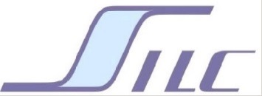
Money and Banking SS I 2017
Dr. Andrew L. H. Parkes
“A Macroeconomic Understanding for use in Business”
“Sub Prime”
卜安吉

Slide 2
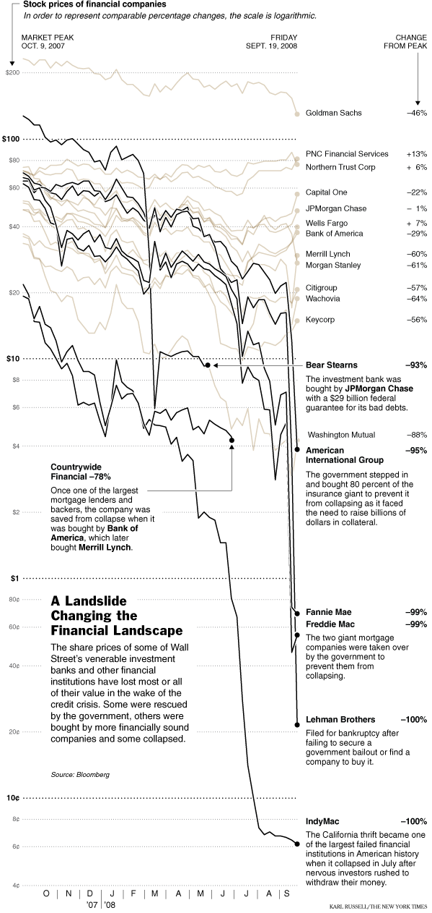
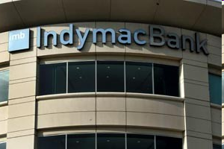
“Sub-Prime” Fallout
Some Stock Value Changes
From Market Peak on
Oct. 9 2007
Eve AIG is down 95% as of
Friday, Sept. 19, 2008

Slide 3
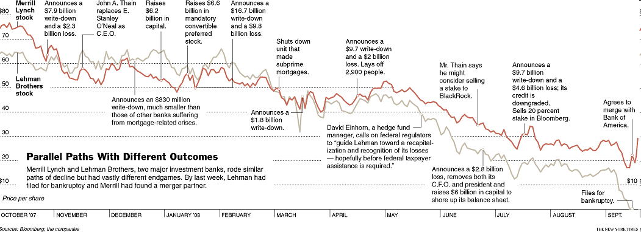
Merrill-Lynch and Lehman Bros

Slide 4
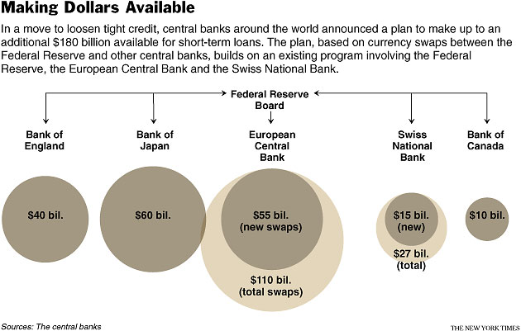
The “Sub-Prime” Fallout
A total of $180 Billion had been offered globally before Saturday when Ben and Henry ordered up another $700 billion for the U.S. alone.

Slide 5
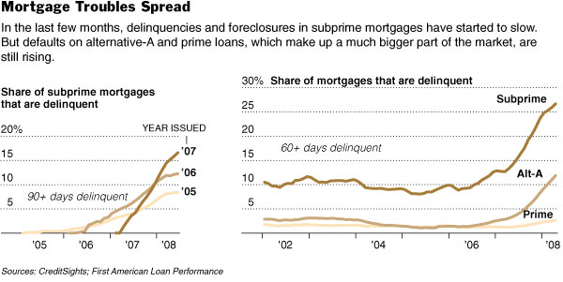
The “Sub-Prime” Fallout
Here is a picture taken right at the beginning of August, right before the Olympics began. SEE “PRIME!”

Slide 6
The “Sub-Prime” Fallout
Free Markets and the government?!?

Slide 7
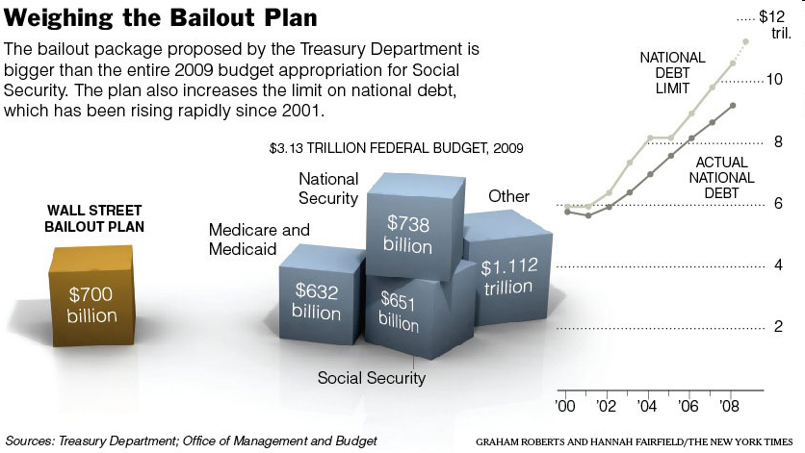
The “Sub-Prime” Fallout
Bigger than Social Security?
Almost as big as National Security!!

