Slide 1
Chapter 10 The Environment and Development

Slide 2
10.1 Environment and Development: The Basic Issues
Environmental issues affect, and are affected by, economic development
Classic market failures lead to too much environmental degradation
Poverty and lack of education may also lead to non-sustainable use of environmental resources
Global warming and attendant climate change is a growing concern in developing countries

Slide 3
10.1 Environment and Development: The Basic Issues
Sustainable development and environmental accounting
Population, resources, and the environment
Poverty and the environment
Growth versus the environment?
Rural development and the environment

Slide 4
10.1 Environment and Development: The Basic Issues
Urban development and the environment
The global environment and economy
Nature and pace of Greenhouse Gas-Induced Climate change
Natural Resource-Based Livelihoods as a pathway out of poverty: Promise and Limitations

Slide 5
10.1 Environment and Development: The Basic Issues
Sustainable development and environmental accounting

Slide 6
10.1 Environment and Development: The Basic Issues
Sustainable development has been defined as “meeting the needs of present generation without compromising the wellbeing of future generations”
So, running down the capital stock is not consistent with the idea of sustainability
Environmental and other forms of capital are substitutes only to a degree; eventually they likely act as complements
In developing countries, environmental capital is generally a larger fraction of total capital
To know whether environmental capital is increasing or decreasing, we need environmental accounting

Slide 7
10.1 Environment and Development: The Basic Issues
Sustainable net national product is:
Where
NNI* is sustainable national income
GNI is Gross national income
D_{m} is the depreciation of manufactured
capital assets
D_{n} is the depreciation of environmental
capital

Slide 8
10.1 Environment and Development: The Basic Issues
More expansively, sustainable net national product is:
Where
NNI** is the revised NNI calculation
GNI, D_{m}, and D_{n} are defined as before
R is expenditure needed to restore
environmental capital
A is expenditure required to avert
destruction of environmental capital
(Note: R and A are components of GNI but not NNI**)

Slide 9
The poor as both agents and victims of environmental degradation
Victims:
The poor live in environmentally degraded lands which are less expensive because the rich avoid them
People living in poverty have less political clout to reduce pollution where they live
Living in less productive polluted lands gives the poor less opportunity to work their way out of poverty
Agents:
The high fertility rate of people living in poverty
Short time horizon of the poor (by necessity)
Land tenure insecurity
Incentives for rainforest resettlement

Slide 10
10.1 Environment and Development: The Basic Issues
Natural resource based livelihoods are at risk
The Scope of Domestic-Origin Environmental Degradation: An Overview
Environmental problems have consequences both for health and productivity
Loss of agricultural productivity
Prevalence of unsanitary conditions created by lack of clean water and sanitation
Dependence on biomass fuels and pollution
Airborne pollutants

Slide 11
Rural Development and the Environment: A Tale of Two Villages
Representative African village
Representative South American village

Slide 12
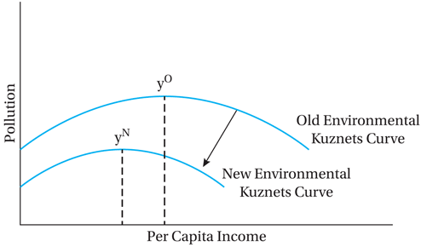
Figure 10.1 Hypothetical Income-Pollution Relationship: Environmental Kuznets Curves

Slide 13
10.2 Global Warming and Climate Change: Scope, Migration, and Adaptation
The benchmark 2007 Fourth IPCC report painted a dire picture for developing economies.
Recent follow up reports have amplified findings and concerns:
Summary in World Bank 2009 World Development Report
2010 U.S. NOAA study found evidence of global warming due to greenhouse gases on all 11 indicators examined
2012 and 2013 “Turn Down the Heat” Reports show severity of consequences for developing countries
2013/2014 Fifth IPCC reports released: Even less uncertainty regarding human causes and severe physical and social consequences of greenhouse gas emissions-based global warming
Impact of global warming likely hardest on the poorest
Agriculture harmed in tropical and subtropical areas
Resultant conflicts over natural resources may grow
Range of adverse health impacts

Slide 14
Some impacts of climate change in Developing Countries identified by IPCC
prolonged droughts, expanded desertification
increased severity of storms with heavy flooding and erosion
longer and more severe heat waves
reduced summer river flow and water shortages
decreased grain yields
climate-induced spreading ranges of pests and disease
lost and contaminated groundwater
deteriorated freshwater lakes, coastal fisheries, mangroves, coral reefs
coastal flooding
loss of essential species such as pollinators and soil organisms,
forest and crop fires

Slide 15
10.2 Global Warming and Climate Change: Scope, Mitigation, and Adaptation
Problem primarily but not exclusively caused by developed countries
Rapid industrial growth especially in Asia
Deforestation in developing countries
Strategies for mitigation
Taxes on carbons
Caps on greenhouse gases (with “carbon markets”)
Subsidies to encourage technological progress
Types of adaptation
Planned (or “policy”) adaptation
Autonomous adaptation (some types are reviewed in Box 10.1)

Slide 16
10.3 Economic Models of Environment Issues
Privately owned resources
Inefficiencies result from imperfections in property rights
Perfect property rights are characterized by
Universality
Exclusivity or Excludability
Transferability
Enforceability

Slide 17
Allocational efficiency
Equate PV of marginal net benefits of last unit consumed in each period
That is, for allocational efficiency, consumer must be indifferent between consuming last unit in this period or in another period

Slide 18
10.3 Economic Models of Environment Issues (cont’d)
Common property resources
Inefficiencies may arise because resource is not privately owned
Traditional models do not concern themselves with equity and income distribution
Family farmers can benefit from extended tenancy or ownership
Who should buy publicly owned land

Slide 19
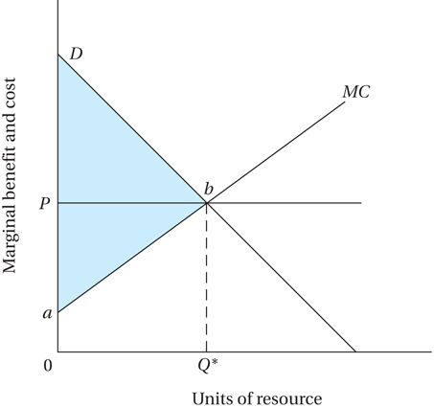
Figure 10.2 Static Efficiency in Resource Allocation

Slide 20
Understanding the Tragedy of the Commons
Users fail to take account of an externality: that as each uses more of the common resource the average return is lowered for other users
Traditional societies have sometimes responded effectively with social enforcement mechanisms
Reviewed in Box 10.2

Slide 21
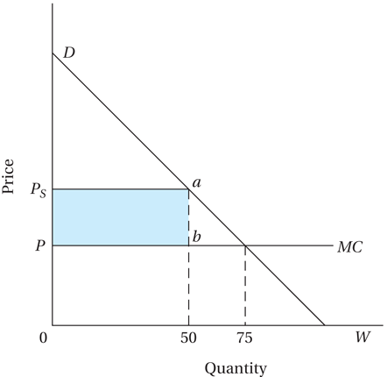
Figure 10.3 Optimal Resource Allocation over Time

Slide 22
Elinor Ostrom’s Common Property Design Principles Derived from Empirical Studies
Clearly Defined Boundaries of the resource system
Proportional equivalence between benefits and costs for users
Collective-choice arrangements including those affected
Monitoring, with those who audit accountable to users
Graduated Sanctions
Conflict-resolution mechanisms
Recognition of rights to organize
Nested enterprises when resources are parts of larger systems

Slide 23
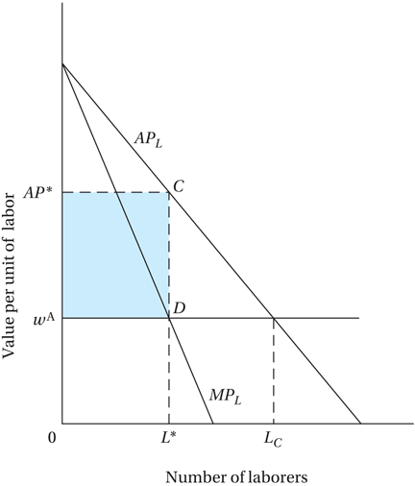
Figure 10.4 Common Property Resources and Misallocation

Slide 24
10.3 Economic Models of Environment Issues (cont’d)
Public goods and bads: regional environmental degradation and the free-rider problem
Internalization of externalities is not easy
Free rider problems
Limitations of the public goods framework
Pricing mechanism

Slide 25
10.4 Urban Development and the Environment
Environmental Problems of Urban Slums
Health threatening pollutants
Unsanitary environmental conditions
Serious impact on poor
Industrialization and urban air pollution
Environmental Kuznets curve (see Figure 10.1)
Pollution tax
Absorptive capacity of the environment
Severity of industrial pollution- impact on health

Slide 26
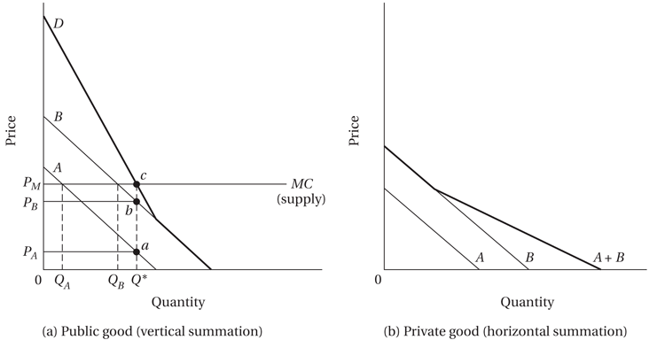
Figure 10.5 Public Goods, Private Goods, and the Free-Rider Problem

Slide 27
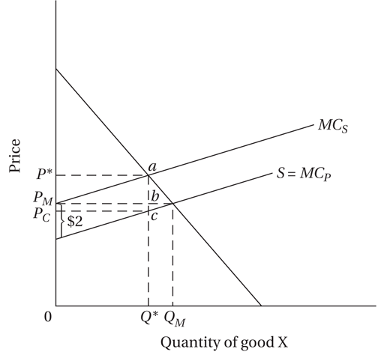
Figure 10.6 Pollution Externalities: Private versus Social Costs and the Role of Taxation

Slide 28
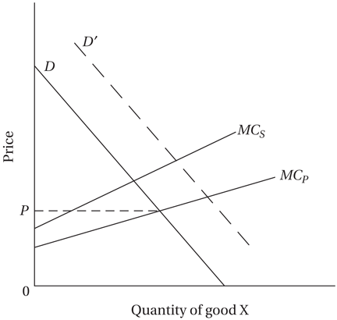
Figure 10.7 Increasing Pollution Externalities with Economic Growth

Slide 29
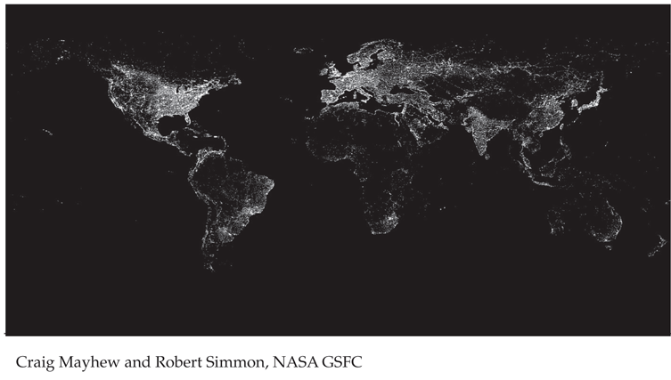
Figure 10.8 The Earth at Night, Reflecting Inequality of Energy Use across High-, Middle-, and Low-Income Countries; and Concentration of Economic Activity along Seacoasts

Slide 30
10.4 Urban Development and the Environment (cont’d)
Problems of congestion, Clean water, and Sanitation
High health and economic costs associated with environmental degradation
Drag on development
Impact on poor
Private wells have led to land subsidence and flooding
Impact on export earnings

Slide 31
10.5 The Local and Global Costs of Rain Forest Destruction
Rainforest loss contributes to global warming
Loss of biodiversity
Loss of livelihoods for people living in poverty who depend upon them
Much waste in the process of forest clearing
Thus, rainforest preservation (and restoration) is a global public good - a restorative mechanism for the environment
Sustainable management of rain forests is a priority
Provide funds, debt relief to help enhance biodiversity
In addition, support for forest preservation as climate change mitigation

Slide 32
10.6 Policy Options in Developing and Developed Countries
What Developing Countries can do
Proper resource pricing
Community involvement
Clearer property rights and resource ownership
Improved economic alternatives for the poor
Improved economic status of women
Investments that yield returns regardless of the shape of climate change, such as a better road network
Industrial emissions abatement policies
Proactive stance toward adapting to climate change

Slide 33
10.6 Policy Options in Developing and Developed Countries (cont’d)
How developed countries can help developing countries
Lower developing country costs for environmental preservation
Trade policies: reduce barriers, subsidies
Debt relief and debt for nature swaps
Development assistance

Slide 34
10.6 Policy Options in Developing and Developed Countries (cont’d)
What developed countries can do for the global environment
Emissions controls, including greenhouse gases
Research and Development on green technology and pollution control
Transfer of technology to developing countries
Restrictions on unsustainable production

Slide 35
Concepts for Review
Absorptive capacity
Biodiversity
Biomass fuels
Clean technologies
Climate change
Common property resource
Consumer surplus
Debt-for-nature swap
Deforestation
Desertification
Environmental accounting
Environmental capital
Environmental Kuznets curve
Externality
Free-rider problem
Global public good
Global warming
Greenhouse gases

Slide 36
Concepts for Review (cont’d)
Internalization
Marginal cost
Marginal net benefit
Pollution tax
Present value
Private costs
Producer surplus
Property rights
Public bad
Public good
Scarcity rent
Social cost
Soil erosion
Sustainable development
Sustainable net national income (NNI*)
Total net benefit

