Slide 1
Chapter 11
The Balance of Payments

Slide 2
Topics to be Covered
Introduction to Balance of Payments Accounting
Measures of the Balance of Payments
Transactions Classifications
Balance of Payments Equilibrium and Adjustment

Slide 3
The Study of International Finance Covers:
Balance of payments
Exchange rate
Foreign exchange market
International macroeconomics
International monetary system

Slide 4
Balance of Payments
Balance of Payments (BOP) - an accounting record of a country’s international transactions over a particular time period.

Slide 5
International Transactions
International transactions that domestic residents might undertake with nonresidents:
Domestic residents can buy goods, services or financial assets
Domestic residents can sell goods, services or financial assets
Domestic residents can send gifts
Domestic residents can receive gifts

Slide 6
Features of the BOP
BOP follows the accounting procedure of double-entry bookkeeping (debits and credits).
A credit (+) entry records an item or transaction that brings foreign exchange into the country.
A debit (-) entry represents a loss of foreign exchange.
Note: There is no relationship between the sign (+, -) of an item and whether the item is “good” or “bad.”

Slide 7
Features of the BOP (cont.)
BOP will always balance.
A BOP deficit (surplus) means that the debit entries exceed (are less than) the credits. This imbalance applies only to a particular account or component of the BOP.

Slide 8
Components of the BOP
Current Account
Capital Account
Financial Account

Slide 9
Current Account Entries
The current account includes the value of trade in merchandise, services, income from investments, and unilateral transfers (refer to Table 11.1).
Merchandise—tangible goods.
Services—include travel and tourism, banking, transport costs, and insurance.
Income from investments—interest, royalties, and dividends.
Unilateral transfers—include foreign aid, gifts, and charity payments.

Slide 10
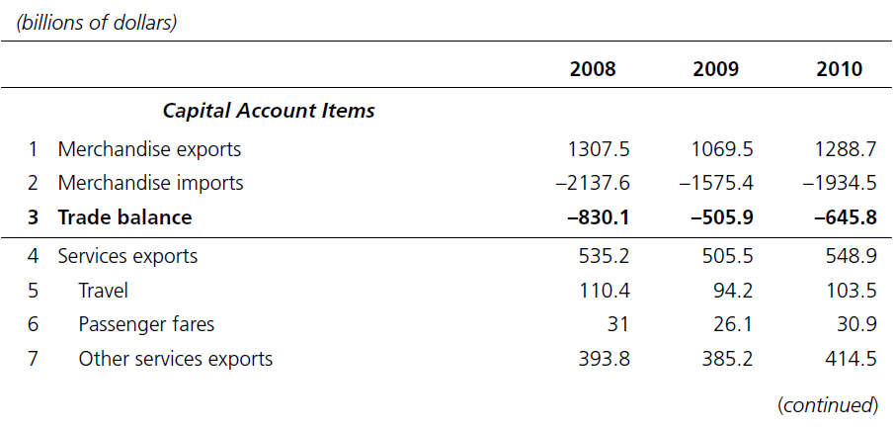
TABLE 11.1 U.S. International Transactions, 2008-10

Slide 11
TABLE 11.1 U.S. International Transactions, 2008-10 (cont.)

Slide 12
TABLE 11.1 U.S. International Transactions, 2008-10 (cont.)

Slide 13
TABLE 11.1 U.S. International Transactions, 2008-10 (cont.)

Slide 14
TABLE 11.1 U.S. International Transactions, 2008-10 (cont.)

Slide 15
Gross Domestic Product vs. Gross National Product
Gross Domestic Product (GDP) – total value of final goods and services produced in a country in a year, regardless of who made these products.
Gross National Product (GNP) – total income of a country’s nationals, regardless of where they undertake their activity.
GNP equals GDP plus net factor payments (line 7 plus line 8 in Table 11.1).

Slide 16
Financial Accounts Entries
International capital flows involve international purchases and sales of financial assets.
Two types of transactions:
Capital account activities
Financial account activities

Slide 17
Capital Account
This line is relatively small for the U.S. and includes primarily transactions involving debt forgiveness.

Slide 18
Financial Account
Financial transactions include:
Direct Investment
Purchases of Equity and Debt Securities
Bank Claims and Liabilities
U.S. Government Assets Abroad
Foreign Official Assets in the U.S.

Slide 19
International Reserves
International reserves are short-term, highly liquid assets (ex., gold, foreign currencies, assets of the International Monetary Fund) held by governments.
International reserves can be used for foreign exchange market intervention and settlement of BOP imbalances.
An increase in international reserves leads to an increase in central bank assets, and a rise in domestic money supply.

Slide 20
Measures of the BOP
Balance of Trade – difference between a country’s merchandise exports and imports
Current Account Balance – a measure of the net flows of goods, services, and gifts between a country and the rest of the world
Official Settlements Balance – includes all BOP entries except those involving official reserve assets and changes in short-term assets held by foreign governments

Slide 21
Drawing a Line in the BOP
If we draw a line at the current account balance, then:
Items “above the line” refer to the current account trade in goods, services, income, and unilateral transfers.
Items “below the line” are the capital and financial account transactions (purchases and sales of financial assets).

Slide 22
Drawing a Line in the BOP (cont.)
Since the BOP always balances, then a current account deficit (above the line) implies that the country is running a net surplus in assets trade (below the line), so that the country is a net borrower from the rest of the world.

Slide 23
National Income, Spending, and the Current Account Balance
Given the national income accounting identity:
Y = C + I + G + (X-IM) +NFP
where Y is national income or GNP, C is consumption spending, I investment, G government spending, (X-IM) net exports, and NFP is net factor payments, we can rearrange this identity as:
Y = C + I + G + CAB
where CAB is the current account balance (net exports plus NFP).

Slide 24
National Saving, Investment, and the Current Account (cont.)
Rearranging further, we get:
CAB = Y - (C + I + G)
A country experiences a current account deficit when its spending exceeds national income.
Except for 1991, the U.S. has had a CAB deficit since 1982 and has been borrowing in the international financial markets to finance the deficits. See Global Insights 11.1.

Slide 25
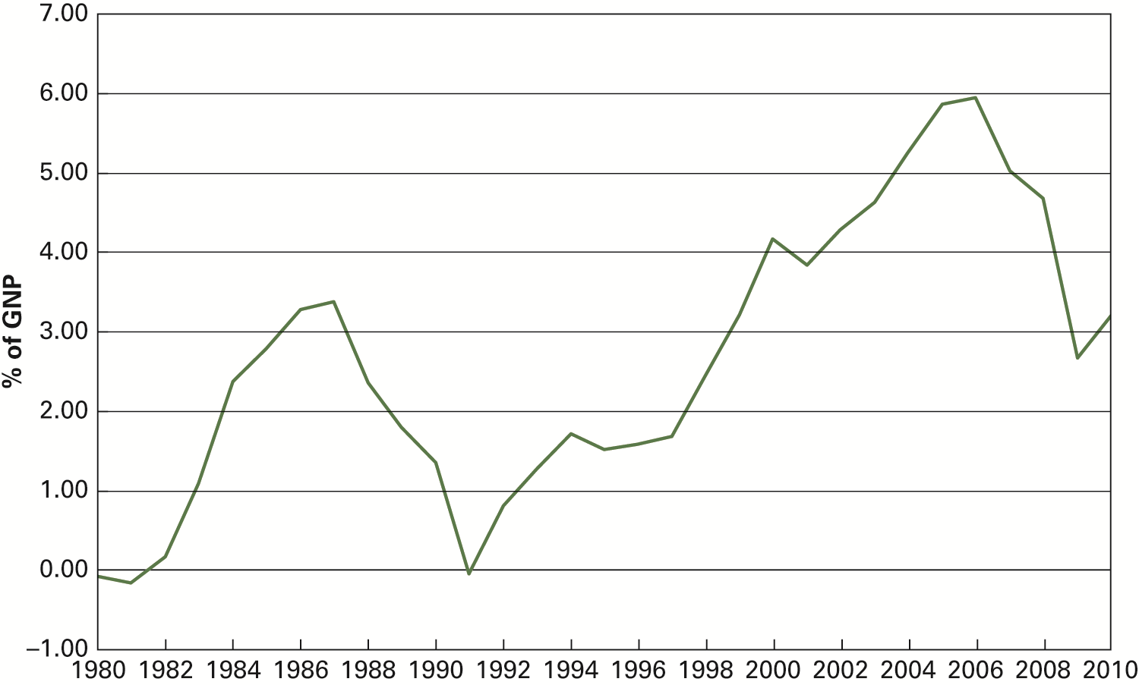
Figure 11.1 U.S. Current Account Deficits as a Share of GNP 1980-2010

Slide 26
Official Settlements Balance
A country can use its international reserves to intervene in the foreign exchange market and keep its currency price stable.
Countries hold excess reserves to provide insurance against unexpected economic downturns and to invest in profitable ventures.

Slide 27
Examples of Double-entry Bookkeeping
Given six hypothetical transactions
Refer to Table 11.2

Slide 28
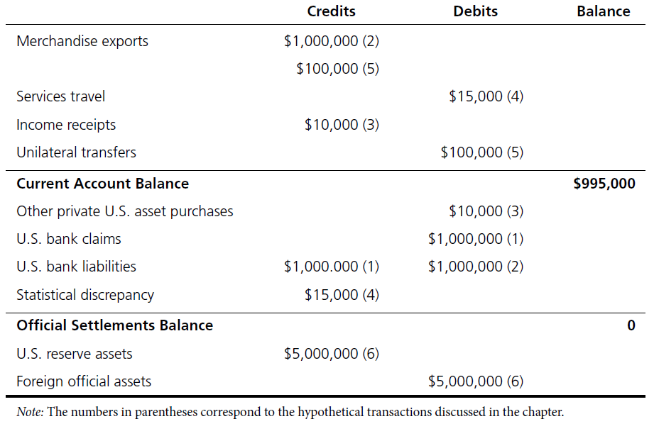
TABLE 11.2 Balance-of-Payments Example

Slide 29
Implications of the BOP
It is impossible for every country in the world to have a trade surplus.
If international trade is voluntary, then it is difficult to argue that deficit countries are harmed and surplus countries benefit.
Deficits are not inherently bad, nor are surpluses necessarily good.

Slide 30
Balance of Payments Equilibrium and Adjustment
BOP equilibrium is the situation where total credits equal total debits for a particular measure of a country’s balance of payments.
The process of moving toward equilibrium is called the BOP adjustment. The adjustment could be a natural reaction to an existing situation or may require government intervention.

Slide 31
BOP Adjustment
What happens if the country has a current account deficit?
The country must borrow from (or sell domestic securities to) the rest of the world to finance the current account deficit.
As foreigners accumulate domestic securities, the domestic currency value falls which, in turn, raises net exports and consequently income.

Slide 32
BOP Adjustment (cont.)
What happens if the country has a current account deficit? (cont.)
In addition, domestic interest rates rise which, in turn, lowers consumption and investment spending.
The increase in national income relative to spending will reduce the current account deficit.

